Slide 1
Linux Filesystems in 21 days 45 minutes ...
A Step by Step Introduction to Writing (or Understanding) a Linux Filesystem
Steve French
Linux Filesystems/Samba Design
IBM Linux Technology Center
http://svn.samba.org/samba/ftp/cifs-cvs/samplefs.tar.gz

Slide 2
Legal Statement
This work represents the views of the author and does not necessarily reflect the views of IBM Corporation.
The following terms are trademarks or registered trademarks of International Business Machines Corporation in the United States and/or other countries: IBM (logo), A full list of U.S. trademarks owned by IBM may be found at http://www.ibm.com/legal/copytrade.shtml.
Linux is a registered trademark of Linus Torvalds.
Other company, product, and service names may be trademarks or service marks of others.

Slide 3
Outline
Who am I?
FS background info
Days 1 through 7, basic ops
FS Data Structures
Days 8 and 9
FS Operations
Days 10 - 11 finished our sample
Days 12 - 21 – advanced ops

Slide 4
Who Am I?
Author and maintainer of Linux cifs vfs (for accessing Samba, Windows and various SMB/CIFS based NAS appliances)
Member of the Samba team, coauthor of CIFS Technical Reference and former SNIA CIFS Working Group chair
Architect for Filesystems/NFS/Samba in IBM LTC

Slide 5
Note ...
Linux is constantly evolving, interfaces change (even those used by these small samples)!
  See Documentation directory of kernel (e.g. feature-removal-schedule.txt) or even better kernel source itself if unsure about call
  The kernel page of lwn.net is particularly useful: summarizing kernel API changes
  Examples were built and/or lightly tested on 2.6.16.11 and 2.6.18-rc1

Slide 6
What is a Filesystem
[“file system”]?
“a file system is a set of abstract data types that are implemented for the storage, hierarchical organization, manipulation, navigation, access, and retrieval of data” [http://en.wikipedia.org/wiki/Filesystem]
A Linux kernel module used to access files and directories. A filesystem provides access to this data for applications and system programs through consistent, standard interfaces exported by the VFS, and enables access to data that may be stored persistently on local media or on remote network servers/devices, or even transient data (such as debug data or kernel status) stored temporarily in RAM or special devices.

Slide 7
Linux ... perfect fs experimental platform?
Linux is easily available and usable filesystems can be smaller in Linux than many other OS
  e.g. Ramfs is working 390 LOC example (simpler shmem/tmpfs) and stubs in fs/libfs.c make starting easy
  Filesystems average under 30KLOC
Lots of samples in kernel:
  >12 (general) local filesystems (e.g. ext2/3, reiserfs, xfs, UDF, ...)
  >16 special purpose local fs
  8 network/cluster fs (nfs, cifs, ocfs2...)

Slide 8
Some common Linux FS

Slide 9
samplefs
Goals for samplefs
  Small, understandable (yet extend existing ramfs and rkfs samples)
  Easy to compile on reasonably current (e.g. 2.6.9 or later) kernels
  Demonstrate basic data structures and concepts that would help one:
    Implementing a new fs for Linux
    Experimenting with fs Linux
    Learning Linux fs concepts to help debugging and/or tuning Linux

Slide 10
Day 1: Basic Module 101...
A Linux filesystem kernel driver:
  Can be built as distinct module or
  Can be built into vmlinuz itself
Kernel modules usually have:
  Entry in Kconfig (./fs/Kconfig)
  New directory (fs/samplefs)
  Makefile (fs/samplefs/Makefile)
  C Code to do module init/remove

Slide 11
Day 1 – key data structure
We fill in struct file_system_type and information describing our filesystem kernel module
  Name of fs
  Method to allocate/kill superblock

Slide 12
Day 1: cont
gunzip samplefs.tar.gz
cd to root of kernel source tree
If you have not built before and .config file does not exist (create config file that matches your installed kernel or do “make oldconfig”)
make menuconfig (or equivalent)
  Select “File systems” then [M] for “Sample Filesystem (Experimental)”
make M=~/samplefs/day1

Slide 13
Day 1 - status
What can we do with our little sample now?
(as root) /sbin/insmod ~/samplefs/day1/samplefs.ko
/sbin/lsmod shows our module loaded
/sbin/rmmod will remove it

Slide 14
Day 2 Mount – What is a superblock
Each mount has a superblock which contains information about the mount
Key data: “struct super_block” and “struct vfsmount”
Fill in superblock operations and create the first (root) inode

Slide 15
Day 2 - continued
make M=~/samplefs/day2
Note:
  Addition of routines to allocate/free superblock and parse mount options
  Your filesystem (like the case of fs/ramfs) may not need to have fs specific sb info or mount options but this is provided as an example

Slide 16
Day 2 - status
Mount code added, but mount would oops in get_sb_nodev if attempted
Time to add debug code

Slide 17
Day 3 Control and debug our filesystem
“dmesg” displays kernel error/warning messages
Lets fix msg: “samplefs: module license 'unspecified' taints kernel.”
Also will add debug messages (errors, warnings and/or information messages) for various conditions
Add optional enablement for /proc which allows debug information and settings to be easily displayed (may move to sysfs and/or debugfs)
make M=~/samplefs/day3

Slide 18
Day 3 - status
Loading and unloading module now displays inform. messages to dmesg
Added an entry in /proc/fs for future e.g. runtime debugging or status information
Added ability to parse parms passed on module init
Debug code allowed us to isolate problem with iget line
Example of debug statement depending on menuconfig setting

Slide 19
Day 4 What is an inode?
An inode is a representation of a file and its metadata (timestamps, type, size, attributes) but not its name
Inodes can represent files, directories (containers of files), symlinks and special files
Fill in function pointers to inode and file (open file) operations
Fill in inode metadata (uid owner, mode, file timestamps, etc.)

Slide 20
Day 4 - status
We can mount now (e.g. “mount -t samplefs any /mnt”)
“cat /proc/mounts”
“stat -f /mnt”
“stat /mnt”

Slide 21
Day 5 What is a dentry?
The dcache contains dentries, and provides a fast way to lookup inodes based on a specific pathname
The dentries for individual path components (parent directory, parent of parent, etc.) of a file name form a hierarchy
A file inode can have multiple different dentries pointing to it (e.g. Due to hardlinks)

Slide 22
Day 5 - continued
Our dentry operations do not save negative dentries as most fs do
If a filesystem exports same data through other mechanisms (e.g. Other nodes in a network or cluster filesystem), then d_revalidate would normally be exported
Our example adds case insensitive support (mount option ignorecase)

Slide 23
Day 5 - status
Still need to add some operations, time to work on inode operations

Slide 24
Day 6 simple inode operations
Time to add
  create
  mkdir
  unlink (delete)
  rmdir
  mknod

Slide 25
Day 6 - status
Now ... like magic, we can do simple operations like mkdir and mknod
But readdir (“ls /mnt”) yields “Not a directory”
And open (“touch /mnt/file ; cat /mnt/file”) gets “Invalid argument

Slide 26
Day 7 simple file operations
Files AND directories have file operations
Those ops for the directory (to support e.g. Readdir) are easy in this type of Linux fs ... but what about for files?
We could add the simplest set of file operations
  Read
  Write
  (some fs also need seek and fsync)
But Linux has a powerful page cache that is not much harder to use for this

Slide 27
Day 7 - status
We can now do “ls /mnt1” (after creating some test files) and get expected output
Now for some review of the various structures we have talked about and their relationship ...

Slide 28
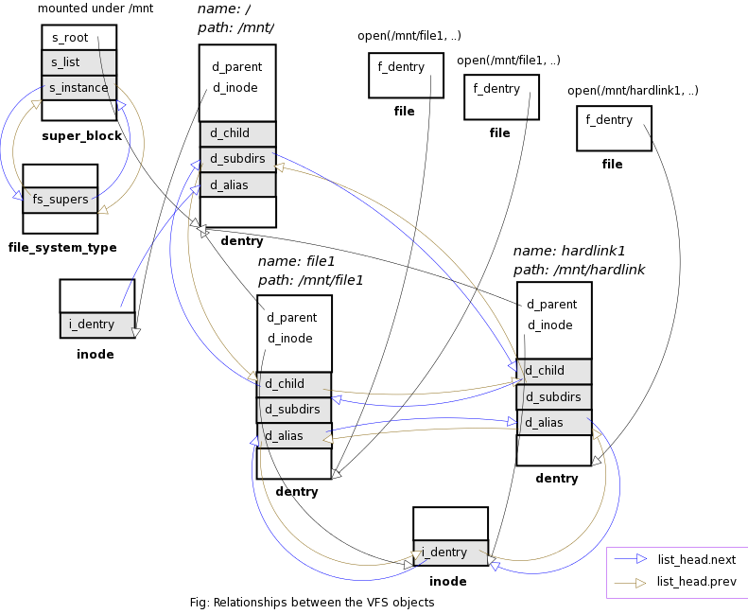
Source: http://www.geocities.com/ravikiran_uvs/articles/rkfs.html

Slide 29
Day 8 Opening a file
A “File” (struct file) represents an open instance of an inode (for a particular pathname, with particular open flags)
The call for “open” (or “create” or “mkdir” etc.) in userspace do not map atomically into just one corresponding call into the fs unfortunately, but Linux filesystems can use the “intent” fields on lookup and create to improve efficiency

Slide 30
Day 9 Introducing the page cache
Lets add calls to our driver to use the generic page cache
  File operations map via
    Generic_file_read
    generic_file_write
  To readpage
  And writepage
  With or without mmap

Slide 31
Day 9 - status
We can create files, write data and read data and do most common file operations
So lets review how these operations tie together ....

Slide 32
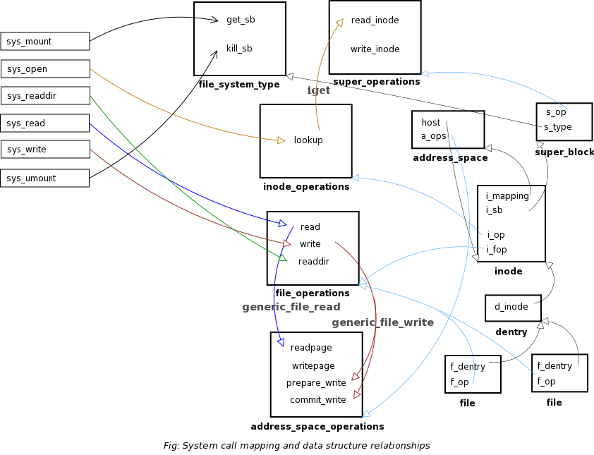
Source: http://www.geocities.com/ravikiran_uvs/articles/rkfs.html

Slide 33
Day 10 Multipage operations
Linux has two interesting high performance page cache read/write op
  Readpages (nine filesystems use)
  Writepages (eight filesystems use including ext3, nfs and cifs)
Useful for coalescing reads/writes together (NB Some network filesystems like cifs typically negotiate buffer sizes much larger than a 4K page so this allows more efficiency)
For cifs (unlike for samplefs) using writepages dramatically improved write performance over GigE

Slide 34
Day 11 Hardlinks and symlinks
Adding hardlinks & symlinks easy
Status after day 11 ... most important operations work:
smf-t41p:/usr/src/linux-2.6.16.11-7 # ls /mnt1 -l
total 0
drwxr-xr-x 2 root root 0 2006-07-18 23:53 dir
drwxr-xr-x 2 root root 0 2006-07-18 23:53 dir1
drwxr-xr-x 2 root root 0 2006-07-18 23:55 fifo1
-rw-r--r-- 1 root root 0 2006-07-18 23:53 file
-rw-r--r-- 3 root root 0 2006-07-18 23:53 file1
-rw-r--r-- 3 root root 0 2006-07-18 23:53 file2
lrwxrwxrwx 1 root root 11 2006-07-18 23:54 file3 -> /mnt1/file1
-rw-r--r-- 3 root root 0 2006-07-18 23:53 hardlinktofile1

Slide 35
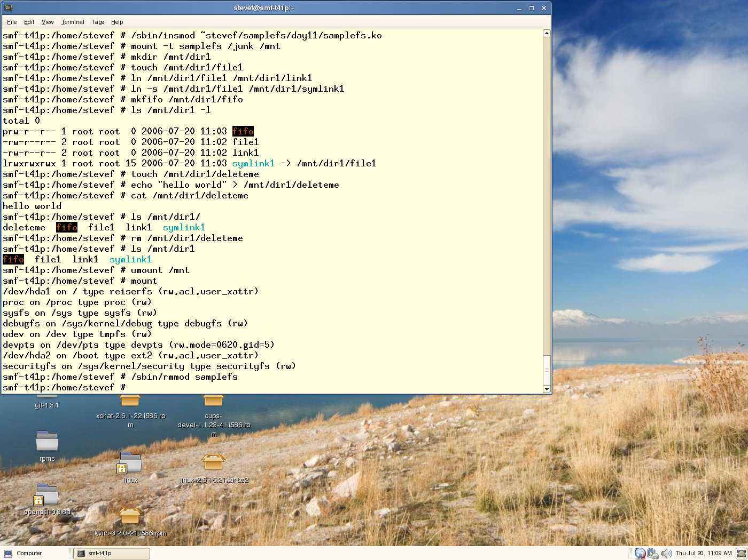
It works!

Slide 36
Halfway through 21 days we have a complete FS!
Good stopping point for our code sample ... (otherwise the sample could get too complex, or require a different backend storage mechanism)
But
  Some additional fs concepts may be helpful
  many Linux filesystems implement more advanced features that are worth discussing in more detail

Slide 37
Day 12 inodes continued - Changing inode metadata
Setattr is a key call
  Based on the iattr struct passed in can change
    Uid, gid, mode, timestamps, size,
    Linux has three timestamps (atime, mtime, ctime) does not have a way of returning create timestamp
    Linux allows an fs to specify a time granularity via s_time_gran mask (cifs e.g. reports time in 100 nanosecond units, jfs uses even better 1 ns, but ext2/ext3 timestamps much worse)
Other “attributes” are changeable through xattrs and ioctls

Slide 38
Day 13 readdir
Especially for network filesystems “ls” can cause “readdir” storms (hurting performance) by immediately following readdir with lots of expensive stat calls (unless the stat results are requested together, or cached)

Slide 39
Day 14 byte range locks, leases/distributed caching
Linux supports the standard POSIX byte range locking but also supports “leases”
F_SETLEASE, F_GETLEASE, used by programs like Samba server, help allow servers to offer safe distributed caching (e.g. “Oplock” [cifs] and “delegations” [nfs4]) for network/cluster filesystems

Slide 40
Day 15 Dir change tracking – inotify, d_notify
There are two distinct mechanisms for change notification
  Fcntl F_NOTIFY
  And the newer, more general inotify

Slide 41
Day 16 kernel memory, object tracking
Filesystems can take advantage of key mm features of Linux
  Memory pools
  Slab allocations (named, easy to track) for fixed size allocations
  Kmalloc
  Various optional Linux memory leak debugging facilities

Slide 42
Day 17 Address space mapping
The few places where filesystems are not passed kernel memory, extra care must be taken to read/write to user memory
  copy_to_user
  copy_from_user
Operations:
  Read, Write (not using page cache)
  Readlink
  Some fcntls

Slide 43
Day 18 xattrs
Xatts, similar in some ways to OS/2 “EAs” allow additional inode metadata to be stored
This is particular helpful to Samba to store inode information that has no direct equivalent in POSIX, but a different category (namespace) also is helpful for storing security information (e.g. SELinux) and ACLs

Slide 44
Day 19 POSIX ACLs, permissions
Since Unix Mode bits are primitive, richer access control facility was implemented (based on an expired POSIX draft for ACLs).
Now working w/CITI, Andreas et al to offer optional standard NFS4 ACLs (NFSv4 ACLs loosely based on CIFS)
POSIX ACLs are handled via xattr interface, but can be stored differently internal to the filesystem. A few filesystems (including CIFS and NFS) can get/set them natively to Linux servers

Slide 45
Day 19 continued
ACL mapping works ok for:
  POSIX ACL <-> Mode
Being researched are the mappings to/from:
  POSIX ACL <-> CIFS/NFSv4 ACL
  CIFS/NFSv4 <->Mode
Some Linux (out of kernel) fs such as GPFS already include NFSv4 ACL support in their Linux client

Slide 46
Day 20 Misc entry points: fcntl, ioctl
Fcntl useful not just for get/setlease
Ioctl includes two “semi-standard” calls which fs should consider implementing
  getflags/setflags (chattr, lsattr on some other platforms)

Slide 47
Day 21 FS communication with userspace
Various options including
  Notify/read/write on a pseudofile
  “connector” upcall (via cn.ko) which is nice in order to avoid netlink
  Dbus
  Ioctl (not recommended)

Slide 48
Future ...
That is why we are here
Linux filesystems continue to evolve and improve
Research continues across the community in many key areas important for fs:
  Large page, perf improvements
  Duplicate mount optimizations
  Offline caching
  Credential management
  Improved network and cluster fs ...

Slide 49
Thank you for your time!

Slide 50
For further reading ...
General kernel module bckgrnd
  O'Reilly books:
    Linux Device Drivers 3rd edition (also online at http://lwn.net/Kernel/LDD3/)
    Understanding the Linux Kernel 3rd edition
  Prentice Hall book:
    Linux Debugging and Performance Tuning: Tips and Techniques (http://vig.prenhall.com/catalog/academic/product/0,1144,0131492470,00.html)
  Kernel API http://lwn.net/Articles/2.6-kernel-api/
  Linux Kernel Module Programming Guide (http://www.tldp.org/LDP/lkmpg/2.6/html/)
  Linux kernel documentation (Documentation directory of kernel source tree)

Slide 51
For further reading (cont)
Linux Filesystems
  Documentation/filesystems/vfs.txt
  http://www.geocities.com/ravikiran_uvs/articles/rkfs.html
  This presentation and samples:
    http://linux-cifs.samba.org/cifs/samplefs.html
    http://svn.samba.org/samba/ftp/cifs-cvs/samplefs.tar.gz
    http://svn.samba.org/samba/ftp/cifs-cvs/ols2006-fs-tutorial-smf.odp

