Slide 1
I leave twenty million dollars to my friendly cousin Bill.
Example Plain Text
Step 1: Break plain text into blocks of 16 letters, ignoring spaces, punctuation, and capitalization
ileavetwentymill
iondollarstomyfr
iendlycousinbill
Split Text
Step 2: Pad last block with nulls if it contains less than 16 chars
ileavetwentymill
iondollarstomyfr
iendlycousinbill
Padded Text (No change required for this example)
Running Total
Step 3: Initialize running total
ileavetwentymill
iondollarstomyfr
iendlycousinbill
(0, 0, 0, 0)
8 | 11 | 4 | 0
21 | 4 | 19 | 22
4 | 13 | 19 | 24
12 | 8 | 11 | 11
19 | 10 | 1 | 5
Step 4: For the first block, arrange chars into 4x4 block, and convert the chars to numbers (A=0, B=1, etc.). Sum the columns, and add the mod 26 of the result to the running total
i | l | e | a
v | e | t | w
e | n | t | y
m | i | l | l
+=
(19, 10, 1, 5)
11 | 4 | 0 | 8
19 | 22 | 21 | 4
24 | 4 | 13 | 19
11 | 11 | 8 | 12
13 | 15 | 16 | 17
Step 5: Shift 1st row left by 1. Shift 2nd row left by 2. Shift 3rd row left by 3. Reverse the fourth row. Sum the columns, add the result to the running total, and mod 26 the result.
+=
(6, 25, 17, 22)
+=
(9, 23, 20, 2)
Step 6: Repeat for all blocks
+=
(1, 5, 16, 6)
Step 7: Convert the running total into chars, using the same mapping as before (0=A, 1=B, etc.)
BFQG
Final Hash Value

Slide 2
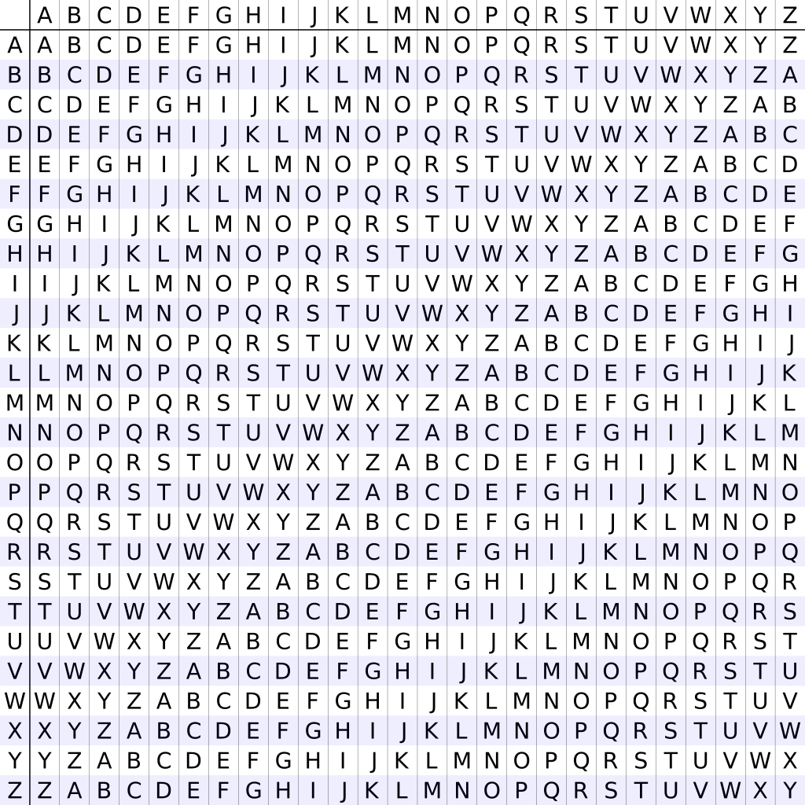
2
3
1

