Slide 1
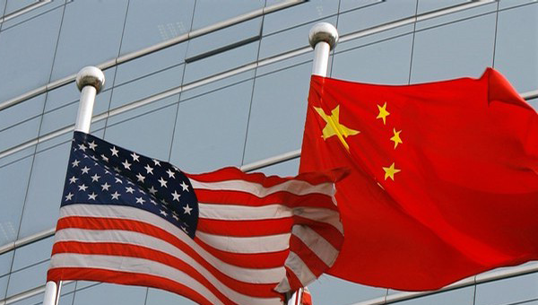
Super Power (Example)
Your name here
Glossary Definition: | Examples: | Related Words:
My Definition: | Picture:
An extremely powerful national capable of influencing international events and the acts and policies of less powerful nations.
USA, USSR
China today
Cold War
World Systems
Core-Periphery
Source: citation (book/article/site you searched. Ex. Knox et al. 2015
A country so powerful they can affect and influence other countries and international policies

Slide 2
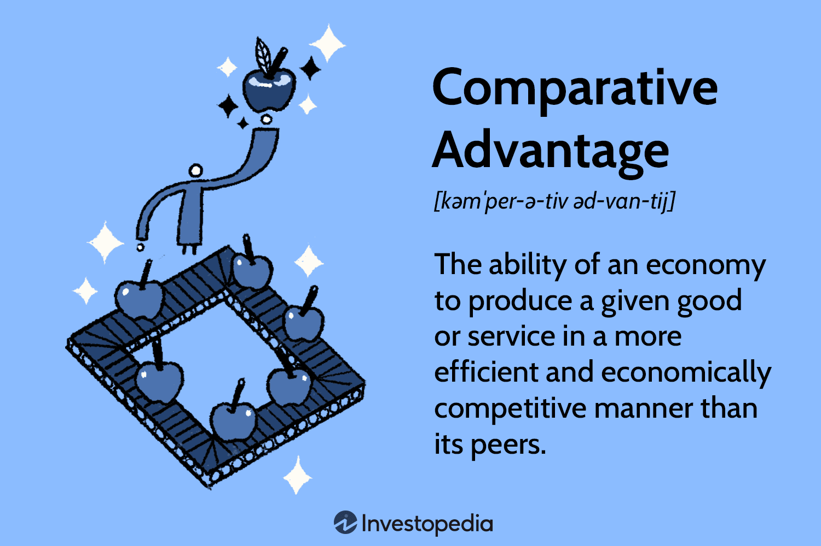
Comparative Advantage
Kyle Lund
Glossary Definition: | Examples: | Related Words:
My Definition: | Picture:
The principle used to explain patterns of trade and specialization: If each region or country specializes in those economic activities they perform relatively better than others and imports goods for which their own production costs are relatively higher, each is likely to gain.
Saudi oil, Taiwanese semi-conductors
Opportunity cost, specialization, absolute advantage, trade
Source:
Differences in local resources, infrastructure, geography, and culture (among other variables) result in different regions/populations being better at some activities than others. This results in a situation where this population/region can trade away the results of the activities they are good at, for the results of activities they are bad at. This trade results in acquiring more of the need good than they could make on their own.

Slide 3
Definition 2
Your name here
Glossary Definition: | Examples: | Related Words:
My Definition: | Picture:
Xxxx
Xxxxx
Xxxxx
Source:
Xxxxxx

Slide 4
Definition 3
Your name here
Glossary Definition: | Examples: | Related Words:
My Definition: | Picture:
Xxxx
Xxxxx
Xxxxx
Source:
Xxxxxx

