Slide 1
Woche 8: Cultural Presentation
Kyle Lund

Slide 2
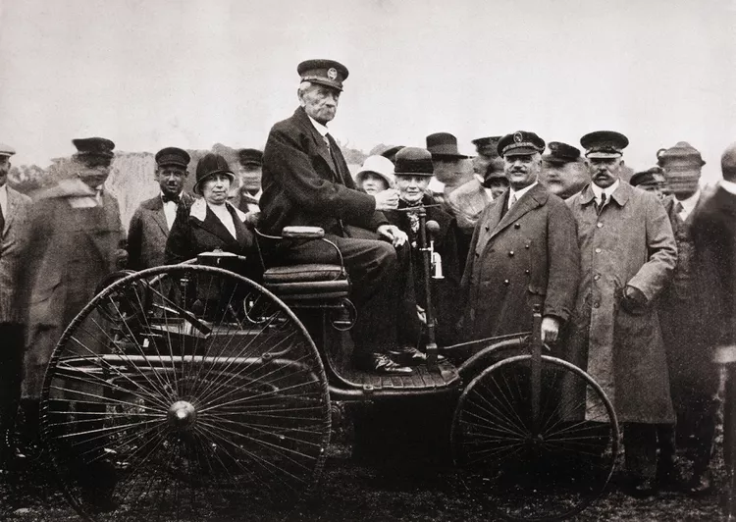
Carl Benz
Born in Mühlburg
Studied Mechanical Engineering at Karlsruhe Polytechnic
Founded his first firm in Mannheim in 1871
In 1883, Benz founded Benz & Co. Rheinische Gasmotoren-Fabrik
Patent 37435
https://www.thoughtco.com/karl-benz-and-automobile-4077066
https://group.mercedes-benz.com/company/tradition/founders-pioneers/carl-benz.html
Notes:
Carl Benz was born in 1844 in Mühlburg, near Karlsruhe in western Germany, and was the son of a train conductor. From an early age, he was fascinated by machines and went on to graduate from the Polytechnic in Karlsruhe with a degree in mechanical engineering. He then worked for several engineering firms before opening his first business in 1871 in Mannheim with August Ritter. The venture almost failed when this partner proved unreliable; but Benz’s fiancée used her dowry to buy out Ritter’s share of the business, keeping the company alive. He then spent years refining his design for a two-stroke engine, which earned him several patents that built the foundation for his later work. In 1883, with new financial backers, he founded Benz & Cie. Rheinische Gasmotoren-Fabrik in Mannheim. The company’s early success producing industrial engines is what finally allowed him to pursue the creation of a self-propelled vehicle. Other inventors approached this problem by attempting to bolt existing engines onto carriages, but Benz’s approach was to treat the engine and chassis as a single integrated system. And in 1885, he built the Benz Patent-Motorwagen, the first purpose-built automobile. It had three wheels, a single-cylinder four-stroke engine producing less than one horsepower and could only reach speeds around 10 miles per hour. And on January 29, 1886, he received German patent No. 37435, which is often called the birth certificate of the automobile.
From here, he continued expanding his company and by 1890 it was Germany’s second-largest engine factory. He had a number of accomplishments throughout the rest of that decade, including solving a steering issue which finally enabled four-wheeled cars, his Benz Velo became the first mass-produced car, with over 1,200 built by 1893, he also designed the first truck, the first motor bus, and patented the boxer flat engine. And by 1900, his company was the world’s largest automobile manufacturer. He retired in 1903 and died in 1929, though his legacy does live on through the Mercedes-Benz company which still bears his name.

Slide 3

Mannheim
Located on the Rhine between Frankfurt and Stuttgart
Can be traced back to a Roman fort
Officially founded by Fredrick IV in 1606
Harbor construction in 1834 turned the city into an industrial center
https://www.meet-mannheim.de/en
https://www.britannica.com/place/Mannheim
Google Earth
Google Maps
Notes:
For the place we’ll look at Mannheim. This city played a crucial role in shaping his success and was one of the industrial hearts of Germany during the 19th century. It’s located on the Rhine River at the mouth of the Neckar and started its life as a roman fort in the 1st century, though it was officially established as a city by Fredrick IV in 1606. Its position on the Rhine and near the strategic iron and coal mines of the Rhineland made it a center for trade, transport, and engineering innovation. The city’s harbor, completed in 1834, became one of Europe’s largest inland ports and drew factories, machine shops, and entrepreneurs including Carl Benz from across the region. In addition to its other advantages, the entire city followed a geometric grid pattern, which was efficient and modern even by today’s standards, reflecting the structured thinking that defined the industrial age in post-unification Germany. During this period, Mannheim rebuilt itself after centuries of war and embraced the mechanical revolution, producing engines, chemicals, and steel products that powered Germany’s transformation into a modern nation-state. This thriving industrial atmosphere eventually gave Benz access to the skilled workers, precision tools, and investors he needed to create his automobile.

Slide 4
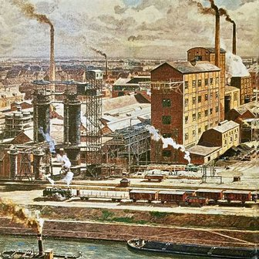
Industrialization
Collision between the industrial revolution and German unification
Steel and rail
New German identity
https://www.cambridge.org/core/journals/journal-of-economic-history/article/railways-growth-and-industrialization-in-a-developing-german-economy-18291910/0A37B4DAC9EEDBF8FF82836A706CDE2E
https://www.erih.net/how-it-started/industrial-history-of-european-countries/germany
Notes:
And now we come to industrialization and its effects on Germany. When the Industrial Revolution collided with German unification in the late 19th century, it created a perfect storm that shaped the new nation’s destiny. New inventions, theories, and processes were being created at an unprecedented rate and now there was a unified German state could coordinate trade, build railways, and develop heavy industry on a national scale. This created an enormous cultural shift. Farmers became factory workers, merchants became manufacturers, and invention became a patriotic act. In Germany, industry became a national identity.
Mannheim was one of the many places that stood at the heart of this transformation, and they were only a small part of a broader national movement toward innovation and science.
Steelworks and factories multiplied, and the products they produced where used to connect distant regions into an interconnected web of production and commerce. Railways stitched together the patchwork of former kingdoms, carrying goods as well as ideas between regions that previously a little contact with each other.
Finally, industrialization also altered how Germans saw themselves. Precision and efficiency became virtues. Education turned toward the applied sciences, and technical mastery and away from the old aristocratic ideals of art and philosophy., shifting the German identity from poets and princes to engineers and builders.

Slide 5
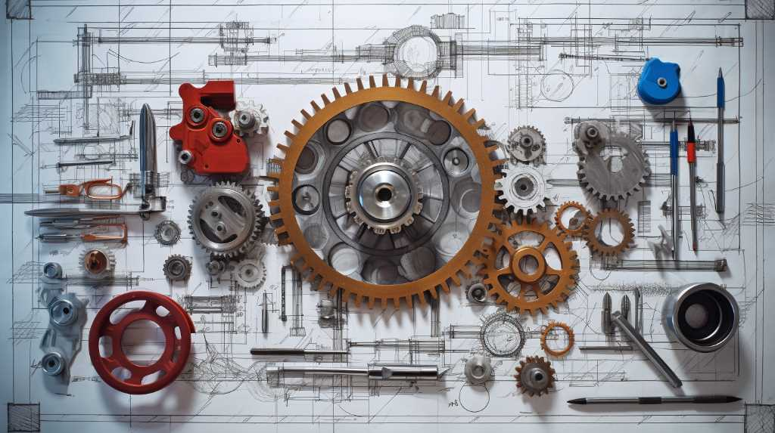
Personal Interest
Crossroad of two interests
Engineering
Societal development
https://futia.edu.ng/course/mechanical-engineering/
Notes:
I chose this combination of person, place, and trend because it interacts with two interests of mine. First, is engineering. I’m an engineer by trade, my first degree was in aerospace engineering and I’m currently in the computer science program. So, the technical side of this spoke to me, especially getting to look back at the invention of the car and the environment that created it, which is one of the most influential technologies for most people’s day-to-day life.
The other half of this is the geopolitical side, specifically that one of my favorite reading topics is how trends and other influences can leave their mark on society. Or said another way, how a seemingly small moment can create little nudges on society which shapes it in unexpected ways. Basically, the butterfly effect, but at a national scale. The combination of German unification and industrialization fit this perfectly. There was an entire new society creating a new identity almost from scratch, and the industrial revolution just happened to be occurring at the same time and was all too happy to fill in that vacuum.
So anyways, that why I chose this particular topic.

Slide 6
Sources
Bellis, Mary. “Biography of Karl Benz.” ThoughtCo, 6 May 2025, www.thoughtco.com/karl-benz-and-automobile-4077066. Accessed 17 Oct. 2025.
Braun, Sebastian Till, and Richard Franke. “Railways, Growth, and Industrialization in a developing German economy, 1829–1910.” The Journal of Economic History, vol. 82, no. 4, Dec. 2022, pp. 1183–221. https://doi.org/10.1017/s0022050722000377.
Duggan, et al. “Germany | Facts, Geography, Maps, and History.” Encyclopedia Britannica, 17 Oct. 2025, www.britannica.com/place/Germany/The-economy-1890-1914. Accessed 17 Oct. 2025.
Futia. “BEng in Mechanical Engineering.” Federal University of Technology Ikot Abasi - Welcome to FUTIA, 26 Apr. 2024, futia.edu.ng/course/mechanical-engineering. Accessed 17 Oct. 2025.
“Germany.” European Route of Industrial Heritage, www.erih.net/how-it-started/industrial-history-of-european-countries/germany. Accessed 17 Oct. 2025.
“Meet Mannheim.” Meet Mannheim, www.meet-mannheim.de/en. Accessed 17 Oct. 2025.
Mercedes-Benz. “Carl Benz.” Mercedes-Benz Group, group.mercedes-benz.com/company/tradition/founders-pioneers/carl-benz.html. Accessed 17 Oct. 2025.
The Editors of Encyclopaedia Britannica. “Mannheim | Germany, Map, and History.” Encyclopedia Britannica, 20 July 1998, www.britannica.com/place/Mannheim.
The National Inventors Hall of Fame. “Carl Benz.” The National Inventors Hall of Fame, 2025, www.invent.org/inductees/carl-benz. Accessed 17 Oct. 2025.
Turner, et al. “Germany | Facts, Geography, Maps, and History.” Encyclopedia Britannica, 17 Oct. 2025, www.britannica.com/place/Germany/The-economy-1890-1914. Accessed 17 Oct. 2025.

