Slide 1
Woche 11: Cultural Presentation
Kyle Lund

Slide 2
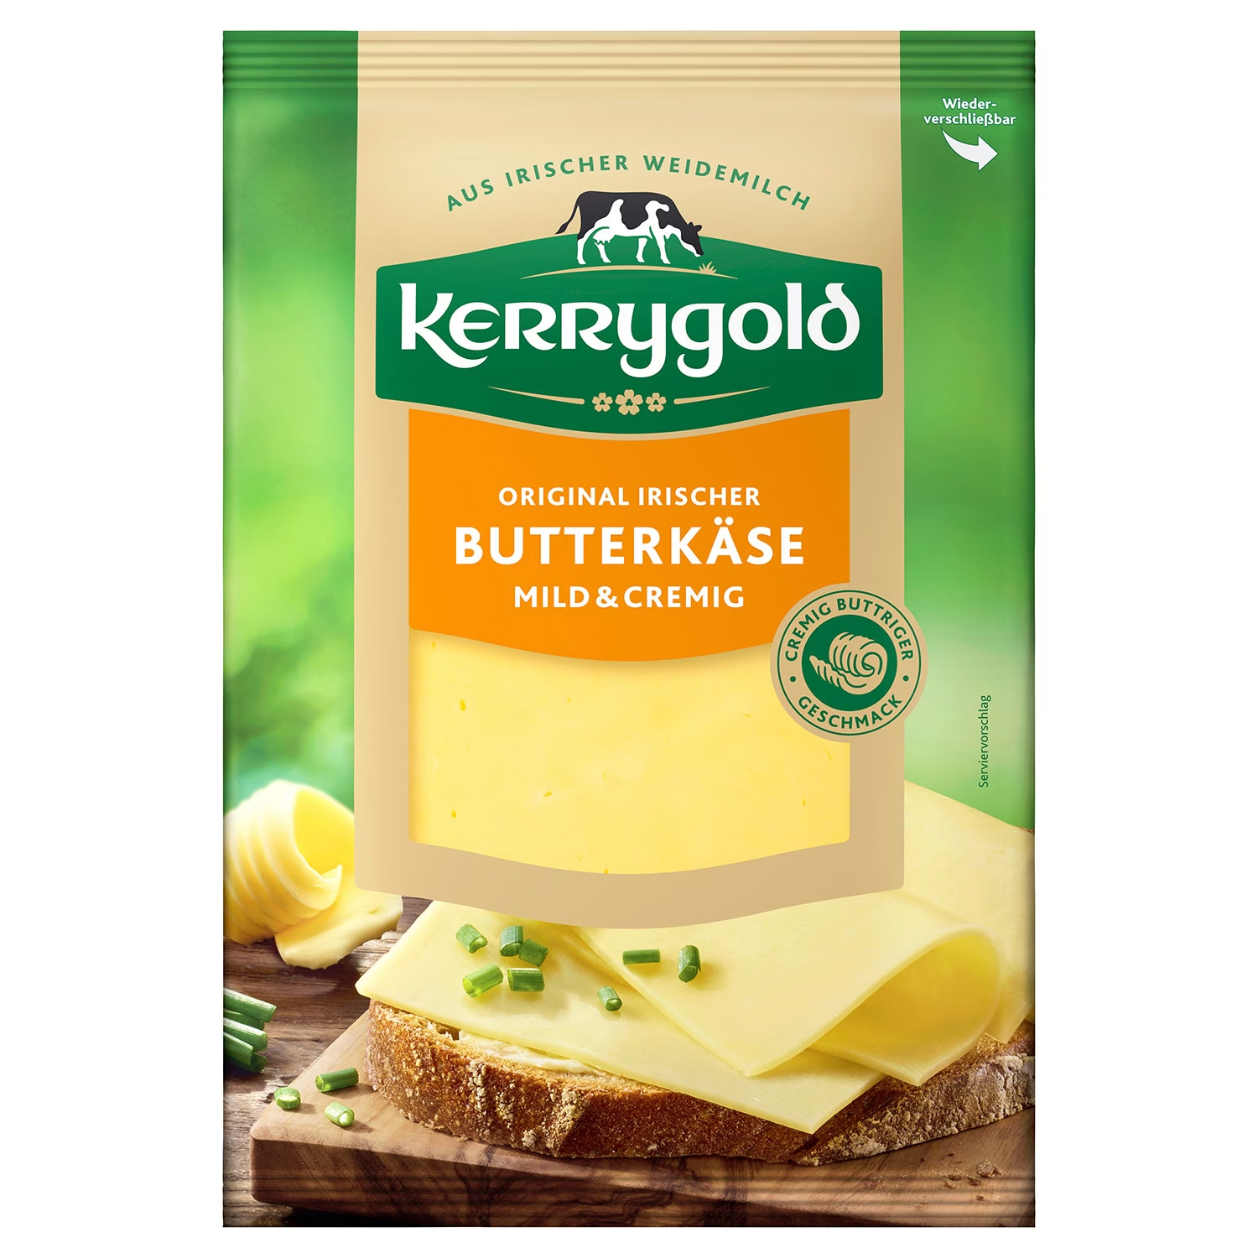
Butterkäse
Milder Deutscher Käse
Basierend auf Bel Paese, einem italienischen Käse
Wird häufig für Sandwiches verwendet
Beliebt in der Allgemeinheit, besonders bei Kindern
https://www.wisconsincheese.com/the-cheese-life/article/151/butterkase
https://s7g10.scene7.com/is/image/aldi/202508200502
Notes:
Butterkäse, also known as damenkäse, or ladies cheese, is a mild tasting German cheese whose history dates back to the early 20th century. In 1906, an Italian cheese called Bel Paese became popular, and after the name was trademarked, German cheesemakers attempted to make their own version. In 1928, the Staatliche Molkerei Weihenstephan dairy company developed Butterkäse, a mild tasting, inexpensive cheese that was easy to use on sandwiches and other quick-to-prepare foods. It quickly became popular among the general public, but especially amongst children, as this was unlike the stinky cheeses that Germans are typically known for.

Slide 3
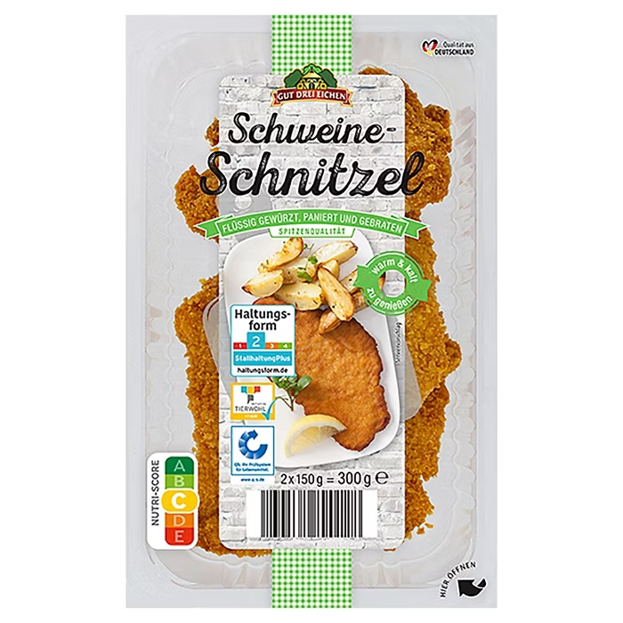
Schnitzel
Flach geklopftes, paniertes und in der Pfanne gebratenes Fleisch
Kann aus verschiedenen Fleischsorten bestehen
Passt gut zu vielen verschiedenen Beilagen
Römischen Ursprungs, hat sich weltweit verbreitet
https://wordpress.kpu.ca/foodhistory/2023/02/10/scrumptious-schnitzel/
https://s7g10.scene7.com/is/image/aldi/202409060301?$H10-XL$
Notes:
If there was one dish that made people think of Germany, it would be Schnitzel. Broadly speaking schnitzel is a thin or flattened piece of meat, which is breaded with flour, eggs, and breadcrumbs, and then either pan or deep fried. Schnitzel can be made from a variety of meats. The traditional Weinerschnitzel uses veal, but you can also use pork, chicken, or less commonly, beef. It’s a relatively simple dish to make and has the advantage that it pairs well with a variety of side dishes.
The origins of this dish date back to roman times, as there are written records that show evidence of similar dishes. Eventually, modern Italians developed their own version known as the Cotoletta Alla Milanese. And then Austria developed their own approach with the Weinerschnitzel, which is term that is still trademarked and protected under Austrian laws today. Much like the black forest cake, this dish followed Germans as they moved around the world. German immigrants in Texas developed a version using beef and emphazied hammering the meat flat in order to tenderize it. Immigrants to Israel commonly used either chicken or turkey for their schnitzel. And today, other countries have developed their own approaches. For example, in Egypt it is known as frakh pane, and is commonly served with French fries. My own personal favorite version is jagerschnitzel, which covers the meat in a mushroom and bacon based sauce.

Slide 4
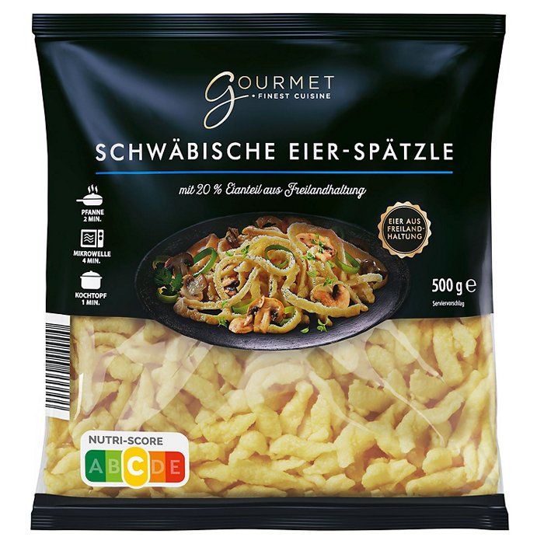
Spätzle
Liegt zwischen Knödel und Nudel
Besteht aus Mehl, Wasser und Ei
Vielseitige Grundlage für verschiedene Gerichte
Wichtiger Bestandteil der schwäbischen Kultur
https://www.kitchenproject.com/german/recipes/Spaetzle/History.htm
https://s7g10.scene7.com/is/image/aldi/202411130554?$H10-XL$
Notes:
Now, every good schnitzel needs some side dishes, and the first one I choose was spätzle. This is a Swabian dish that is somewhere between a dumpling and a noodle. Like pasta, it is typically made with a simple combination of flour, egg, and water which is then seasoned with salt and other flavors. The mixture results in a somewhat runny batter that is then poured in thin strings into boiling water using a special tool. Once it’s cooked, almost anything can be added to the spätzle to make it a proper side dish or even a main meal.
The early record of spätzle are seen in painting which have been traced back to 1725. These depict medieval knights with their spätzle boards. Spätzle was and still is an important part of Swabian culture, with one poet going so far as to say that spätzle is the “”alpha and omega of Swabian cuisine.” Additionally, the history of the seven Swabians, a novel first published in 1827 describes Swabian mealtime habits as “one eats daily five times a day, five times soup, and twice to Knöpfle or Spätzle.” Knöpfle is just spätzle in a small round form. And finally, while spätzle is native to Germany, it to has spread around the world and now has different names in other countries, such as Glauska, Chnophli, and Halusky.

Slide 5
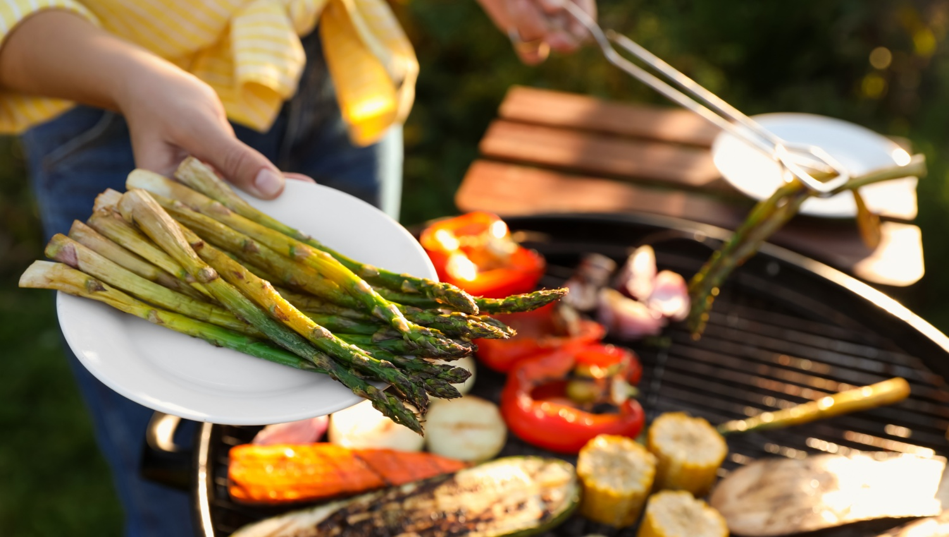
Spargel
Spargelzeit
Luxusgemüse aus dem Mittelmeerraum
Weißes Gold
https://wordpress.kpu.ca/foodhistory/2023/02/10/scrumptious-schnitzel/
https://s7g10.scene7.com/is/image/aldi/E05_Bild_Desktop_Header_Grillen_SpargelGrillen_1200x680_2x?$E05-XL$
Notes:
And finally, we of course need to have a vegetable for our meal. And in Germany, while the fall is marked by apples, the spring is dominated by asparagus. While we in the US are likely more familiar with the green variety that we can find year-round, Germans prefer the white variety. This version is in season from about mid-April to June 24th, this time is affectionately referred to as Spargelzeit. Asparagus was considered a luxury vegetable and eaten as far back as 2000 BC throughout the Mediterranean. But make no mistake, no nation loves asparagus like the Germans. I could point out that during Spargelzeit, the average German eats asparagus daily. Or that the average yearly consumption in Germany is over 70,000 tons. Or even that four different German states have official “asparagus routes.” And those are all useful metrics but what stood out for me is that when I was doing my research, I did a search for “Germany’s favorite vegetable”, and the top result was a youtube video simply titled “Asparagus: A love poem for Germany's favorite vegetable”. So, yeah, the vegetable referred to as “Weißes Gold”, or white gold, is a big deal over there.

Slide 6
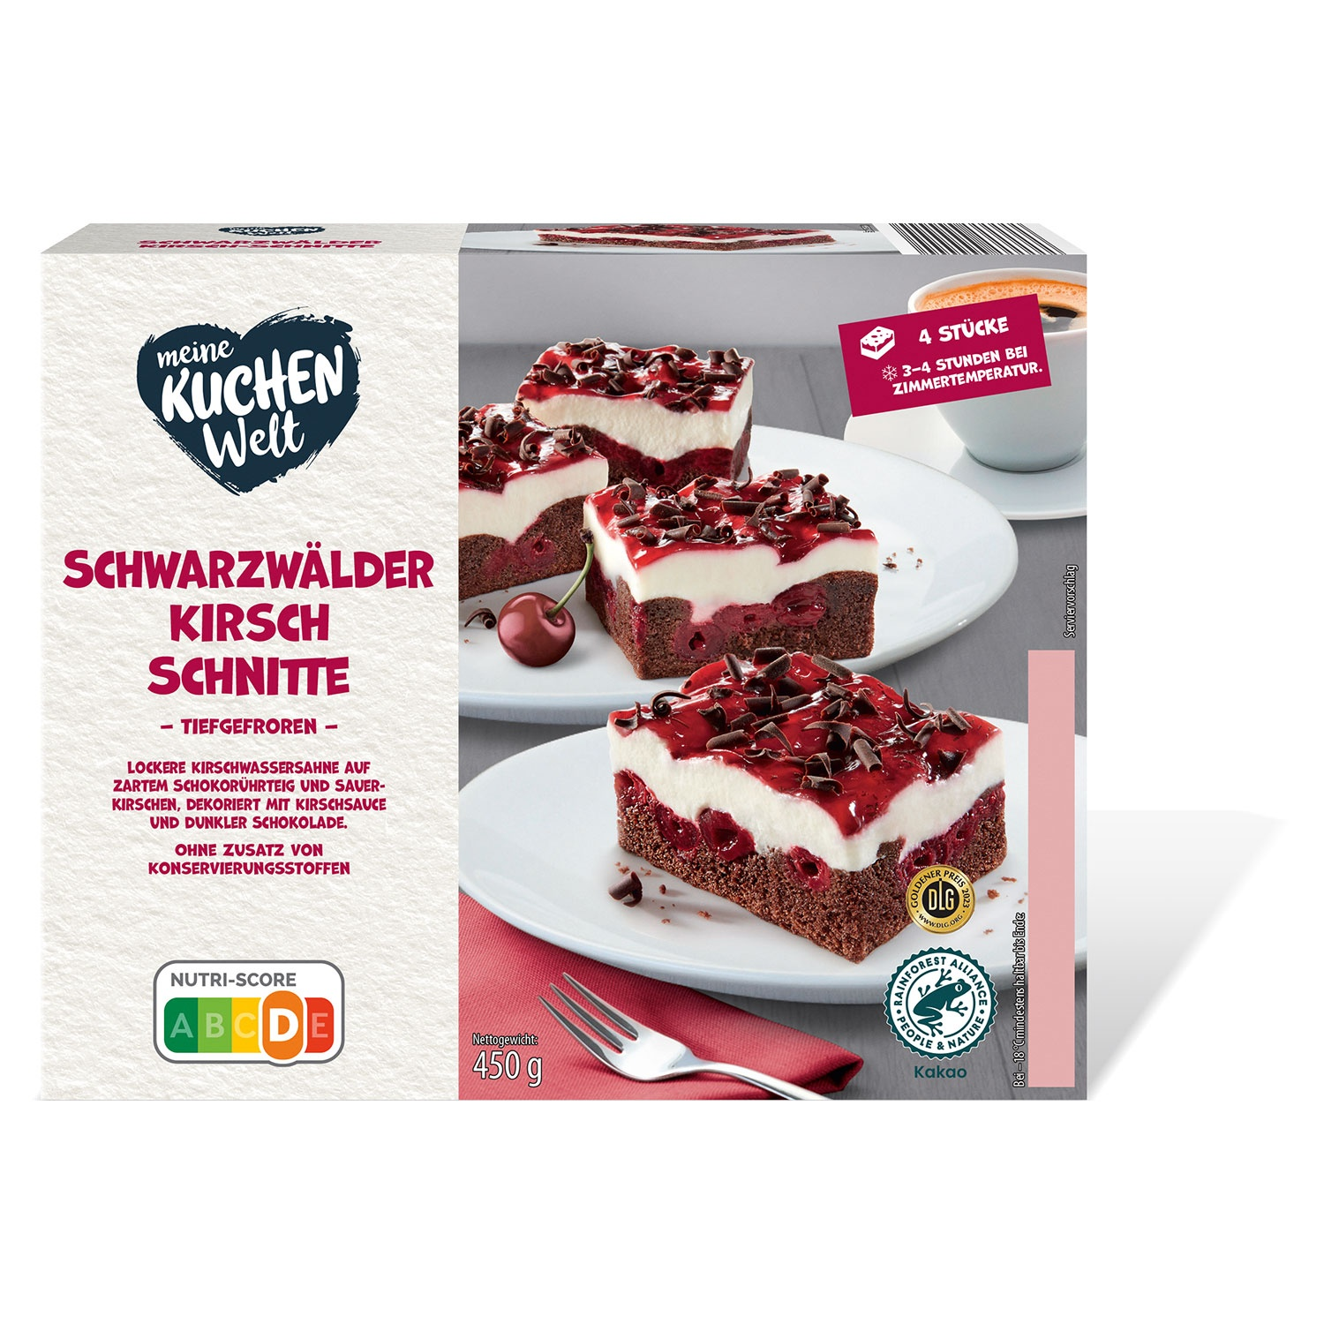
Schwarzwälder Kirschtorte
Traditionelles deutsches Dessert
Stammt aus der Schwarzwaldregion
Verbreitete sich weltweit, als Deutsche in andere Länder auswanderten
https://jackandbeyond.com/blogs/cake-resources/the-surprising-history-of-black-forest-cake
https://s7g10.scene7.com/is/image/aldi/202407250374?$H10-XL$
Notes:
The Black Forest cake is a dessert consisting of layers of chocolate sponge cake, whipped cream, and cherries. It is then traditionally garnished with chocolate shavings and more cherries on top. This cake originated in the Black Forest region of Germany, hence its name, and incorporates the flavors and ingredients found in the Black Forest, such as cherries and Kirsch, a cherry brandy. While the exact origins are unknown, this treat is believed to have evolved from an older dessert known as the "Schwarzwälder Kirschwasser Torte," which translates to Black Forest cherry brandy torte. This dessert was made with layers of chocolate cake soaked in Kirsch and topped with cherries. As germans emigrated throughout the 18th to 20th centuries, they took this cake with them, and today versions of this cake are considered signature dishes all across the world, spreading to countries such as Trinidad, Pakistan, Chile, Lebanon, Nepal, and Fiji. Odds are, if you ask someone to draw a cake, they’ll draw a black forest cake.

Slide 7
Sources
ALDI SÜD. “GOURMET Spätzle.” ALDI SÜD, www.aldi-sued.de/de/p.gourmet-spaetzle--g-eierspaetzle.000000000277810003.html?search=spatzel. Accessed 4 Nov. 2025.
ALDI SÜD. “KERRYGOLD Scheibenkäse.” ALDI SÜD, www.aldi-sued.de/de/p.kerrygold-scheibenkaese-mix--butterkaese.000000000695589003.html?search=butterkase. Accessed 4 Nov. 2025.
ALDI SÜD. “Schwarzwälder Kirsch.” ALDI SÜD, www.aldi-sued.de/de/p.meine-kuchenwelt-sahneschnitten--g-schwarzwaelder-kirsch.000000000191740001.html. Accessed 4 Nov. 2025.
ALDI SÜD. “Spargel Grillen – Tipps Und Anleitungen | ALDI SÜD.” ALDI SÜD, www.aldi-sued.de/de/rezepte/spezielles-und-saisonales/grillen/spargel-grillen.html. Accessed 4 Nov. 2025
“Cheese Lover’s Guide to Butterkäse.” Wisconsin Cheese, 12 Oct. 2022, www.wisconsincheese.com/the-cheese-life/article/151/butterkase. Accessed 4 Nov. 2025.
“The History of Spaetzle.” Kitchen Project, www.kitchenproject.com/german/recipes/Spaetzle/History.htm. Accessed 4 Nov. 2025.
Krishna, Priya. “How Did Black Forest Cake Become the World’s Favorite Dessert?” The New York Times, 29 Apr. 2024, www.nytimes.com/2024/04/29/dining/black-forest-cake.html. Accessed 4 Nov. 2025.
Rakowski, Kaya. “Scrumptious Schnitzel!” Food in History, 10 Feb. 2023, wordpress.kpu.ca/foodhistory/2023/02/10/scrumptious-schnitzel. Accessed 4 Nov. 2025.
“The Surprising History of Black Forest Cake.” Jack and Beyond, 22 Jan. 2024, jackandbeyond.com/blogs/cake-resources/the-surprising-history-of-black-forest-cake. Accessed 4 Nov. 2025.

