Slide 1

FINAL PRESENTATION

Slide 2
Code Structure

Slide 3
CLASS STRUCTURE
Class Inheritance from Node.py
Basic generic functionality is defined there, whilst more specific needs of robots are defined individually.
Generic functionality includes, object detection/avoidance and maneuverability

Slide 4

World

Slide 5
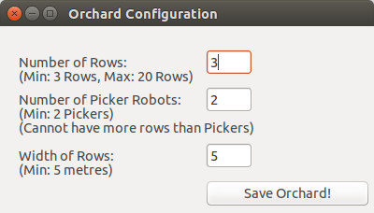
CONFIGURATION
The complexity of the world is configurable to the user
The variables, ‘Number of rows’, ‘Number of Pickers’ and the ‘Row width’ are configurable, within reasonable limits.
Once set, the configured simulation can be run to demonstrate the user’s desired settings
Figure 1.) The Configuration GUI

Slide 6
Static Objects

Slide 7

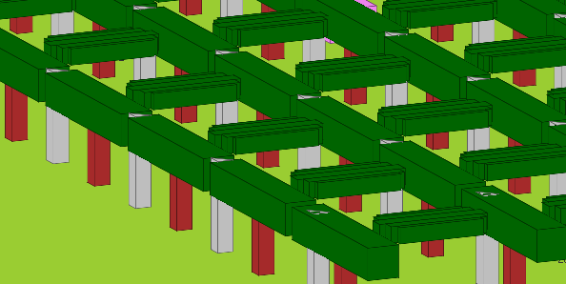
STATIC OBJECTS
Cannot detect obstacles
Does not react to anything
Weeds are considered unwanted are needed to be rid of.
People mow down the weeds when near
Animals eat the weeds also!
Figure 2.) Weed
Figure 3.) Trees and Pergolas

Slide 8
Different Robots

Slide 9
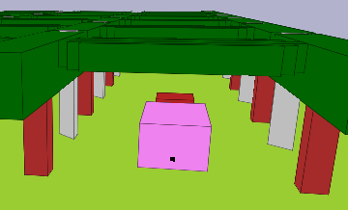
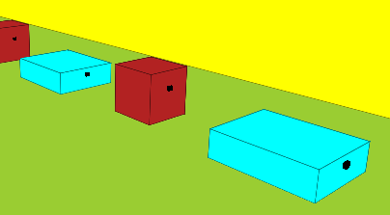
ROBOTS
ROBOTS
There are two different types of harvesting robots, the Picker and the Carrier
Figure 4. Picker moving through a row
Figure 5. The queue of carriers

Slide 10
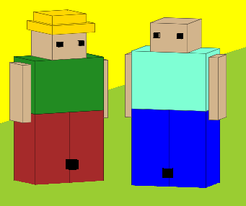
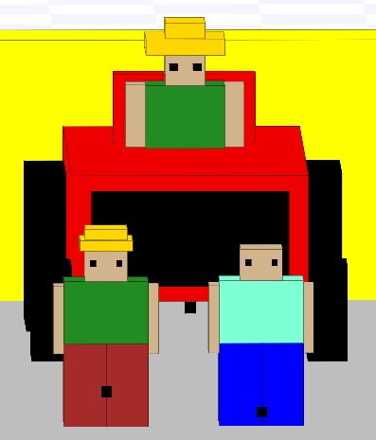
ROBOTS
There are also two different types of people, visitors and workers. These can be identified best by the presence of a worker hat on the worker robot. There is also a tractor robot that is much larger and moves faster than people.
Figure 6.) A worker and visitor
Figure 7.) Size comparison of tractor and people

Slide 11
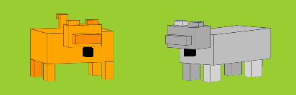
ROBOTS
Animals have also been modelled to roam throughout the orchard. There are two models, cats and dogs. There are no real behavioural differences between the two.
Figure 8. The dog and cat share a rare moment of peace

Slide 12
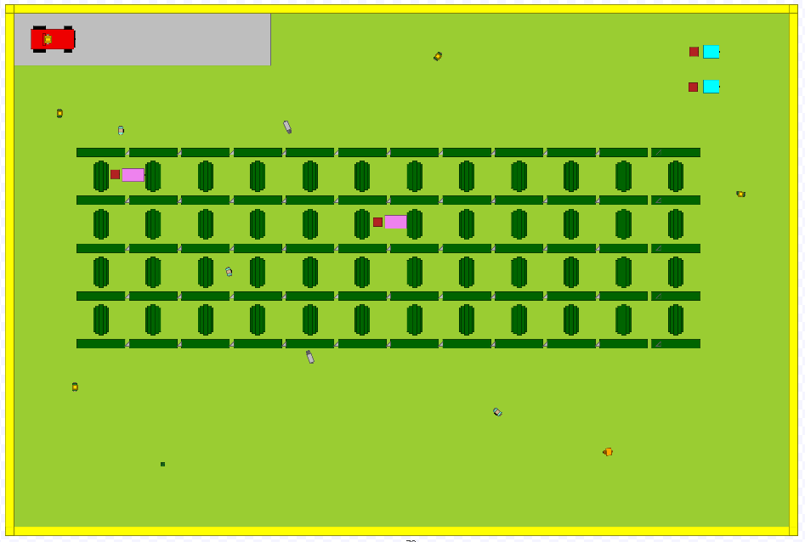
DEMO PRESENTATION

Slide 13
Robot Behaviour

Slide 14
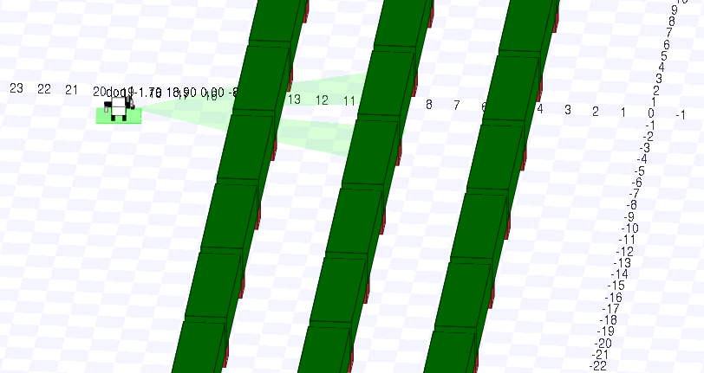
OBSTACLE DETECTION
Sensing behavior
Aim: ensure the robots can use sensors to sense their environment and react appropriately
Use: in every dynamic object
Previously:
60 degree sensor
Failing in corners
Now:
180 degree sensor
Different sensing behaviour for different robots

Slide 15
TURNING
Aim: For a robot to have the ability to turn exactly 90 degrees clockwise and anticlockwise
Use: Every dynamic object, except animals and trespassers, as their behaviour in terms of where they go can be considered random
Procedure:
Method has been made where the twist.angular.z is modified. It is understood that twist.angular.z is in terms of angular velocity so this is set to pi/8, meaning the robot will rotate pi/8 radians per second (one full 360 degree rotation every 16 seconds.
The rospy is set to sleep for 4 seconds, after which twist is initialised again.
This initialisation resets the values of twist, stopping the robot
After this 4 second sleep, the robot should have rotated 90 degrees (pi/2 radians).

Slide 16
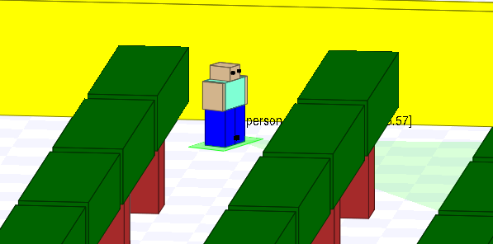
Figure 10.) A person mid-turn

Slide 17
DIRECTED MOVEMENT
Aim: moves robot to a destination
Use: in every dynamic object
What has been done:
Node can move x metres forward
Uses the amount of time to move x metres by the node's velocity
Publishes its velocity for this amount of time and then stops
Node can move to a position on the map given by a point
The robot retrieves data regarding its position in the world
Utilises turning and move x metres functionality to get to the new position
Moves in x then y direction

Slide 18
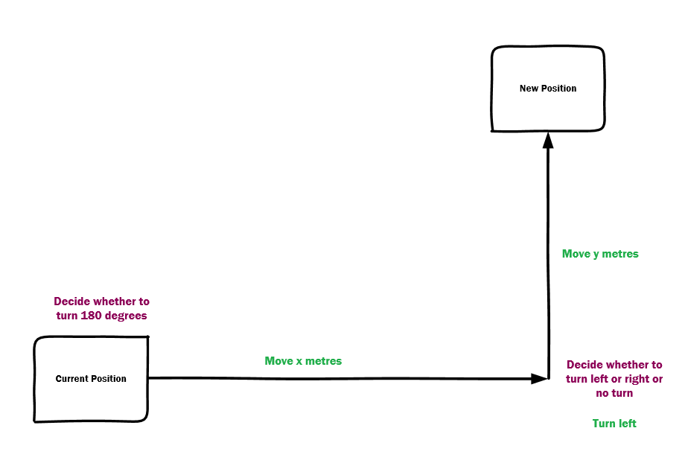
Figure 11.) The sequence in which a robot moves to a position

Slide 19
AWARENESS
Aim: Have the robots be aware of position and act accordingly
Use: In every dynamic object that does not move randomly
What has been done:
Robot now knows its current orientation, gained by converting its quaternion values to euler values.
Robots also now have a ‘Face’ value, where it understands if it is facing North or South… etc
Since the turning functionality of all robots is time based, there are infrequent errors that happen when a robot rotates.
By knowing its exact orientation, the robot calculates the radians to the nearest ‘Face’, and reorientates itself periodically so that the robots in the simulation are always working parallel or perpendicular to each other.

Slide 20
Robot Communication

Slide 21
COMMUNICATION
Utilized rostopics as the method of transporting messages
Custom messages used for communication between nodes, with publishers and subscribers
Subscribers react appropriately to the information given in the messages
Examples of message passing :
Bin sends messages to carriers to be picked up
Carriers communicate regarding who to attend to the bin
Pickers inform carriers when their bins need to be replaced

Slide 22
Debugging

Slide 23
DEBUGGING
Multiple terminals to track down progress of each robot individually
Print functions
Outputting robot progress data to a file for observation and studying
Using rqt_console

Slide 24
Testing

Slide 25
TESTING
Unit testing of individual functions with python unittest
Trying to achieve branch coverage of the methods
Used rostests to test robot’s behavior in stage
Mainly focused on the movement methods as they were most troublesome
Acceptance testing of the output through visual display and rostests

Slide 26
Innovation

Slide 27
FOLLOWING
Aim: make one robot follow the other
Use:
When a harvesting-robot is carrying a bin, the simulation should show the bin following the robot, then both of them start moving together, to model the "carrying". This means that bin has to "follow" the robot with the same speed.
Procedure:
Harvesting-robot publishes its velocity to a rostopic, which is received by a subscribing bin.
Bin extracts the velocity from the message received, and sets its own velocity accordingly.
Standard messages are sent to categorize following behavior. For example, full bins send a request to be picked to carrier robots.

Slide 28
ATTACH/DETACH
Aim: Have the functionality to attach and detach
Use:
For bins attaching and detaching from robots.
Procedure:
Bins detach when they want to stop following
Bins attach when they want to start following

Slide 29
Moving down rows
Aim: Have the functionality to attach and detach
Use:
For bins attaching and detaching from robots.
Procedure:
Picker has an attached bin, moves down row
Then detach this bin, and wait for a new empty bin
This goes on as a routine

Slide 30
Queuing
Each carrier has a state, either working or waiting
Each bin has a state, either picked, or unpicked
Bin detects closest carrier to it and calls it specifically to be picked up
Carrier picks it, drops it at bin station and go back to its position in the queue

Slide 31
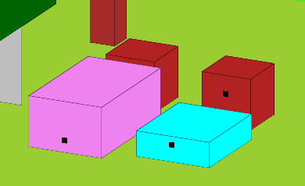
Figure 11.) The red bin is following the pink picker and the cyan carrier

Slide 32
Weeds
Weeds get mown away if a person or harvesting robot come close
Animals eat weeds

Slide 33
OBSTACLE DETECTION
Sensing behavior
Aim: ensure the robots can use sensors to sense their environment and react appropriately
Use: in every dynamic object
Previously:
60 degree sensor
Failing in corners

Slide 34
Documentation and Github

Slide 35
Documentation
Documentation was created continuously throughout the project
Github was used so that the entire group could access everything that everyone else worked on
Only a single branch was used at a time to ensure that everyone was working on the same code

Slide 36
