Slide 1
Universal Learning
Deborah S, Jedidiahy H, Jennifer V, Jonathan L, F. Lin, Mia P, Ricardo B, Taylor R

Slide 2
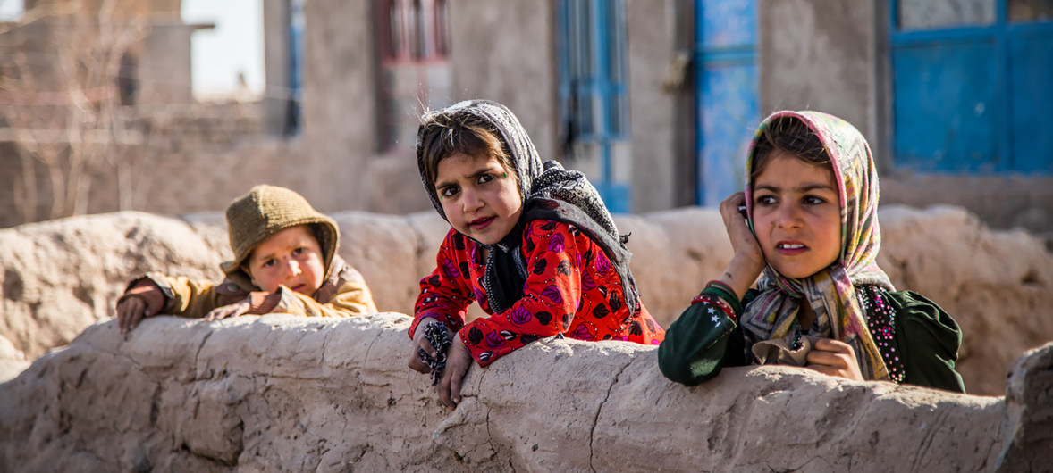
THE VILLAGE
Notes:
There are children around the world who lack the privilege of following their imagination and to live beyond what they know. They grow up suppressing their dreams and following the life of their parents and grandparents in the same village, scared and not knowing what else they can find out in the world. These children may have the gift of our greatest leaders like Nelson Mandela, Nikola Tesla, George Washington, or Henry Ford, but the world would never know and so will they.

Slide 3
OUR BEGINNING
Empathize
We defined the problem that children are not aware of the countries that compose of the world they live in.
Ideate
Talk through the pros and cons and feasibility of each idea.
Map It Out
Discuss
Define
We recognized the need for children around the world to learn what they don’t know.
We collaborated ideas that can solve our issue.
We brought our ideas into the world so that it may be visualized.

Slide 4
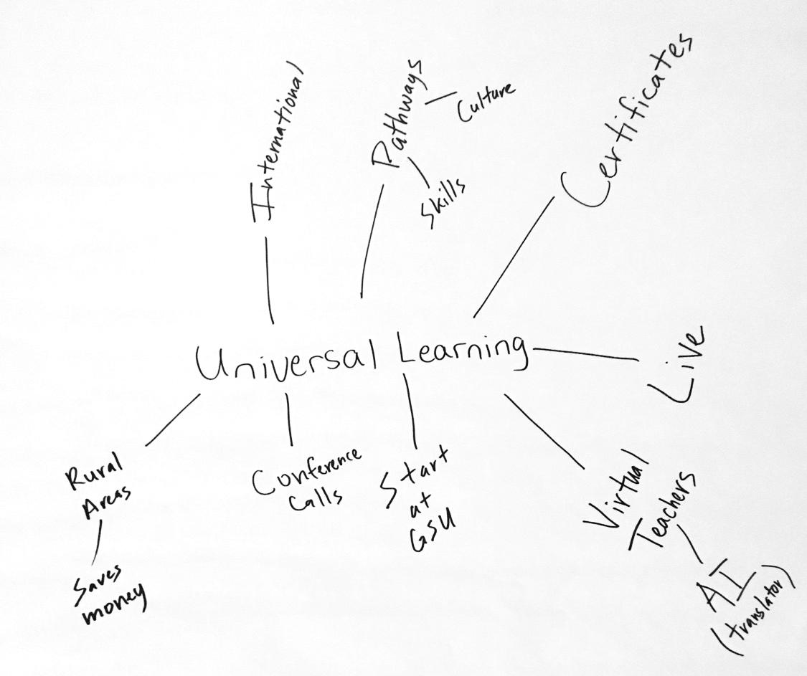
THE RESULT

Slide 5
How many languages do you need to know to communicate with the rest of the world?

Slide 6


But, it can take only up to 2- 3 languages to communicate with 40% of the world.
90
Notes:
With our advantage of speaking english if we can learn chinese we would be able to communicate to almost half of the world population.

Slide 7
“Knowledge can be greatest divide but also the greatest equalizer.”
Notes:
Please raise your hand if you can speak any foreign languages.
Please keep your hands up if you learn your second language from an education system?
Keep your hands up if you would like to use the second language that you learnt from school to translate the message listed below?

Slide 8
The World Inequality Database on Education found that 50% of the poorest children in the world completed
primary school in 39 out of 88 countries.
Notes:
This slide will be presented as like a fun fact.

Slide 9
The goal of our project, Universal Learning, is to grant learners around the world easy access to learn something new and fun in the language with which they are familiar.
OUR GOAL
Notes:
Learning a foreign language is a long journey.
we will focus on English at the beginning phase

Slide 10
Universal Learning will navigate virtual digital learning technology to fertilize users' interests through the learning experiences and interactions offered by our volunteer teaching team, formed by Georgia State University students.
OUR SOLUTION
Universal Learning hopes to motivate users to enjoy learning a foreign language, a new skill, and a different culture.

Slide 11

Our program will help students around the world from villages to remote communities make their ideas come into reality to change the world by learning what they don’t know through many languages offered by Universal Learning.

Slide 12
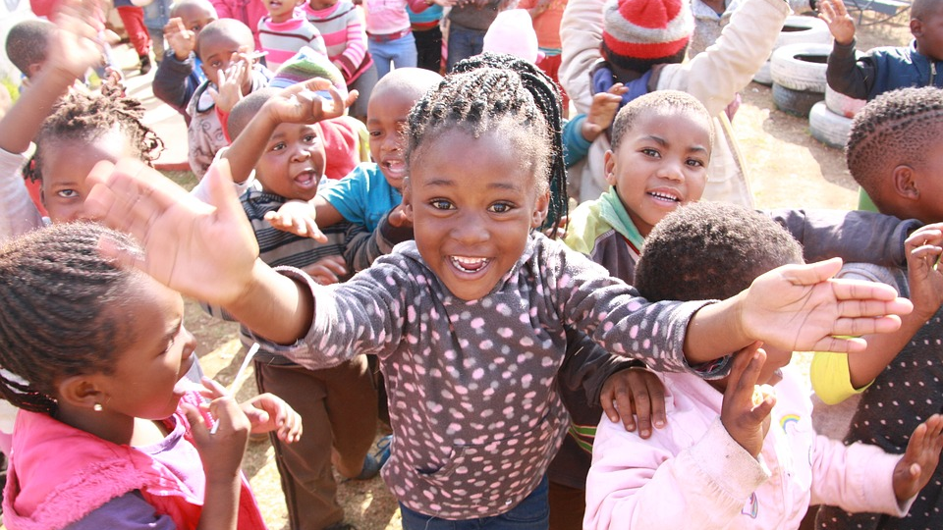
THANK YOU

