Slide 1


UVM Sequence Layering for Register Sequences
Effective Reusability
Muneeb Ulla Shariff, Mirafra Technologies Pvt Ltd, Bangalore
Sangeetha Sekar, Mirafra Technologies Pvt Ltd, Bangalore
Ravi Reddy, Roche Sequencing Solutions, Santa Clara

Slide 2
Agenda
Basic UVM Sequence flow
Introduction to UVM Sequence Layering
Protocol Adapter Layering Sequence with the RAL Model
Implementation
Use case 1 - PCIe
Use case 2 - SPI
Results
Conclusion

Slide 3
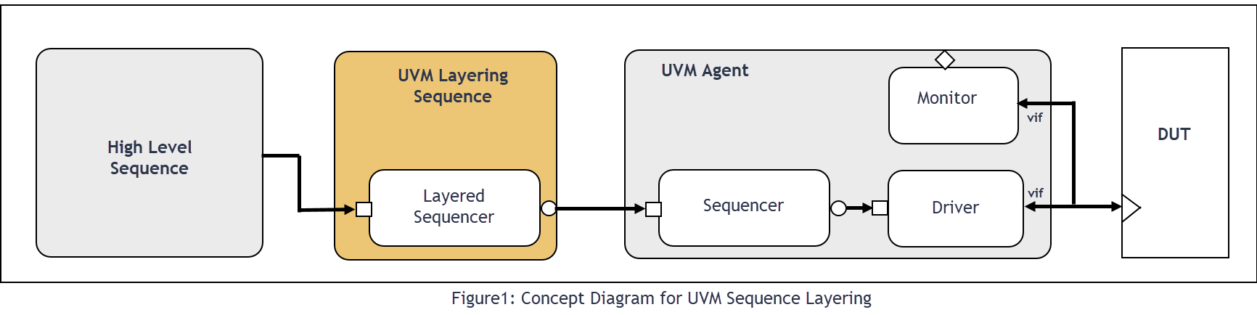
Basic UVM Sequence flow

Slide 4
Introduction to UVM Sequence Layering

Slide 5
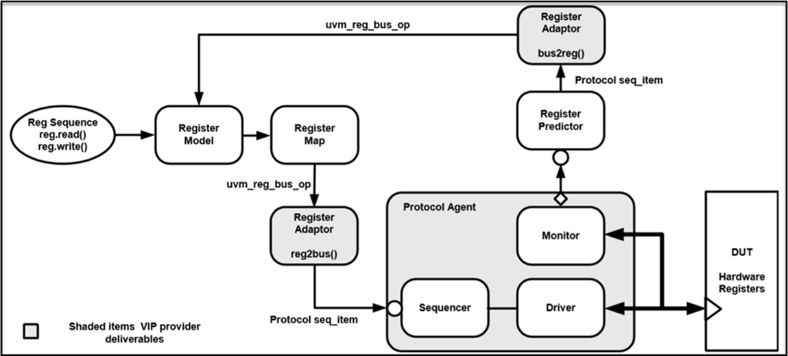
UVM RAL
Mimics the design hardware register contents at the TestBench (TB) side.
Provides the abstract accesses to registers and memories.
Figure 1. UVM Register Model Integration [1]

Slide 6
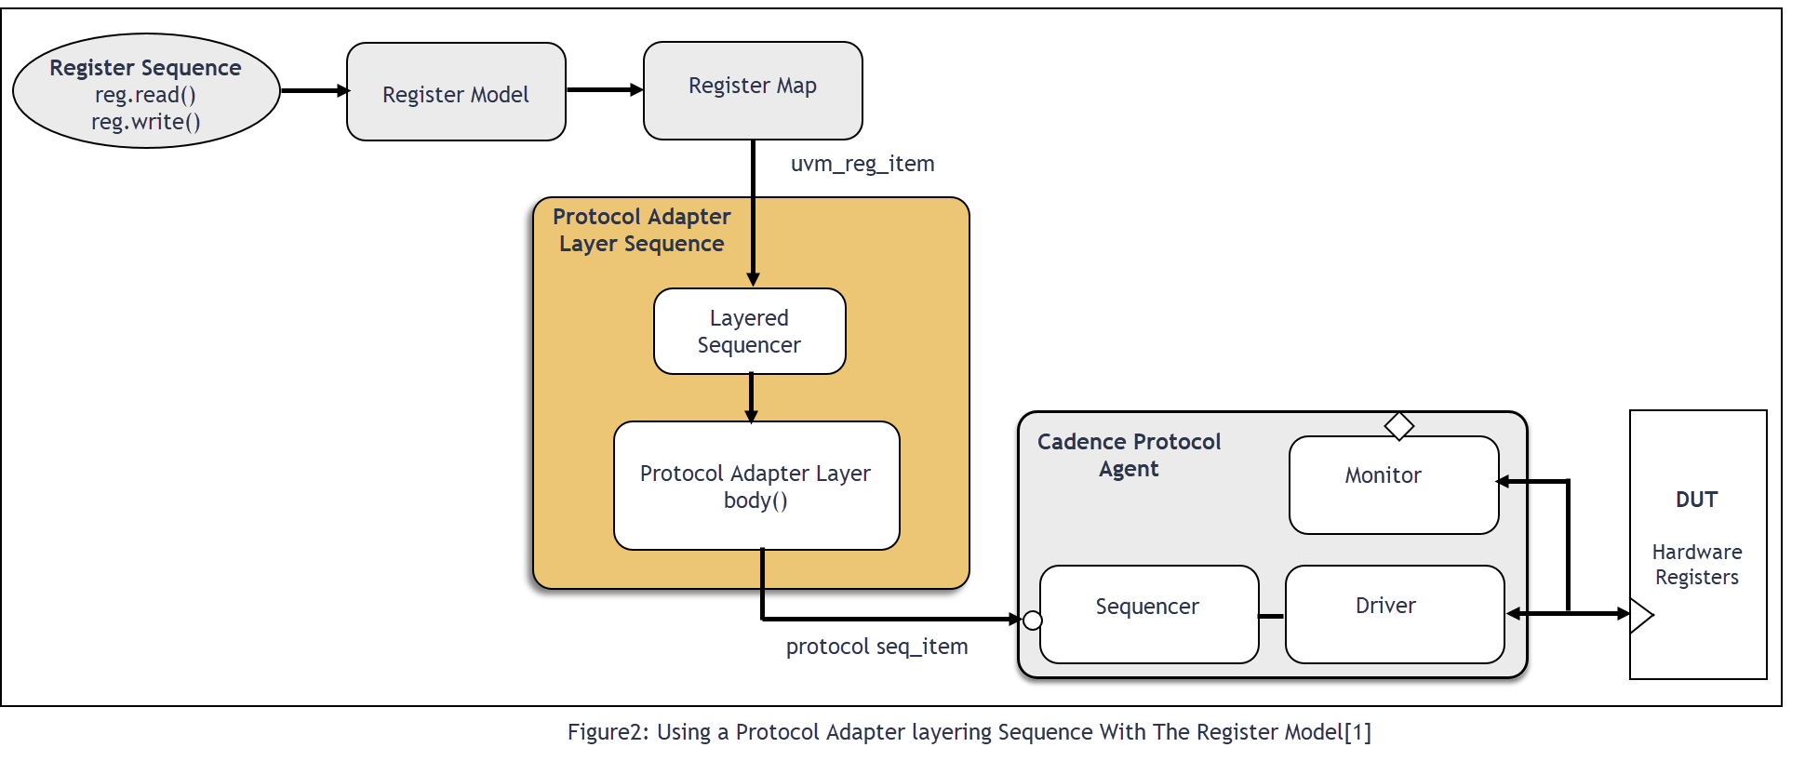
Protocol Adapter Layering Sequence with the RAL Model

Slide 7
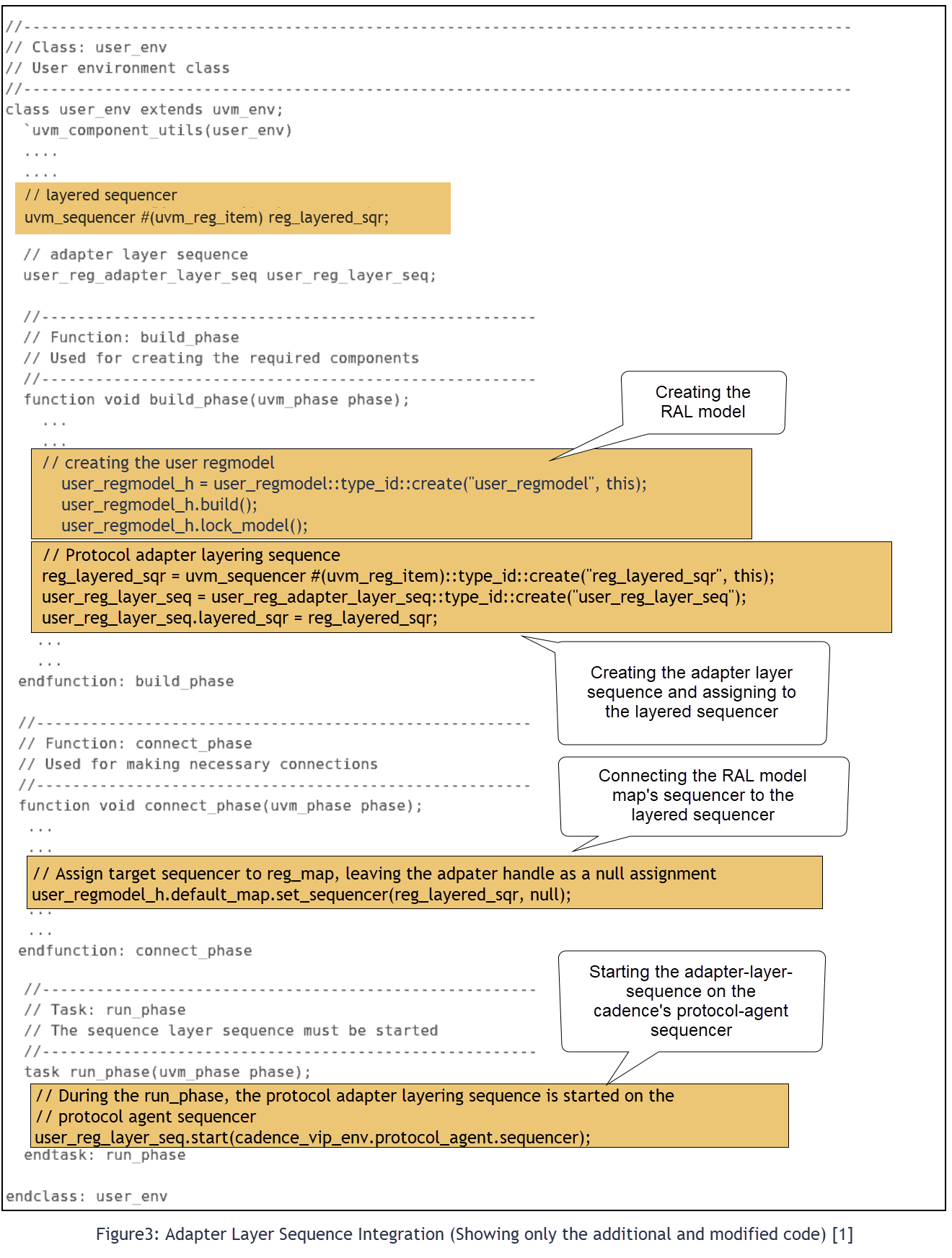
Implementation

Slide 8
Implementation (contd..)

Slide 9
Use case 1 :: PCIe
A request that can have several completion packets that have to be tied back to the originating request.
PCIe transfers frequently overlap with each other since the completion packets can arrive in any order and the PCIe root complex is free to send further requests to an endpoint.

Slide 10
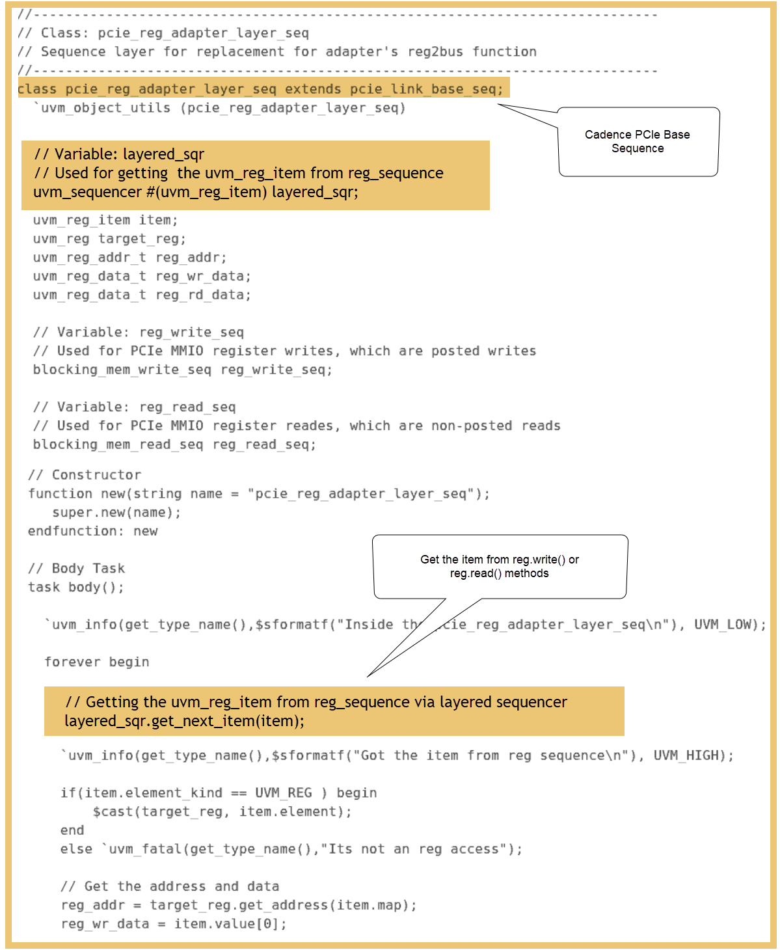
Use case 1 :: PCIe

Slide 11
Use case 1 :: PCIe

Slide 12
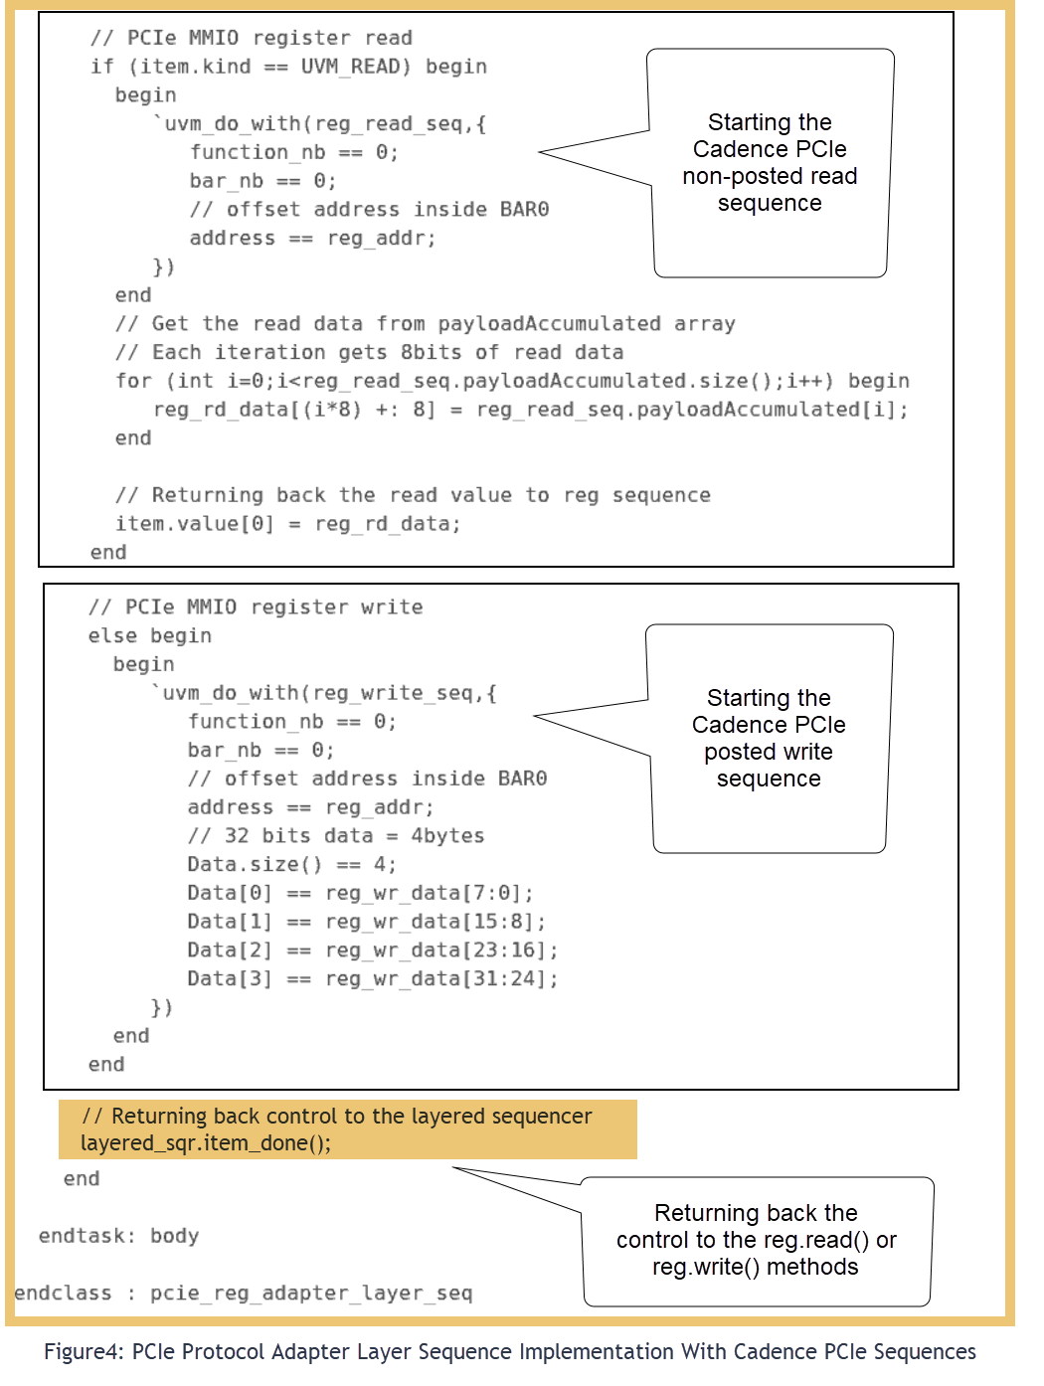
Use case 1 :: PCIe

Slide 13
Use case 1 :: PCIe

Slide 14
Use case 2 :: SPI
In our design, every register accessed via the SPI interface should be a 80 bits transfer. In other words, every reg.write() or reg.read() needs to be converted to a 80 bits SPI transfer.
In-order to support byte-granularity we need to send multiple transactions but the traditional RAL adapter's reg2bus() function will be called only once for each reg.write() or reg.read().
Hence, using the SPI adapter layer sequence, we can achieve byte-granularity with existing register sequences.[4]

Slide 15
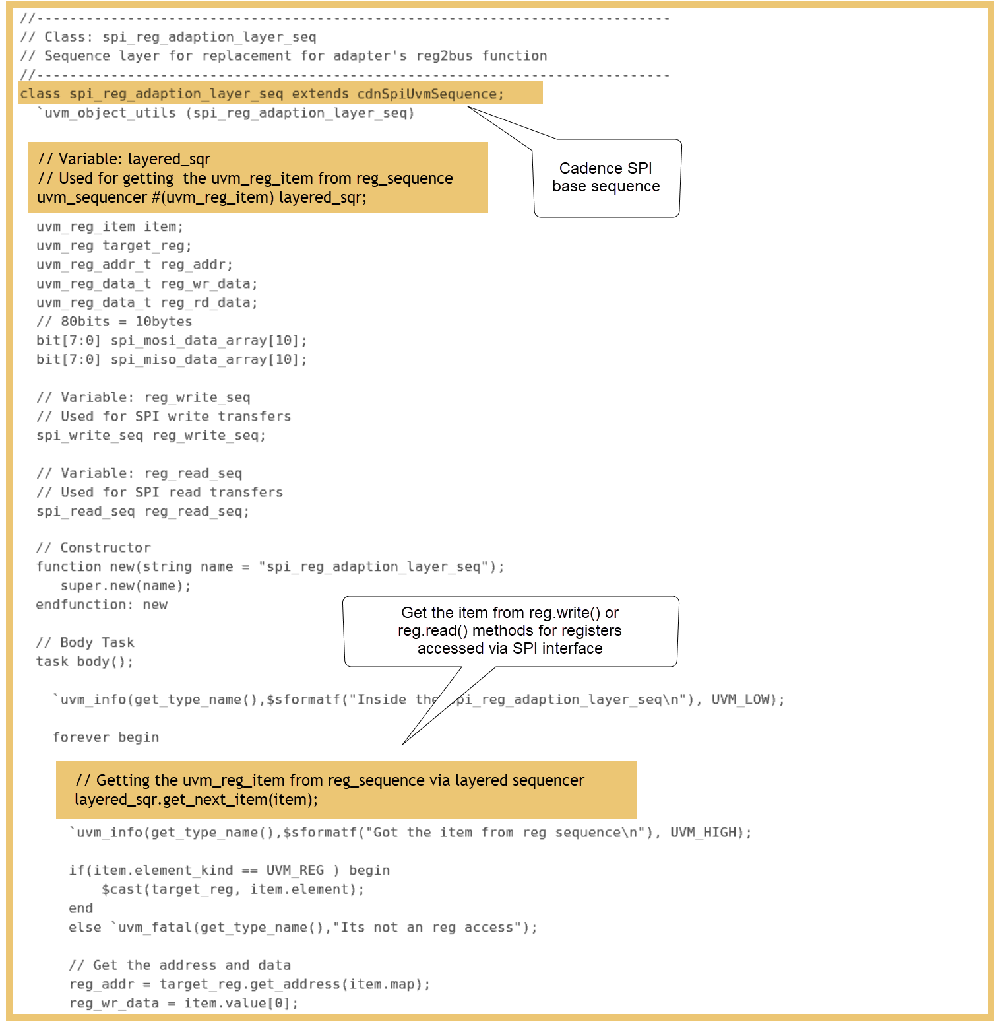
Use case 2 :: SPI

Slide 16
Use case 2 :: SPI

Slide 17
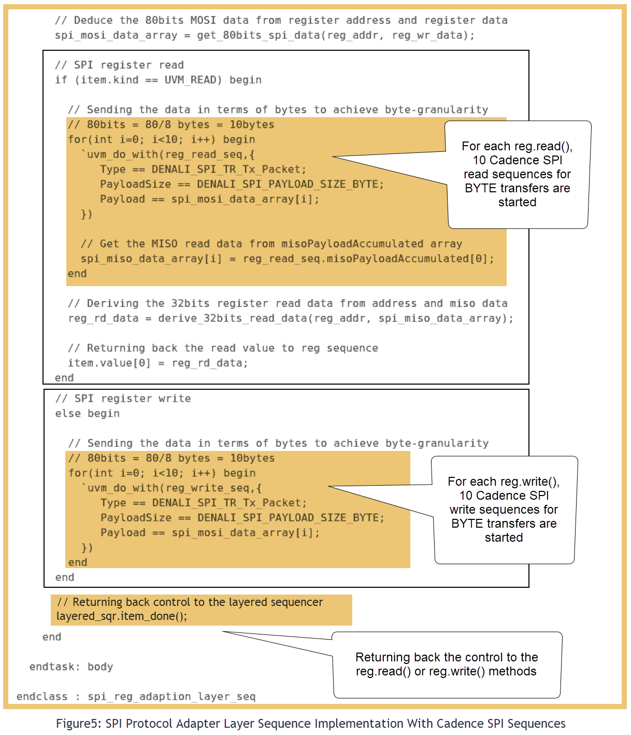
Use case 2 :: SPI

Slide 18
Use case 2 :: SPI

Slide 19
Results
With the implementation of UVM Sequence Layering for RAL, we were able to reuse register sequences with a faster verification turnaround time without modifying the testbench.
The development of sequence_adapter_layer required only 8% extra effort but resulted in a 70% time-saving while bringing up the testbench and running tests.
The overall activity effort to re-write sequences and develop custom verification components was just around 100-man hours, including the use of Cadence VIP for PCIe and SPI interfaces with excellent support from the Cadence VIP team.

Slide 20
Conclusion
In conclusion, the paper demonstrates the successful application of Universal Verification Methodology (UVM) Sequence Layering on RAL register sequences, using Cadence VIP for PCIe and SPI protocols.
The introduction of the sequence adapter layer resulted in faster verification turnaround times with minimal additional effort.
This approach significantly improved code reusability and scalability, making it a valuable technique for complex verification environments.

Slide 21
References
M. Peryer, D. Aerne, "A New Class Of Registers," -DVCon US 2016
Verification Academy – UVM Cookbook: https://verificationacademy.com/cookbook/registers/integrating
Universal Verification Methodology (UVM) 1.2 User's Guide – Accellera, October 8, 2015
UVM Tutorial for Candy Lovers – 16. Register Access Methods – ClueLogic
‹#›

Slide 22
Questions?
© Accellera Systems Initiative
‹#›

