Slide 1
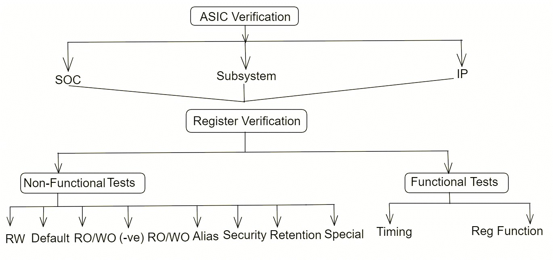
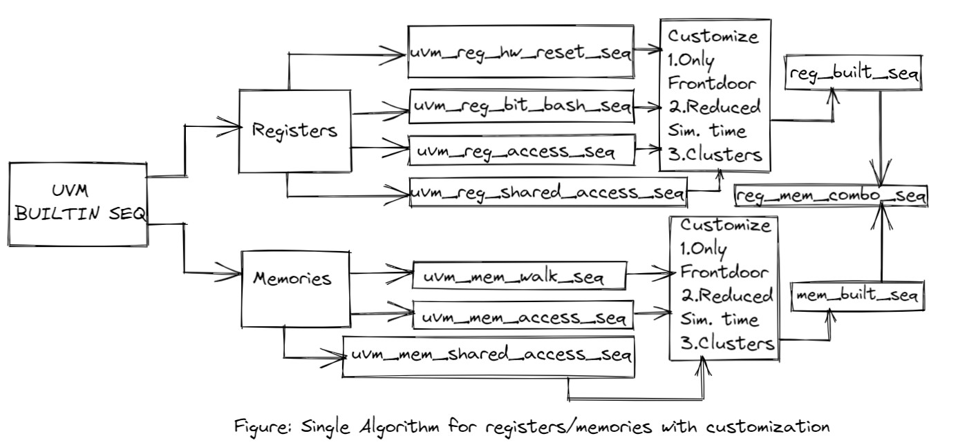
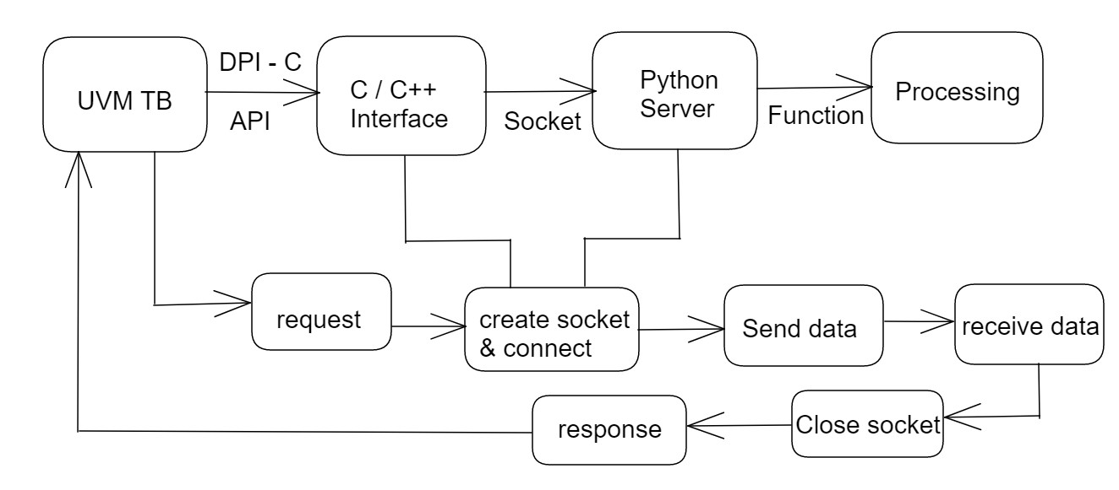
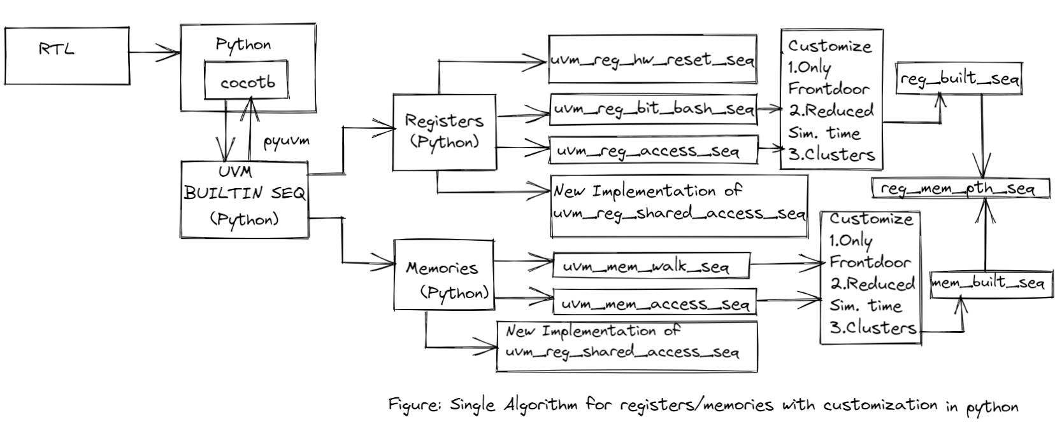
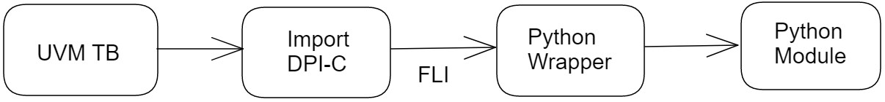

Counterintuitive approaches to have better communication between UVM and Python for registers with Single Controlling Algorithm
Sougata Bhattacharjee,
Senior Staff Engineer, Samsung Semiconductor (SSIR), Bangalore, India Email: Sougata.b@samsung.com
Problem Statement/Introduction
Register Verification can be grouped together into many different sub-areas as shown in the figure below:
Single controlling algorithm for register access in UVM
The motivation behind writing this paper is to address the challenges in register verification and develop an alternative solution to speed up the verification process.
Below are the different techniques used:
The first set of solutions is modifying the UVM RAL infrastructure to make it more efficient and customizable as per the project needs. A single UVM inbuilt sequence has been designed and a customizing feature has been induced into it.
The second set of solutions is achieved through Cocotb (Co-routine Co-simulation) based Python testbench which is more efficient than the first approach and also less verbose.
Communication of UVM Testbench with Python
Client Server Socket execution steps:
Python server script that sends the request on the socket and processes them.
DPI-C Interface in the UVM TB to communicate with Python server.
Implement the DPI-C
function to send requests to the Python server.
The header file for implementing the helper function needs to be integrated for communication.
Using FLI:
  The UVM TB calls the DPI-C function and the FLI transfers the call from the UVM TB to the Python wrapper.
  The Python wrapper calls the Python function from the Python module and then returns the result.
Single controlling algorithm for register access using Python
Execution steps of the custom algorithm using cocotb
Results
RTL codes are integrated with Python testbench with the help of VPI/VHPI known as cocotb which is a coroutine co-simulation environment and helps to leverage the Python libraries with pyuvm.
Divide the set of inbuilt sequences of registers and memories.
Execute each of the register sequences like hard reset, bit bash, etc for registers and mem walk, and mem access sequences for memories.
Enable customization features like forming clusters of groups of address based on offset for bit bash/mem walk, frontdoor write and read, and reduced simulation time for reg/mem access.
Combine all the sequences and coded the reg/mem combo sequences with conditional compilation switch and merge them.
Implement the reg/mem shared access sequence in Python and plugin with the reg and mem builtin seq.
[1] Python-based test benches using cocotb have reduced the verbosity of the test environment by 20% since the use of the construct is simple and easy and the coding and debug effort is reduced by 40% because the single algorithm takes care of each unique feature in the simplistic way possible. (Calculated on the basis of coding length, non-use of macros, refactored phases & generation of algorithms).
[2] The customized RAL algorithms in UVM help in a reduced simulation time of 20% by segregating the registers on the basis of their regions and then feeding it to the bit bash sequence but with the help of cocotb this has been further reduced by 10% and hence increasing the overall productivity of the testbench.
REFERENCES
IEEE Standard for Universal Verification Methodology 1800.2-2017 language reference manual
Universal Verification Methodology (UVM) 1.2 User’s Guide by Accellera
https://uvm-python.readthedocs.io/en/latest/
© Accellera Systems Initiative

