Slide 1
Welcome to cocotb
Python can drive your testbench while the simulator owns time and the DUT
learn_cocotb — intro
Notes:
Python can drive your testbench while the simulator owns time and the DUT. This short clip welcomes you to learn cocotb—cocotb triggers, DUT handles, and self-check patterns before you grow into pyuvm methodology. You will see how the course is meant to be used, not every API on day one. Two practice tracks share the same ideas: a real cocotb shell and browser sketches.

Slide 2
Why cocotb
SystemVerilog testbenches are powerful
More, while still talking to real RTL
This course builds literacy you can reuse with Verilator or Icarus
learn_cocotb — intro
Notes:
SystemVerilog testbenches are powerful, but many teams already live in Python for scripts, CI, and data. cocotb lets you write async Python coroutines that await simulator events—clock edges, timers, and more—while still talking to real RTL. This course builds literacy you can reuse with Verilator or Icarus, not a full commercial VIP flow in the browser.

Slide 3
Two tracks, one idea
Every lab module offers two ways to practice
Makefile runs feel like work you will keep
Waveform literacy, so you can build intuition without finishing every install first
You may do either track, or both
learn_cocotb — intro
Notes:
Every lab module offers two ways to practice. The real cocotb track uses local Python with cocotb and a simulator such as Verilator, so installs, awaits, and Makefile runs feel like work you will keep. The browser lab track uses interactive sketches on the learning platform—async test shape, triggers, DUT handle, scoreboard, and waveform literacy—so you can build intuition without finishing every install first. You may do either track, or both.

Slide 4
Set up the real cocotb track
Install Python three, cocotb, and a free simulator, Verilator is a common choice
Open this course in the monorepo and skim the two-track doc for exact tool names
You do not need a perfect farm on day one; module ten is the dedicated offline run
For now, confirm you know where the examples prompts live in each module folder
learn_cocotb — intro
Notes:
Install Python three, cocotb, and a free simulator—Verilator is a common choice. Open this course in the monorepo and skim the two-track doc for exact tool names. You do not need a perfect farm on day one; module ten is the dedicated offline run. For now, confirm you know where the examples prompts live in each module folder.

Slide 5
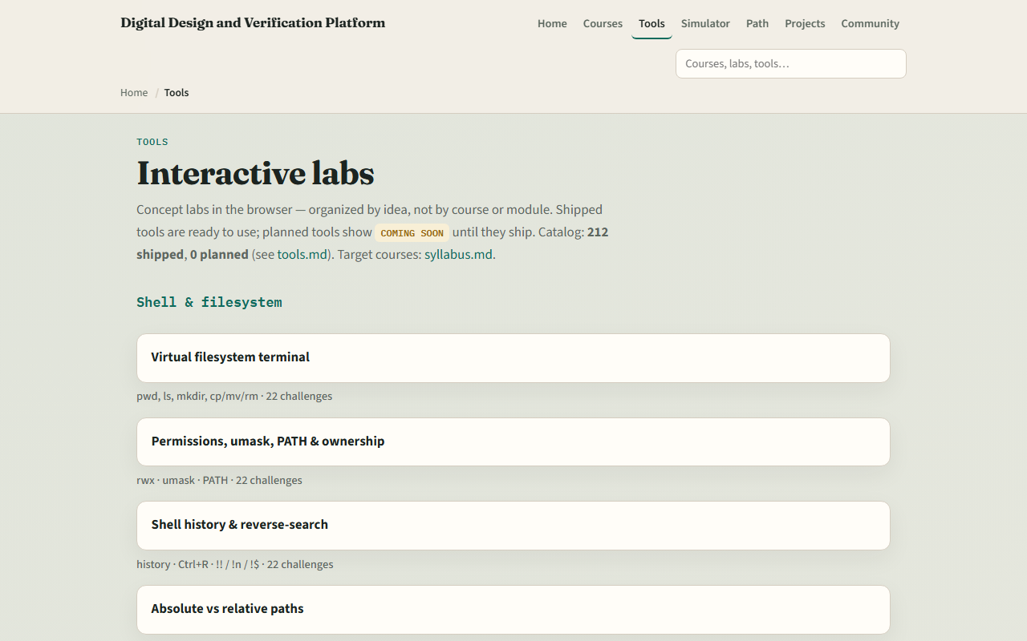
Set up the browser lab track
From the monorepo
Look for the cocotb sketches, async testbench, triggers, DUT handle, scoreboard
If you prefer, use the published tools site instead
Either way, open one sketch once so you know the layout
learn_cocotb — intro
Notes:
From the monorepo, serve the platform folder with a simple local web server, then open the tools index in your browser. Look for the cocotb sketches—async testbench, triggers, DUT handle, scoreboard, and waveform lab—plus shared verification sketches you will reuse later. If you prefer, use the published tools site instead. Either way, open one sketch once so you know the layout: challenge panel, workspace, and Check.

Slide 6
How to move through modules
For each module
Browser labs teach concepts; the real track keeps fidelity
When you finish this intro checklist, continue to the first lab: Python async testbench
learn_cocotb — intro
Notes:
For each module, read the README for the outcome, pick a track—or both—then work the checklist and the short quiz when you are ready. Browser labs teach concepts; the real track keeps fidelity. When you finish this intro checklist, continue to the first lab: Python async testbench.

