Slide 1
Python async TB
Cocotb tests are Python coroutines
learn_cocotb — python async tb
Notes:
cocotb tests are Python coroutines. You mark a test with async def, register it with the cocotb test decorator, and use await to suspend until the simulator resumes you—often after a timer or a clock edge. That shape replaces the procedural always-block style of classic SystemVerilog testbenches with something closer to modern async Python. This module is literacy for that pattern, not a full simulator run yet.

Slide 2
async, await, and the decorator
Three pieces fit together
Async def declares a coroutine, the function can pause at await and come back later
Await hands control to the event loop until a trigger fires
The cocotb test decorator registers your coroutine so the runner actually starts it
A plain def test cannot await
learn_cocotb — python async tb
Notes:
Three pieces fit together. async def declares a coroutine—the function can pause at await and come back later. await hands control to the event loop until a trigger fires, and simulation time can advance while you wait. The cocotb test decorator registers your coroutine so the runner actually starts it. A plain def test cannot await; an async test without the decorator is a valid coroutine but not a registered entry point.

Slide 3
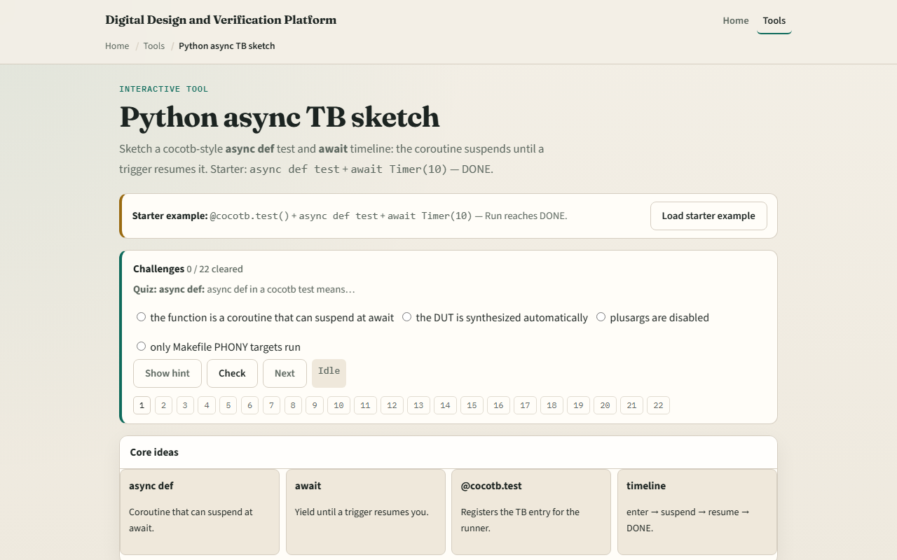
Browser lab
Browser lab starter
learn_cocotb — python async tb
Notes:
In the browser lab track, open the Python async testbench sketch and load the starter example. The step trace shows enter, suspend at Timer, resume, and DONE. Try presets: RisingEdge instead of a timer, two awaits in one test, or the deliberate failures—a plain def or a missing decorator. Use the challenge panel to quiz yourself on async def, await, and registration, then run until you see DONE on a valid starter test.

Slide 4
Real cocotb track practice
In the real cocotb track, open this module's examples prompts
Restate the async testbench idea in one sentence, coroutine plus await plus registration
Sketch a tiny async test on paper
Optional stretch
No simulator required yet; the goal is to recognize the shape when you see it in code
learn_cocotb — python async tb
Notes:
In the real cocotb track, open this module's examples prompts. Restate the async testbench idea in one sentence—coroutine plus await plus registration. Sketch a tiny async test on paper: decorator, async def test taking dut, one await on a timer or edge, then a poke or peek comment. Optional stretch: name one await you would use in a real cocotb Makefile flow you already have. No simulator required yet; the goal is to recognize the shape when you see it in code.

Slide 5
Pitfalls to watch
Do not use a plain def when you need await
Do not forget the test decorator
Do not assume await is instant
And remember
learn_cocotb — python async tb
Notes:
Do not use a plain def when you need await—that is not a coroutine and cocotb will not treat it as a time-advancing test. Do not forget the test decorator; without it your async function never enters the runner's queue. Do not assume await is instant—it suspends until a trigger completes, which is how simulation time moves. And remember: the browser sketch is conceptual; real cocotb still needs imports, a DUT handle, and a simulator behind the scenes.

Slide 6
Your turn
Complete the checklist for at least one track, preferably both
In the browser, load starter, run to DONE
On paper, write one valid cocotb test skeleton with all three pieces named
When you are ready, take the short quiz, then continue to cocotb triggers
learn_cocotb — python async tb
Notes:
Complete the checklist for at least one track—preferably both. In the browser, load starter, run to DONE, and clear a couple of quiz challenges on async and await. On paper, write one valid cocotb test skeleton with all three pieces named. When you are ready, take the short quiz, then continue to cocotb triggers.

