Slide 1
cocotb DUT handle
Triggers tell you when to act
learn_cocotb — cocotb dut handle
Notes:
Triggers tell you when to act. The DUT handle tells you what to poke and peek. This module is that handle: how dotted paths walk the design hierarchy from Python, and how dot value reads or writes a signal. Get this right and every later driver or monitor is just choosing the right leaf.

Slide 2
Path walk and dot value
Dut is the hierarchy root the simulator hands your test
Attribute dots walk instances
Reading dot value peeks; assigning dot value pokes
A missing name raises AttributeError, there is no silent None for a bad path
Deeper nests like dut dot core dot regs dot r zero are the same idea
learn_cocotb — cocotb dut handle
Notes:
dut is the hierarchy root the simulator hands your test. Attribute dots walk instances—dut dot uart dot txd means the txd signal under uart under the top. Reading dot value peeks; assigning dot value pokes. A missing name raises AttributeError—there is no silent None for a bad path. Deeper nests like dut dot core dot regs dot r zero are the same idea: keep walking attributes until you reach the leaf.

Slide 3
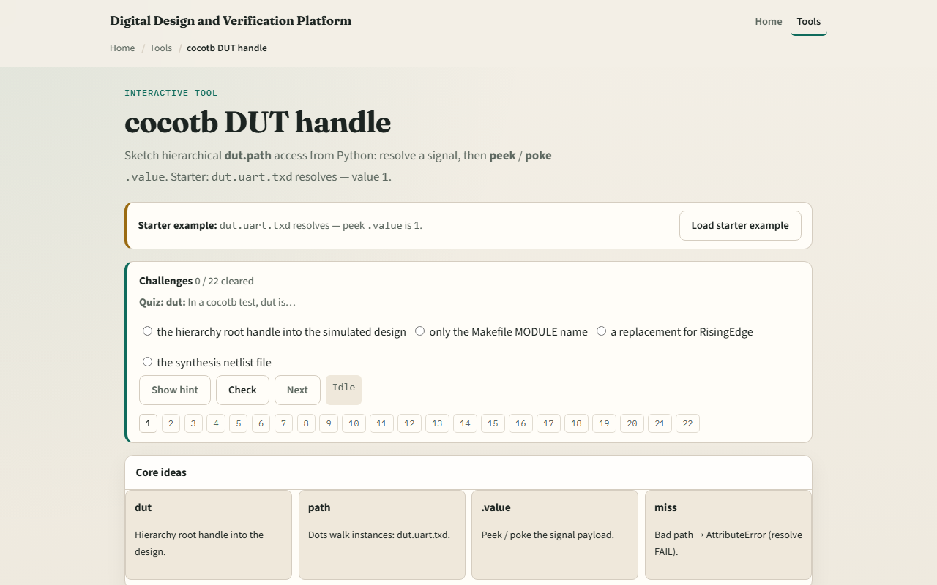
Browser lab
Browser lab starter
learn_cocotb — cocotb dut handle
Notes:
In the browser lab track, open the cocotb DUT handle sketch. You will see a challenge panel, a path resolver, and peek or poke controls. Load the starter—dut dot uart dot txd resolves with value one—then try a deeper path and a missing-path demo so you see AttributeError in the sketch. Work a few challenges and use Check when ready. Orient here; do not tour every button.

Slide 4
Real cocotb practice
In the real cocotb track, restate the handle idea on paper before you touch a simulator
Draw a tiny hierarchy: top, uart block, txd leaf
Write one peek line and one poke line using dot value
A ghost path that fails
This module is handle literacy, not a full live UART simulation yet
learn_cocotb — cocotb dut handle
Notes:
In the real cocotb track, restate the handle idea on paper before you touch a simulator. Draw a tiny hierarchy: top, uart block, txd leaf. Write one peek line and one poke line using dot value. Optional: open the lab’s source sketch and read the comment header—it shows resolve, poke, peek, and a ghost path that fails. This module is handle literacy—not a full live UART simulation yet.

Slide 5
Pitfalls to watch
Watch for inventing hierarchy names that are not in the netlist
A common trap is forgetting dot value; the handle is not the bit by itself
Another miss is treating a successful resolve as correct stimulus
The browser tree is literacy
learn_cocotb — cocotb dut handle
Notes:
Watch for inventing hierarchy names that are not in the netlist—AttributeError is the signal you mistyped the path. A common trap is forgetting dot value; the handle is not the bit by itself. Another miss is treating a successful resolve as correct stimulus—peek after poke to confirm what the DUT saw. The browser tree is literacy; real fidelity is driving live handles against your simulator’s DUT.

Slide 6
Your turn
Complete the checklist for at least one track, preferably both
In the browser, load the starter and try one missing-path challenge
Explain path walk and dot value in your own words, then sketch one poke and one peek
When you are ready
learn_cocotb — cocotb dut handle
Notes:
Complete the checklist for at least one track—preferably both. In the browser, load the starter and try one missing-path challenge. On paper, explain path walk and dot value in your own words, then sketch one poke and one peek. When you are ready, take the short quiz, then continue to cocotb BinaryValue in the next module.

