Slide 1
cocotb BinaryValue
Plain Python integers do not carry bit width
learn_cocotb — cocotb binary value
Notes:
Plain Python integers do not carry bit width. cocotb BinaryValue wraps a value with n bits so drive and read match the signal’s width. You construct it with an integer or hex literal and a width, then assign it to dut dot signal dot value. The helper masks to the low bits and prints a bit string with MSB on the left.

Slide 2
Width, value, and bit string
N bits sets how many bits are kept, wider input is truncated to the low bits
Starter example
Decimal two fifty-five and hex F F mean the same eight-bit pattern
Dut dot data dot value equals BinaryValue with your literal and n bits equals width
To read back, convert the signal value to int when you need a Python number
learn_cocotb — cocotb binary value
Notes:
n bits sets how many bits are kept—wider input is truncated to the low bits. Starter example: eight-bit hex A five becomes binary one zero one zero zero one zero one, MSB left. Decimal two fifty-five and hex F F mean the same eight-bit pattern. For poke, dut dot data dot value equals BinaryValue with your literal and n bits equals width. To read back, convert the signal value to int when you need a Python number.

Slide 3
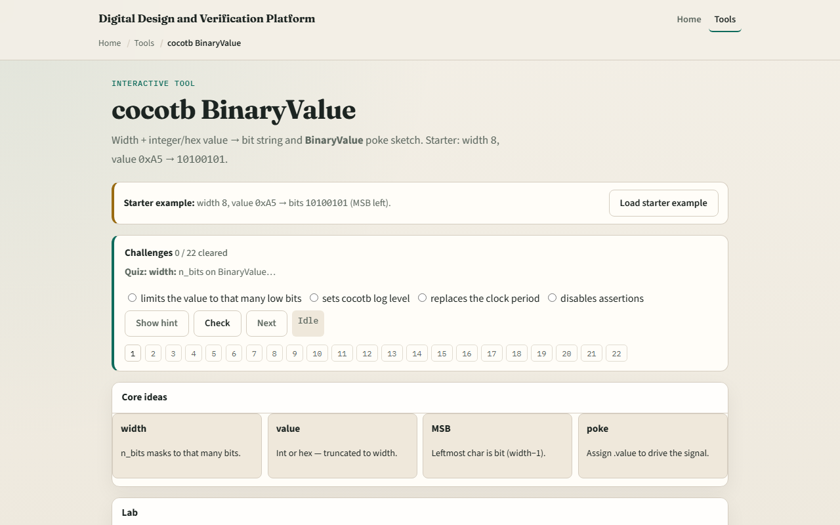
Browser lab
Browser lab starter
learn_cocotb — cocotb binary value
Notes:
In the browser lab track, open the cocotb BinaryValue sketch. You will see a challenge panel, width and value fields, and a bit-string readout. Load the starter—eight bits, hex A five, bits one zero one zero zero one zero one—then try a truncate preset so a wide hex value masks down to eight bits. Work a few challenges and use Check when ready. Orient here; do not tour every button.

Slide 4
Real cocotb practice
In the real cocotb track, work the bit math on paper before you drive a live signal
Write BinaryValue for hex A five with n bits eight and draw the MSB-left string bit by bit
Try width four with hex F and confirm all ones
Optional: open the lab’s source sketch and read how poke and int peek are commented
This module is width-aware drive literacy, not a full scoreboard yet
learn_cocotb — cocotb binary value
Notes:
In the real cocotb track, work the bit math on paper before you drive a live signal. Write BinaryValue for hex A five with n bits eight and draw the MSB-left string bit by bit. Try width four with hex F and confirm all ones. Optional: open the lab’s source sketch and read how poke and int peek are commented. This module is width-aware drive literacy—not a full scoreboard yet.

Slide 5
Pitfalls to watch
Do not assume Python’s bin of an integer matches cocotb’s MSB-left string without applying
A common miss is reading bits MSB-right, cocotb prints index width minus one on the left
Another trap is poking a wider value than the port
And remember
learn_cocotb — cocotb binary value
Notes:
Do not assume Python’s bin of an integer matches cocotb’s MSB-left string without applying the width mask first. A common miss is reading bits MSB-right—cocotb prints index width minus one on the left. Another trap is poking a wider value than the port; truncation happens silently, so know your width. And remember: the browser calculator is literacy; real fidelity is BinaryValue on live simulator handles.

Slide 6
Your turn
Complete the checklist for at least one track, preferably both
In the browser, load the starter and predict the bit string before you set value
On paper, convert hex A five to eight bits MSB left without looking
When you are ready
learn_cocotb — cocotb binary value
Notes:
Complete the checklist for at least one track—preferably both. In the browser, load the starter and predict the bit string before you set value. On paper, convert hex A five to eight bits MSB left without looking. When you are ready, take the short quiz, then continue to the cocotb scoreboard in the next module.

