Slide 1
Self-check pattern
Before scoreboards and agents, every testbench needs a self-check loop
learn_cocotb — self check tb
Notes:
Before scoreboards and agents, every testbench needs a self-check loop: apply stimulus, compute expected from a reference model, sample the DUT output, then pass or fail loudly. cocotb coroutines do the same job with await and asserts—stimulus, golden expect, compare. Good benches fail with a clear message; great benches also tally passes so you trust a green run.

Slide 2
Stimulus, expect, compare
Starter: a two-input AND gate with a equals one and b equals one
The expect comes from the AND truth table, not from copying the DUT output back
Change one input and recompute expect before you compare
Wrong expect on purpose should fail so you practice the error path
Compare after the signal settles, not mid-transition
learn_cocotb — self check tb
Notes:
Starter: a two-input AND gate with a equals one and b equals one, expect y equals one, got one, pass. The expect comes from the AND truth table—not from copying the DUT output back. Change one input and recompute expect before you compare. Wrong expect on purpose should fail so you practice the error path. Compare after the signal settles, not mid-transition.

Slide 3
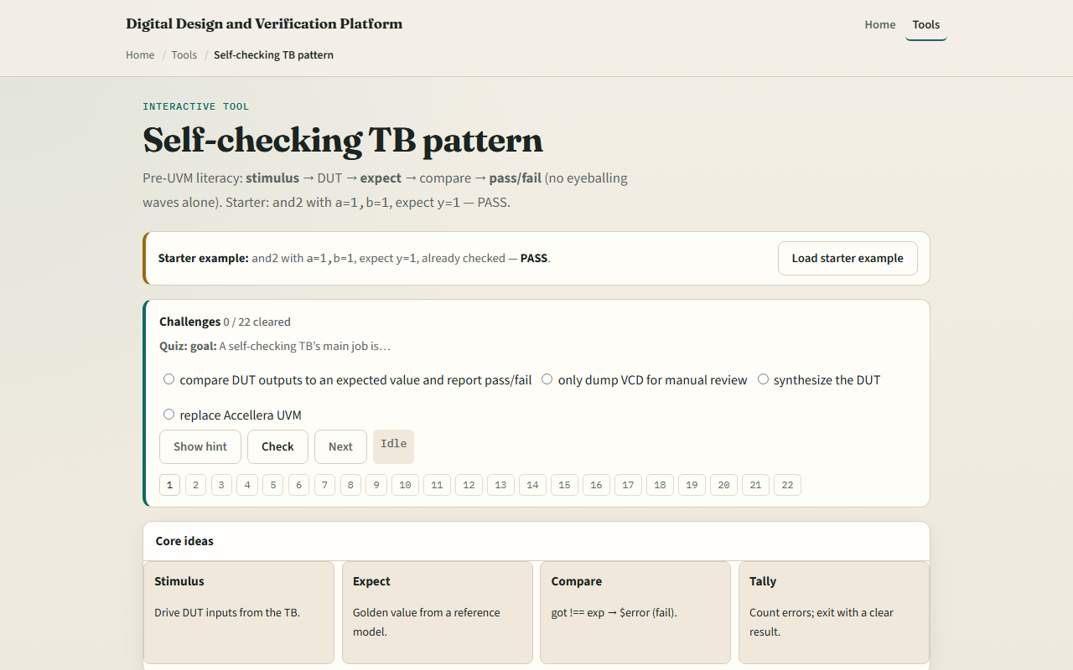
Browser lab
Browser lab starter
learn_cocotb — self check tb
Notes:
In the browser lab track, open the self-check TB sketch. You will see a challenge panel, stimulus fields, expect and got readouts, and a pass or fail verdict. Load the starter—AND gate, both inputs high, expect one, pass—then switch to the adder or mux preset and run check after you set a real reference expect. Work a few challenges and use Check when ready. Orient here; do not tour every button.

Slide 4
Real cocotb practice
In the real cocotb track, restate the loop on paper before you write a live assert
Draw four boxes: stimulus, reference model, DUT sample, compare
Write one cocotb-style check in pseudocode
Optional: open the lab’s source sketch and read the commented bench template
This module is compare literacy, the scoreboard queue comes from the same expect idea
learn_cocotb — self check tb
Notes:
In the real cocotb track, restate the loop on paper before you write a live assert. Draw four boxes: stimulus, reference model, DUT sample, compare. Write one cocotb-style check in pseudocode—poke inputs, await a cycle, assert output equals expected. Optional: open the lab’s source sketch and read the commented bench template. This module is compare literacy—the scoreboard queue comes from the same expect idea.

Slide 5
Pitfalls to watch
Do not treat no error as pass if you never compared anything
Do not echo the DUT output into expect, that hides bugs
A common miss is comparing before the simulator has settled after a poke
Another trap is only checking in waves
And remember
learn_cocotb — self check tb
Notes:
Do not treat no error as pass if you never compared anything. Do not echo the DUT output into expect—that hides bugs. A common miss is comparing before the simulator has settled after a poke. Another trap is only checking in waves; self-check means the log or exit status tells the story. And remember: the browser sketch is literacy; real fidelity is assert or scoreboard on live simulator handles.

Slide 6
Your turn
Complete the checklist for at least one track, preferably both
In the browser, load the starter and predict pass before you run check
On paper, write the four self-check steps for one input change on the AND gate
When you are ready
learn_cocotb — self check tb
Notes:
Complete the checklist for at least one track—preferably both. In the browser, load the starter and predict pass before you run check. On paper, write the four self-check steps for one input change on the AND gate. When you are ready, take the short quiz, then continue to waveform literacy in the next module.

