Slide 1
Reading waves
Waveforms plot each watched signal's value over simulation time
learn_cocotb — waveform lab
Notes:
Waveforms plot each watched signal's value over simulation time—not a substitute for self-check compares, but essential when cocotb assertions or scoreboards fail and you need to see why. Signal names match the elaborated design: clk, reset, data, q. Click the plot to set a cursor and read every visible signal at that instant. A rising clock edge is where clk goes zero to one—often where flip-flops sample. Multi-bit buses show value labels when bits change. X or Z means unknown or high-impedance, not a clean zero or one. This lab runs small in-browser waves from the HDL engine—not a full GTKWave or huge VCD workflow.

Slide 2
Starter D flip-flop
Starter preset
Watch clk, d, and q
Poke D equals one, then click posedge clk
Q rises on the wave at the clock edge
Before the edge you can poke D equals one while q still reads zero
Click inside the wave panel to move the cursor and confirm q at the cursor time
learn_cocotb — waveform lab
Notes:
Starter preset: D flip-flop with a forever hash-five clock—ten time units per full period, five high and five low. Watch clk, d, and q. Poke D equals one, then click posedge clk. q rises on the wave at the clock edge, not when d alone toggles mid-cycle—that is nonblocking update behavior. Before the edge you can poke D equals one while q still reads zero. Click inside the wave panel to move the cursor and confirm q at the cursor time. Uncheck d in the watch list to hide that row without deleting the net.

Slide 3
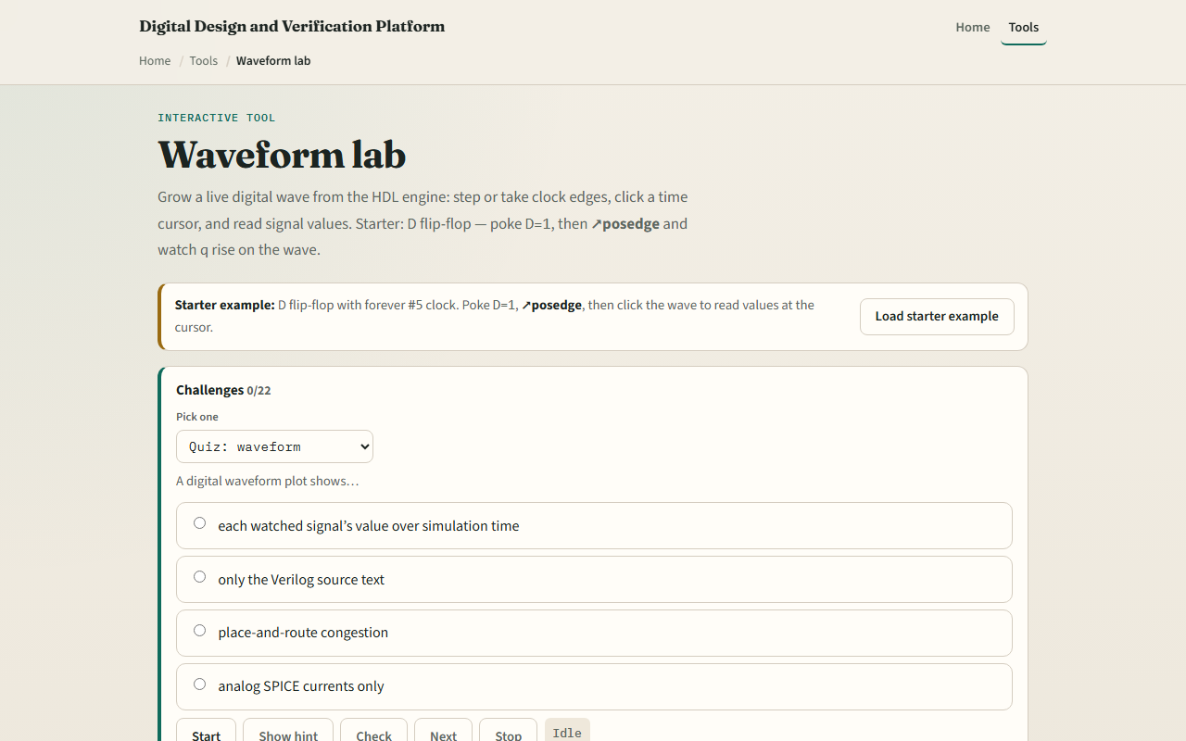
Browser lab
Waveform lab starter
learn_cocotb — waveform lab
Notes:
In the browser lab, load the starter example and read the source panel—the always at posedge block. Step advances simulation time; posedge clk jumps to the next rising edge. Try Register plus enable: with EN zero, q stays flat across edges. Counter shows a four-bit bus ribbon counting up. Two-stage pipeline makes q2 lag q1 by one clock—visible as offset transitions on the wave. Reset session clears time and edges. Challenges ask you to capture q equals one, set a cursor, and read values at the cursor.

Slide 4
Real cocotb practice
In the real cocotb track, sketch clk, d
Write why q updates at the edge, not when d changes alone
Optional: after a cocotb run that dumps waves
This lab teaches wave literacy
learn_cocotb — waveform lab
Notes:
In the real cocotb track, sketch clk, d, and q for one posedge where D was one before the edge. Write why q updates at the edge, not when d changes alone. Optional: after a cocotb run that dumps waves, open the file in your viewer and name three signals you would watch first when a self-check fails. This lab teaches wave literacy—the same signals reappear when you debug async tests and scoreboards later.

Slide 5
Pitfalls to watch
Do not treat eyeballing the wave as the pass criterion
Do not assume q follows d instantly, posedge sampling and NBA timing matter
A flat q with enable off is correct, not a broken sim
Bus labels are binary or hex, read width before comparing
And remember
learn_cocotb — waveform lab
Notes:
Do not treat eyeballing the wave as the pass criterion—that was module eight's self-check job. Do not assume q follows d instantly—posedge sampling and NBA timing matter. A flat q with enable off is correct, not a broken sim. Bus labels are binary or hex—read width before comparing. And remember: this browser engine is a teaching subset; huge traces still belong in GTKWave or your simulator's viewer offline.

Slide 6
Your turn
Complete the checklist for at least one track, preferably both
In the browser, load D-FF starter, poke D equals one, posedge clk until q equals one
On paper, draw one clk period and mark where q would update
When you are ready, take the short quiz, then continue to run a cocotb example offline
learn_cocotb — waveform lab
Notes:
Complete the checklist for at least one track—preferably both. In the browser, load D-FF starter, poke D equals one, posedge clk until q equals one, and click the wave to read q at the cursor. On paper, draw one clk period and mark where q would update. When you are ready, take the short quiz, then continue to run a cocotb example offline.

