Slide 1
cocotb path complete
Mapping cocotb onto UVM roles, then self-check patterns, wave literacy, and one offline cocotb run
learn_cocotb — wrap
Notes:
You have walked the cocotb path—from Python async testbench shape and triggers, through Clock helpers, DUT handles, BinaryValue, scoreboards, and mapping cocotb onto UVM roles, then self-check patterns, wave literacy, and one offline cocotb run. This short wrap names what you can do now and points you to learn pyuvm on the ladder.

Slide 2
What you can do now
You can sketch a Python async testbench and explain how awaits and triggers pace
Map cocotb pieces onto SystemVerilog UVM roles in your own words
You have run, or rehearsed, at least one real offline example with a simulator
That literacy is what pyuvm methodology and later protocol work expect
learn_cocotb — wrap
Notes:
You can sketch a Python async testbench and explain how awaits and triggers pace simulation time. You can drive and sample a DUT handle with width-aware BinaryValue, compare expected versus actual in a scoreboard mindset, and map cocotb pieces onto SystemVerilog UVM roles in your own words. You have run—or rehearsed—at least one real offline example with a simulator. That literacy is what pyuvm methodology and later protocol work expect.

Slide 3
Close the track gaps
If you mainly waited on browser labs, finish module ten offline, venv, make
Waveform reading
Either track works for self-study; both together stick best before you move on
Remember: browser tools are literacy sketches, not a substitute for a live cocotb run
learn_cocotb — wrap
Notes:
If you mainly waited on browser labs, finish module ten offline—venv, make, and a real pass or fail line—so cocotb feels like work you keep. If you mainly used the real shell, skim any skipped browser sketches for visual literacy on async shape, triggers, and waveform reading. Either track works for self-study; both together stick best before you move on. Remember: browser tools are literacy sketches, not a substitute for a live cocotb run.

Slide 4
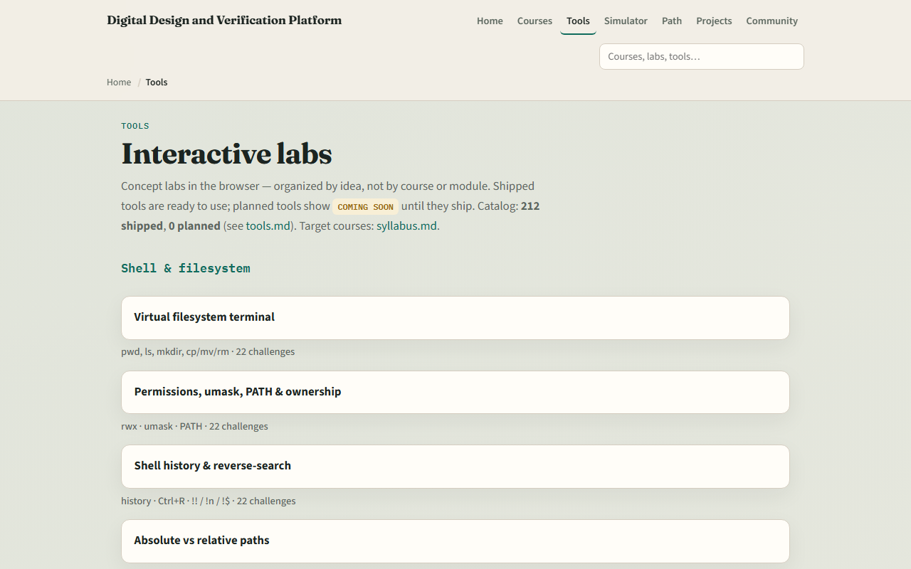
The tools you practiced
Here is the tools index again, the same shelf of Python async, cocotb
You do not need to re-clear every challenge
Use it as a map
learn_cocotb — wrap
Notes:
Here is the tools index again—the same shelf of Python async, cocotb, and shared verification sketches you opened along the way. You do not need to re-clear every challenge. Use it as a map: if a skill still feels shaky, jump back to that lab, then return here when you are ready for pyuvm phases, factory, and agents.

Slide 5
Next
Complete the quiz for this part
Multi-agent ideas, building on the cocotb habits you just finished
learn_cocotb — wrap
Notes:
Learn pyuvm continues the Python verification story with phases, factory, agents, ConfigDB, objections, and multi-agent ideas—building on the cocotb habits you just finished. Learn verification planning and management deepens coverage closure and sign-off. Protocol VIP courses apply the same bench and wave habits to UART, SPI, and I²C. When your wrap checklist feels honest, open learn pyuvm next—or keep practicing weak modules until async tests and DUT handles feel routine.

Slide 6
Your turn
Review the wrap checklist in the module README
Can say how cocotb fits before pyuvm methodology
When you are ready, take the short quiz, then open learn pyuvm on the syllabus
learn_cocotb — wrap
Notes:
Review the wrap checklist in the module README. Confirm you completed Track A for the modules you care about, ran at least one real cocotb example, and can say how cocotb fits before pyuvm methodology. When you are ready, take the short quiz, then open learn pyuvm on the syllabus.

