Slide 1
Welcome to digital foundations
Digital chips speak in bits, gates, clocks, and state
learn_digital — intro
Notes:
Digital chips speak in bits, gates, clocks, and state. Before you write Verilog, you need those ideas in your bones. This short clip welcomes you to learn digital—the foundations course—and shows how the two practice tracks work.

Slide 2
What you’ll build toward
Across the course you’ll move from numbers and encodings
You are not learning a hardware language yet
Coding in Verilog and SystemVerilog comes later
Here you learn the concepts those languages describe
learn_digital — intro
Notes:
Across the course you’ll move from numbers and encodings, through Boolean logic and gates, into clocks and state machines, then datapath and memory. You are not learning a hardware language yet. Coding in Verilog and SystemVerilog comes later. Here you learn the concepts those languages describe.

Slide 3
Two tracks, one idea
Every lab module offers two ways to practice
The workbook track is paper or notes
The browser lab track uses interactive tools on the learning platform for quick feedback
You may do either track, or both
A good rhythm is browser first for the idea, then a paper sketch to harden it
learn_digital — intro
Notes:
Every lab module offers two ways to practice. The workbook track is paper or notes: truth tables, encodings, timing sketches you can redo without a browser. The browser lab track uses interactive tools on the learning platform for quick feedback and visual intuition. You may do either track, or both. A good rhythm is browser first for the idea, then a paper sketch to harden it.

Slide 4
Set up the workbook track
Grab a notebook or tablet
That is the whole setup for the workbook track
When a module asks you to sketch a table or a timing diagram, do it by hand
Stretch reading in the older combined digital-and-Verilog materials is optional
learn_digital — intro
Notes:
Grab a notebook or tablet. That is the whole setup for the workbook track. When a module asks you to sketch a table or a timing diagram, do it by hand. Stretch reading in the older combined digital-and-Verilog materials is optional—not required for this path.

Slide 5
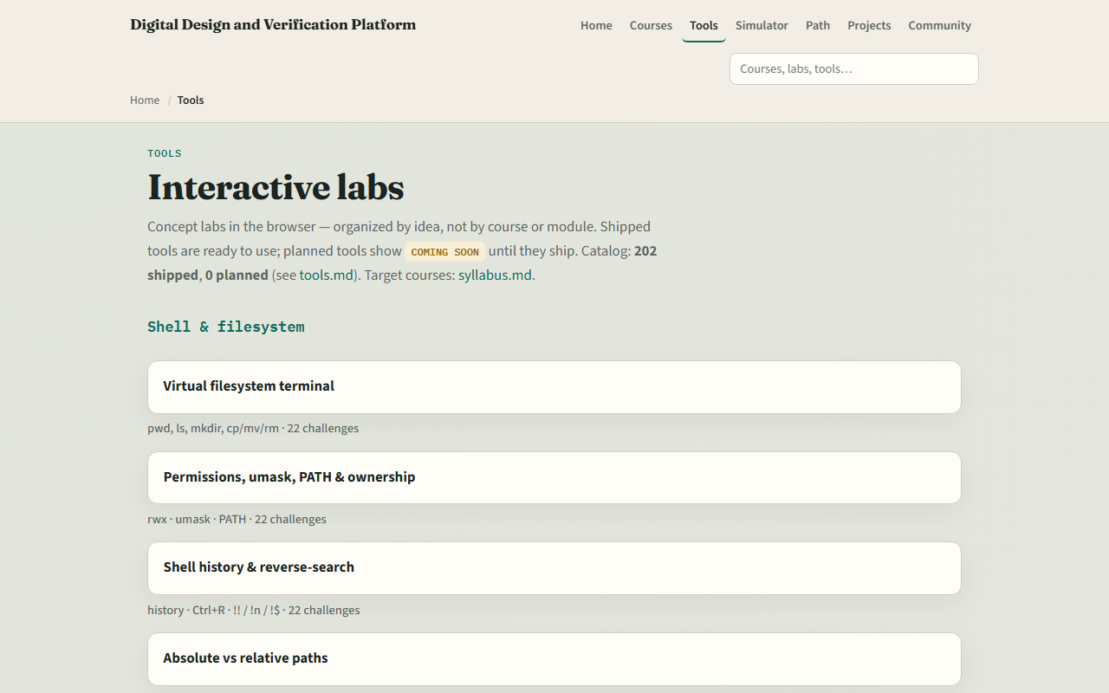
Set up the browser lab track
From the monorepo
That index is the map of interactive labs you’ll use later
If you prefer, use the published tools site instead
Confirm you can reach the tools page, the next module will send you into a specific lab
learn_digital — intro
Notes:
From the monorepo, serve the platform folder with a simple local web server, then open the tools index in your browser. That index is the map of interactive labs you’ll use later. If you prefer, use the published tools site instead. Either way, confirm you can reach the tools page—the next module will send you into a specific lab.

Slide 6
How to move through modules
For each module
When you finish this intro checklist, continue to the first lab
learn_digital — intro
Notes:
For each module, read the README for the outcome, pick a track—or both—then work the checklist. When you finish this intro checklist, continue to the first lab: radix and bit width, where number bases become something you can convert with confidence.

