Slide 1
Two’s complement
Unsigned numbers only go one way
learn_digital — twos complement
Notes:
Unsigned numbers only go one way. Hardware also needs negative values in the same bit box. Two’s complement is the usual signed encoding: the most significant bit is the sign, and addition still works with ordinary binary adders. This module makes that encoding tangible—in the browser, then on paper.

Slide 2
Sign bit, negate, range
At a fixed width, the top bit is the sign
All ones is minus one
To negate, invert every bit and add one
The range is not symmetric
That asymmetric floor is easy to forget when you “just add one more.”
learn_digital — twos complement
Notes:
At a fixed width, the top bit is the sign. All ones is minus one. To negate, invert every bit and add one. The range is not symmetric: at width eight you get minus one hundred twenty-eight through plus one hundred twenty-seven. That asymmetric floor is easy to forget when you “just add one more.”

Slide 3
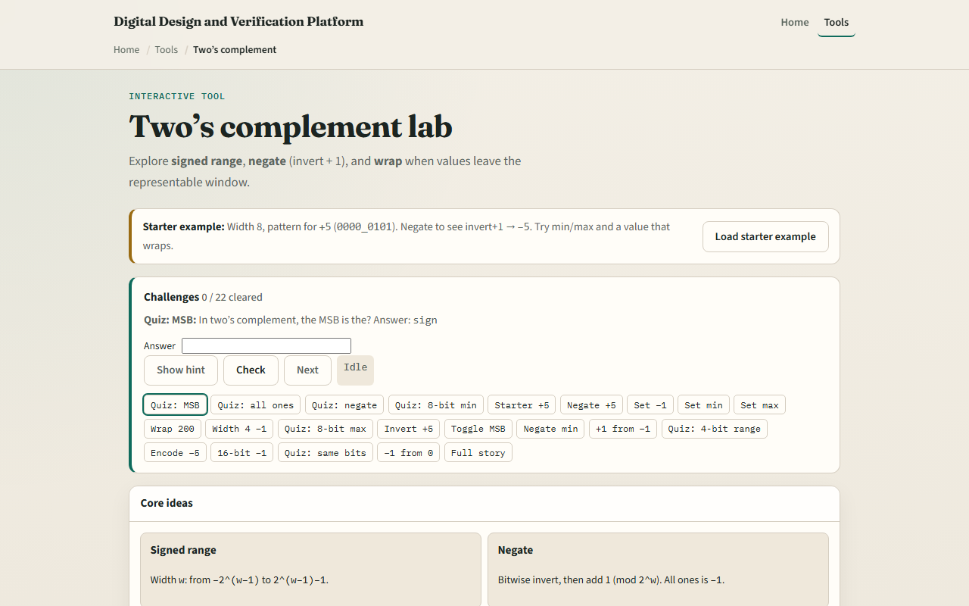
Browser lab
Two’s complement starter
learn_digital — twos complement
Notes:
In the browser lab, look at three pieces: the challenge panel, the bit pattern, and the signed value controls. Load the starter—you should see plus five—then try Negate and watch the bits become minus five. Use Check when a challenge looks done. Explore a few challenges; you do not need a full UI tour here.

Slide 4
Workbook practice
In the workbook track, write width eight on paper
Start from plus five: bits ending in zero one zero one
Negate by hand, invert, then add one, and confirm you land on minus five
Then write the signed meanings of all ones, the minimum pattern with only the sign bit set
Name one RTL pitfall: treating a signed wire as unsigned, or forgetting the asymmetric min
learn_digital — twos complement
Notes:
In the workbook track, write width eight on paper. Start from plus five: bits ending in zero one zero one. Negate by hand—invert, then add one—and confirm you land on minus five. Then write the signed meanings of all ones, the minimum pattern with only the sign bit set, and the maximum with the sign clear and the rest ones. Name one RTL pitfall: treating a signed wire as unsigned, or forgetting the asymmetric min.

Slide 5
Pitfalls to watch
Do not read the most significant bit as “just another magnitude bit” when the type is
Do not expect plus one hundred twenty-eight to fit in eight-bit two’s complement, it wraps
And remember: the browser lab is literacy
Waveforms and RTL still demand the same signed-versus-unsigned discipline
learn_digital — twos complement
Notes:
Do not read the most significant bit as “just another magnitude bit” when the type is signed. Do not expect plus one hundred twenty-eight to fit in eight-bit two’s complement—it wraps. And remember: the browser lab is literacy. Waveforms and RTL still demand the same signed-versus-unsigned discipline.

Slide 6
Your turn
Complete the checklist for at least one track, preferably both
In the browser, finish a few challenges after the starter
On paper, negate one value by hand and list min, max, and minus one for one width
When you are ready, take the short quiz, then continue to overflow and wrap
learn_digital — twos complement
Notes:
Complete the checklist for at least one track—preferably both. In the browser, finish a few challenges after the starter. On paper, negate one value by hand and list min, max, and minus one for one width. When you are ready, take the short quiz, then continue to overflow and wrap.

