Slide 1
Endian packing
The same integer can sit in memory two ways
learn_digital — endian lab
Notes:
The same integer can sit in memory two ways. Little-endian puts the LSB at the lowest address; big-endian puts the MSB there. Network byte order is usually big-endian. Endianness does not change the integer value—it changes how bytes are laid out in RAM. This module makes pack and unpack concrete.

Slide 2
Unpack, pack, swap
Unpack splits a word into bytes in address order for the chosen mode
Pack builds the word from bytes at plus zero through plus three
Byte-swap reverses the four bytes in the word
Compare LE versus BE when you want the side-by-side picture
BE puts one-two first
learn_digital — endian lab
Notes:
Unpack splits a word into bytes in address order for the chosen mode. Pack builds the word from bytes at plus zero through plus three. Byte-swap reverses the four bytes in the word. Compare LE versus BE when you want the side-by-side picture. For hex one-two-three-four-five-six-seven-eight, LE bytes at plus zero are seven-eight five-six three-four one-two; BE puts one-two first.

Slide 3
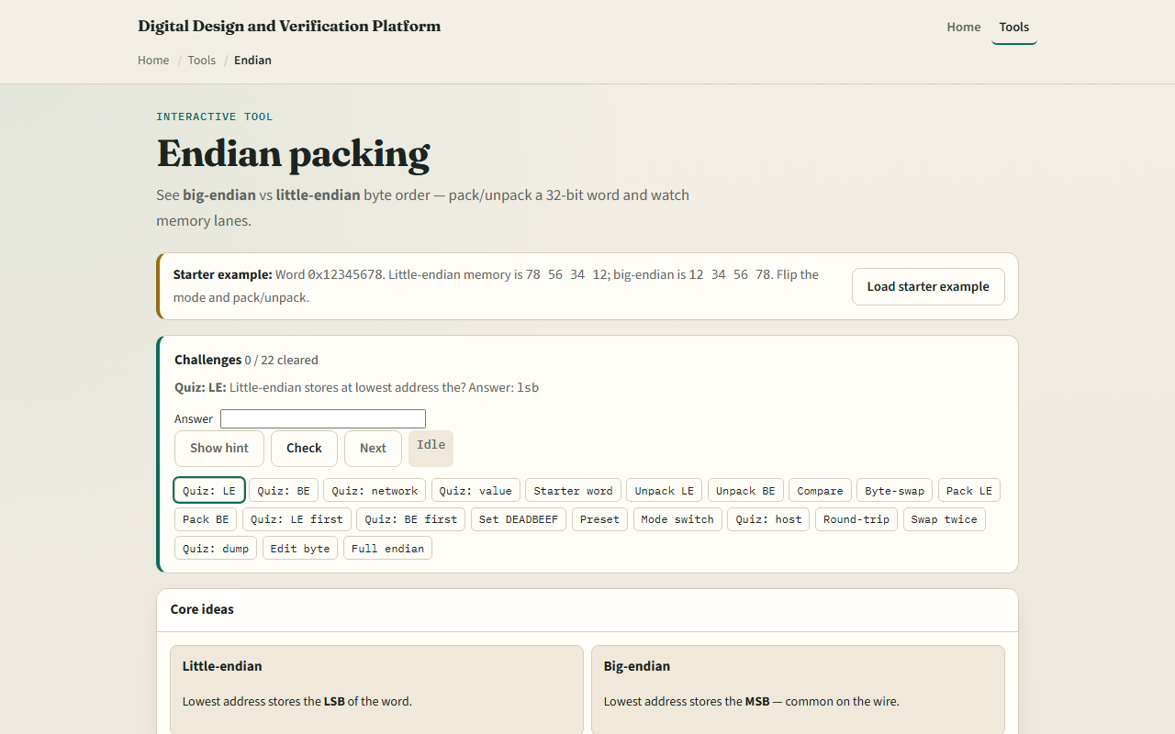
Browser lab
Endian lab starter
learn_digital — endian lab
Notes:
In the browser lab, look at three pieces: the challenge panel, the word and byte-at-address views, and Unpack, Pack, or Swap controls. Load the starter word hex one-two-three-four-five-six-seven-eight. Unpack in little-endian and confirm bytes seven-eight five-six three-four one-two. Switch to big-endian and compare layouts. Try pack from memory bytes or byte-swap to hex seven-eight-five-six-three-four-one-two. Use Check when a challenge looks done.

Slide 4
Workbook practice
In the workbook track, take word one-two-three-four-five-six-seven-eight
Write LE and BE byte order at addresses plus zero through plus three
Pack LE bytes A-A B-B C-C D-D and check you get D-D C-C B-B A-A
Note one pitfall: assuming host endian always matches the wire or the spec
learn_digital — endian lab
Notes:
In the workbook track, take word one-two-three-four-five-six-seven-eight. Write LE and BE byte order at addresses plus zero through plus three. Pack LE bytes A-A B-B C-C D-D and check you get D-D C-C B-B A-A. Note one pitfall: assuming host endian always matches the wire or the spec.

Slide 5
Pitfalls to watch
Do not confuse byte order with bit order inside a byte
Mixing LE and BE across a bus without conversion corrupts multi-byte fields
And remember: the browser lab is literacy
Real SoCs still need explicit endian policy on DMA, registers, and network frames
learn_digital — endian lab
Notes:
Do not confuse byte order with bit order inside a byte. Mixing LE and BE across a bus without conversion corrupts multi-byte fields. And remember: the browser lab is literacy. Real SoCs still need explicit endian policy on DMA, registers, and network frames.

Slide 6
Your turn
Complete the checklist for at least one track, preferably both
In the browser, finish a few challenges after the starter
On paper, unpack one word both ways and pack one byte sequence
When you are ready, take the short quiz, then continue to truth tables
learn_digital — endian lab
Notes:
Complete the checklist for at least one track—preferably both. In the browser, finish a few challenges after the starter. On paper, unpack one word both ways and pack one byte sequence. When you are ready, take the short quiz, then continue to truth tables.

