Slide 1
Truth tables
A truth table lists every input combination and the output F
learn_digital — truth table
Notes:
A truth table lists every input combination and the output F. Two inputs give four rows; three inputs give eight. It is the ground truth for gates, muxes, and adder bits before you write HDL. This module makes fill, check, and read a table concrete.

Slide 2
Every row, one function
Each row is one minterm index from all zeros through all ones
AND is one only when every input is one
OR is one when any input is one
XOR is one when inputs differ
Challenges in the lab ask you to match a described function
Edit F in the table or the expression; both can stay in sync
learn_digital — truth table
Notes:
Each row is one minterm index from all zeros through all ones. AND is one only when every input is one. OR is one when any input is one. XOR is one when inputs differ. Challenges in the lab ask you to match a described function—majority, parity, mux select, full-adder sum. Edit F in the table or the expression; both can stay in sync.

Slide 3
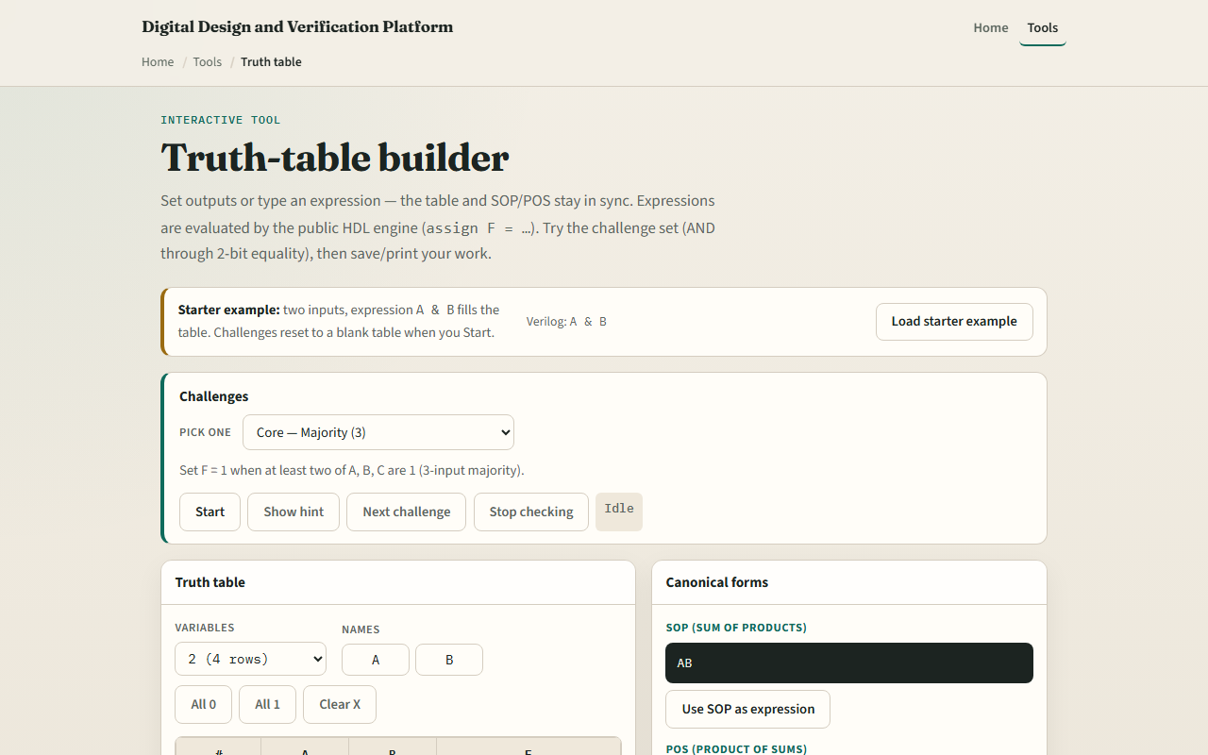
Browser lab
Truth table starter
learn_digital — truth table
Notes:
In the browser lab, look at three pieces: the challenge panel, the input and F columns, and expression or fill controls. Load the starter for F equals A and B on two variables. Step through the four rows and confirm F is one only on the one-one row. Pick a challenge, fill the table or edit the expression, then Check. Export SOP or POS when you want the sum-of-products picture. Explore a few; no full tour needed.

Slide 4
Workbook practice
In the workbook track, build a two-input AND and XOR table by hand
Add a three-input majority row set
Say how many rows you need for four variables
Name one pitfall
learn_digital — truth table
Notes:
In the workbook track, build a two-input AND and XOR table by hand. Add a three-input majority row set. Say how many rows you need for four variables. Name one pitfall: stopping at three rows when you have three inputs—that misses half the table.

Slide 5
Pitfalls to watch
Do not skip rows or duplicate an index
X in a cell means don’t-care, not “pick any answer.” And remember
Real verification still needs exhaustive or constrained cases beyond one hand table
learn_digital — truth table
Notes:
Do not skip rows or duplicate an index. X in a cell means don’t-care, not “pick any answer.” And remember: the browser lab is literacy. Real verification still needs exhaustive or constrained cases beyond one hand table.

Slide 6
Your turn
Complete the checklist for at least one track, preferably both
In the browser, finish a few challenges after the starter
On paper, write one full table and circle the minterms where F is one
When you are ready, take the short quiz, then continue to Boolean laws
learn_digital — truth table
Notes:
Complete the checklist for at least one track—preferably both. In the browser, finish a few challenges after the starter. On paper, write one full table and circle the minterms where F is one. When you are ready, take the short quiz, then continue to Boolean laws.

