Slide 1
Boolean laws
Algebra lets you simplify logic before you draw gates
learn_digital — boolean laws
Notes:
Algebra lets you simplify logic before you draw gates. De Morgan swaps negation over AND and OR. Absorption drops redundant terms. Complement says A plus not-A is one. This module makes step-by-step rewrites concrete—not just names on a cheat sheet.

Slide 2
Rewrite with a reason
Each click should name the law: not of A and B becomes not-A or not-B
A plus A-and-B collapses to A
A and not-A is zero
Double negation peels to A
Factor A-and-B plus A-and-C into A-and the sum of B and C
The history list shows your proof chain; Undo when a step goes wrong
learn_digital — boolean laws
Notes:
Each click should name the law: not of A and B becomes not-A or not-B. A plus A-and-B collapses to A. A and not-A is zero. Double negation peels to A. Factor A-and-B plus A-and-C into A-and the sum of B and C. The history list shows your proof chain; Undo when a step goes wrong.

Slide 3
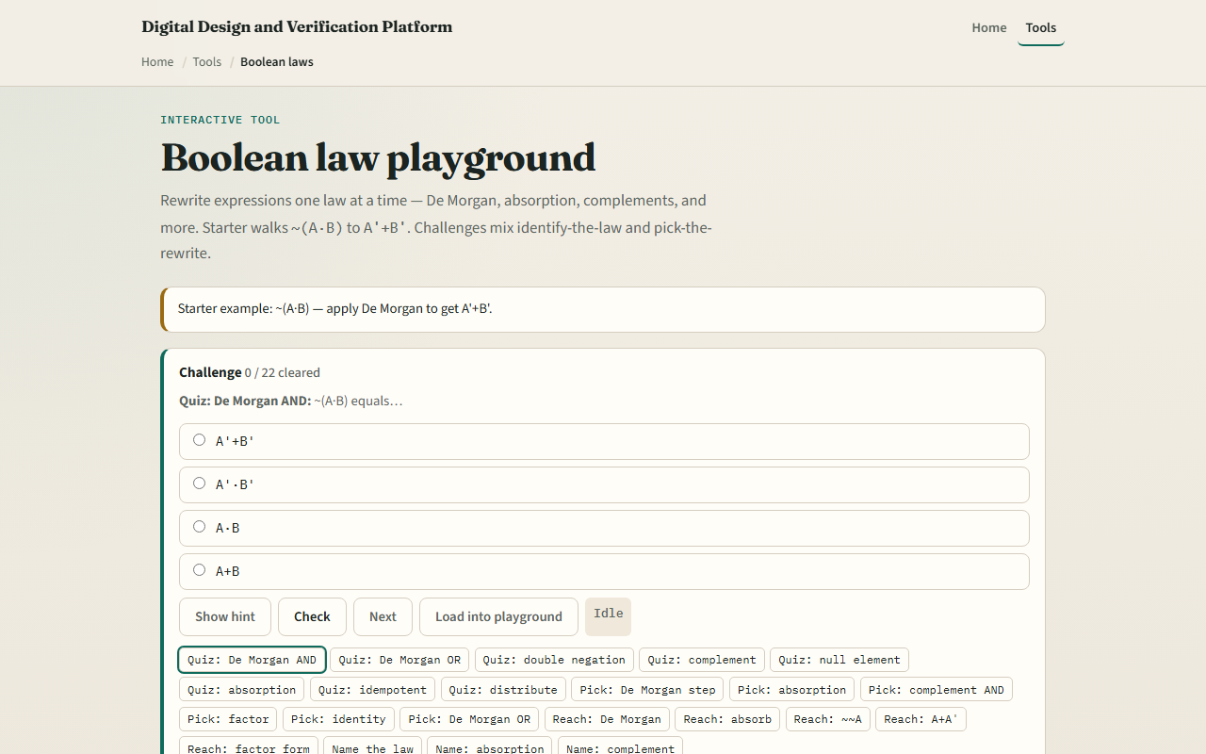
Browser lab
Boolean laws starter
learn_digital — boolean laws
Notes:
In the browser lab, look at three pieces: the challenge panel, the expression stage with rewrite buttons, and the law reference chips. Load the starter for not of A and B. Apply De Morgan until you reach not-A or not-B. Try absorption, complement, and factor challenges from the catalog. Use Check when a challenge looks done.

Slide 4
Workbook practice
In the workbook track, simplify not of A or B by De Morgan
Collapse A plus A-and-B to A
Show A-and-not-A is zero and A-or-not-A is one
Factor A-B plus A-C by hand
Name one pitfall: distributing a NOT only over part of a term
learn_digital — boolean laws
Notes:
In the workbook track, simplify not of A or B by De Morgan. Collapse A plus A-and-B to A. Show A-and-not-A is zero and A-or-not-A is one. Factor A-B plus A-C by hand. Name one pitfall: distributing a NOT only over part of a term.

Slide 5
Pitfalls to watch
Do not treat AND and OR as ordinary arithmetic, De Morgan flips both operator and negation
Skipping steps can hide an illegal rewrite
And remember: the browser lab is literacy
Real synthesis still needs consistent don't-care and timing context
learn_digital — boolean laws
Notes:
Do not treat AND and OR as ordinary arithmetic—De Morgan flips both operator and negation. Skipping steps can hide an illegal rewrite. And remember: the browser lab is literacy. Real synthesis still needs consistent don't-care and timing context.

Slide 6
Your turn
Complete the checklist for at least one track, preferably both
In the browser, finish a few challenges after the starter
On paper, do two rewrites with the law named beside each step
When you are ready, take the short quiz, then continue to K-maps
learn_digital — boolean laws
Notes:
Complete the checklist for at least one track—preferably both. In the browser, finish a few challenges after the starter. On paper, do two rewrites with the law named beside each step. When you are ready, take the short quiz, then continue to K-maps.

