Slide 1
SOP and POS
Sum-of-products ORs minterms where F is one
learn_digital — sop pos
Notes:
Sum-of-products ORs minterms where F is one. Product-of-sums ANDs maxterms where F is zero. Same function, two canonical views—dual of each other. Sigma-m lists minterm indices; pi-M lists maxterm indices. This module makes derive, compare, and read both forms concrete.

Slide 2
Minterms and maxterms
A minterm is a product true on exactly one row, like A-prime B for m zero on two variables
A maxterm is a sum false on exactly one row, like A plus B for M zero
Canonical SOP lists every one row; canonical POS lists every zero row
That full form is not always minimal, you still simplify with grouping or laws
learn_digital — sop pos
Notes:
A minterm is a product true on exactly one row—like A-prime B for m zero on two variables. A maxterm is a sum false on exactly one row—like A plus B for M zero. Canonical SOP lists every one row; canonical POS lists every zero row. That full form is not always minimal—you still simplify with grouping or laws.

Slide 3
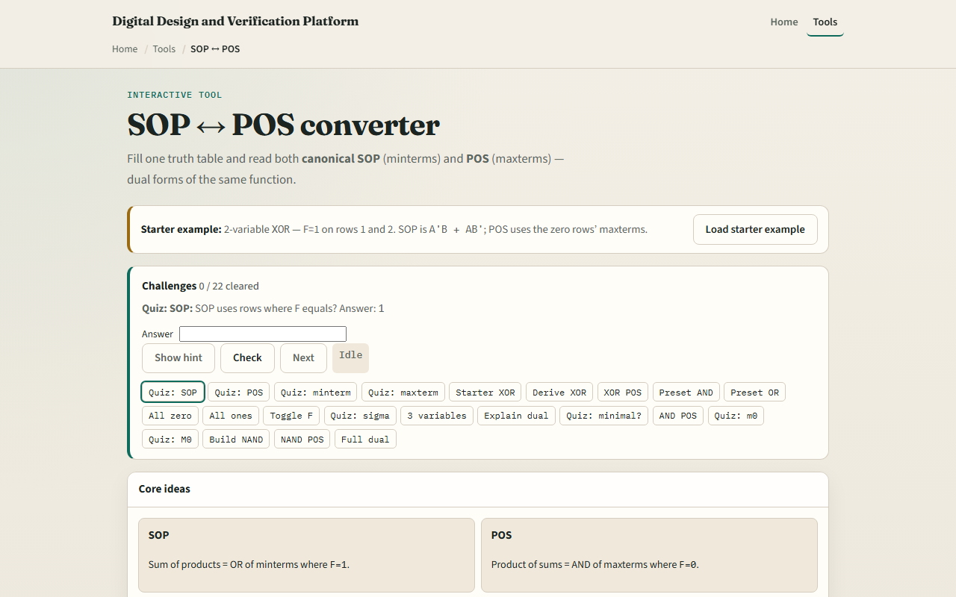
Browser lab
SOP POS starter
learn_digital — sop pos
Notes:
In the browser lab, look at three pieces: the challenge panel, the F column and derived SOP or POS, and Derive or Explain controls. Load the starter XOR—F is one on rows one and two. Derive SOP and POS and check POS includes M zero and M three. Try preset AND or OR, or switch to three variables. Use Check when a challenge looks done.

Slide 4
Workbook practice
In the workbook track, take two-variable XOR
Write canonical SOP from rows one and two, and POS from rows zero and three
For AND, note only m three is one
For all zeros, SOP is zero; for all ones, both forms collapse to one
Name one pitfall: assuming canonical SOP is already minimal
learn_digital — sop pos
Notes:
In the workbook track, take two-variable XOR. Write canonical SOP from rows one and two, and POS from rows zero and three. For AND, note only m three is one. For all zeros, SOP is zero; for all ones, both forms collapse to one. Name one pitfall: assuming canonical SOP is already minimal.

Slide 5
Pitfalls to watch
Do not mix SOP and POS rules, SOP uses F equals one, POS uses F equals zero
Minterm m zero and maxterm M zero are different shapes
And remember: the browser lab is literacy
Real synthesis picks the form that fits your gate library and timing
learn_digital — sop pos
Notes:
Do not mix SOP and POS rules—SOP uses F equals one, POS uses F equals zero. Minterm m zero and maxterm M zero are different shapes. And remember: the browser lab is literacy. Real synthesis picks the form that fits your gate library and timing.

Slide 6
Your turn
Complete the checklist for at least one track, preferably both
In the browser, finish a few challenges after the starter
On paper, write SOP and POS for one small table
When you are ready, take the short quiz, then continue to don’t-care minimization
learn_digital — sop pos
Notes:
Complete the checklist for at least one track—preferably both. In the browser, finish a few challenges after the starter. On paper, write SOP and POS for one small table. When you are ready, take the short quiz, then continue to don’t-care minimization.

