Slide 1
Don’t-care minimization
Some input combinations never happen, or the output does not matter when they do
learn_digital — dont care lab
Notes:
Some input combinations never happen—or the output does not matter when they do. Mark them X in the table. Minimize over ones you must cover; treat X as zero or one if it helps. That can drop literals and terms compared to ignoring X. This module makes with-X versus without-X covers concrete.

Slide 2
ON, OFF, and optional
Every product term must cover all ON minterms
Cubes must never include an OFF row
Don’t-care rows are optional, you choose zero or one to enlarge groups
Sigma-m with d lists minterms and don’t-cares
Compare covers side by side to see the shrink
learn_digital — dont care lab
Notes:
Every product term must cover all ON minterms. Cubes must never include an OFF row. Don’t-care rows are optional—you choose zero or one to enlarge groups. Sigma-m with d lists minterms and don’t-cares. Compare covers side by side to see the shrink.

Slide 3
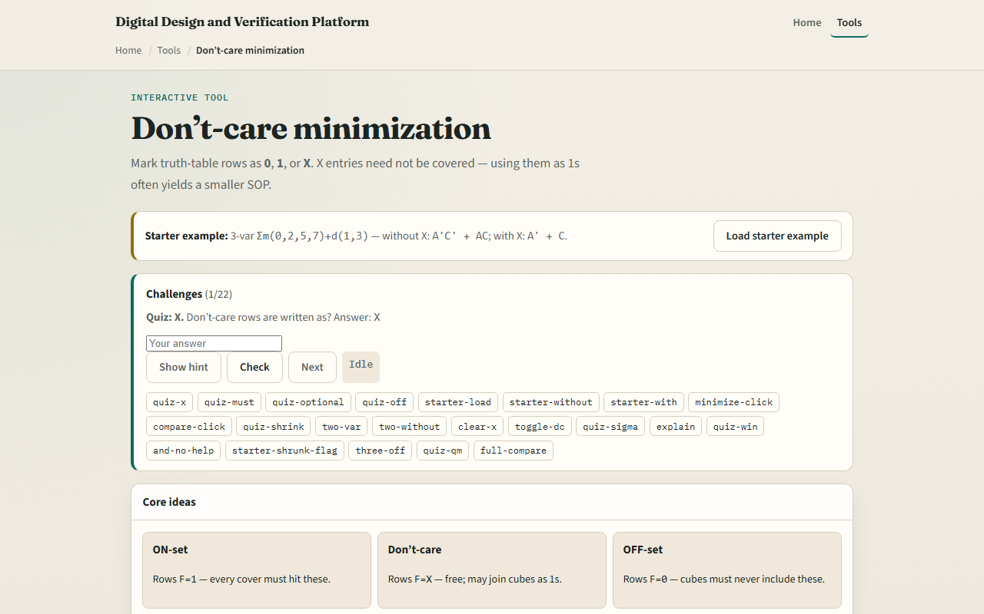
Browser lab
Don’t-care lab starter
learn_digital — dont care lab
Notes:
In the browser lab, look at three pieces: the challenge panel, the F column with blue X cells, and Minimize or Compare controls. Load the starter—ON at zero, two, five, and seven, X at one and three. Minimize with X and check you get A-prime plus C. Compare with and without X to see A-prime C-prime plus AC shrink to two terms. Use Check when a challenge looks done.

Slide 4
Workbook practice
In the workbook track, take the starter pattern by hand
Write the ignore-X SOP, then regroup using X at one and three
Confirm the with-X form has fewer terms
Try a two-variable preset with one ON and one X
Name one pitfall: treating X as OFF by default and missing a smaller cover
learn_digital — dont care lab
Notes:
In the workbook track, take the starter pattern by hand. Write the ignore-X SOP, then regroup using X at one and three. Confirm the with-X form has fewer terms. Try a two-variable preset with one ON and one X. Name one pitfall: treating X as OFF by default and missing a smaller cover.

Slide 5
Pitfalls to watch
Do not let a group cover an OFF row
X is not “don’t optimize”, it is “pick whichever helps.” And remember
Real designs still need a spec for what is truly unreachable versus merely unused
learn_digital — dont care lab
Notes:
Do not let a group cover an OFF row. X is not “don’t optimize”—it is “pick whichever helps.” And remember: the browser lab is literacy. Real designs still need a spec for what is truly unreachable versus merely unused.

Slide 6
Your turn
Complete the checklist for at least one track, preferably both
In the browser, finish a few challenges after the starter
On paper, minimize one small table with at least one X
When you are ready, take the short quiz, then continue to logic hazards
learn_digital — dont care lab
Notes:
Complete the checklist for at least one track—preferably both. In the browser, finish a few challenges after the starter. On paper, minimize one small table with at least one X. When you are ready, take the short quiz, then continue to logic hazards.

