Slide 1
Logic hazards
Combinational logic can glitch when inputs change
learn_digital — logic hazards
Notes:
Combinational logic can glitch when inputs change. A static-one hazard dips to zero while the function should stay one. A static-zero hazard spikes high while output should stay zero. Dynamic hazards add extra transitions. This module makes run, see, and cover hazards concrete.

Slide 2
One input moves, paths differ
Hazard analysis usually changes one input at a time
Different path delays let one SOP term drop before another picks up
A consensus term that bridges adjacent cubes, like B C here, can cover the gap
Equal delays can hide the glitch in simulation but not in silicon
learn_digital — logic hazards
Notes:
Hazard analysis usually changes one input at a time. Different path delays let one SOP term drop before another picks up—classic static-one on A B plus A-prime C when A falls with B and C held at one. A consensus term that bridges adjacent cubes—like B C here—can cover the gap. Equal delays can hide the glitch in simulation but not in silicon.

Slide 3
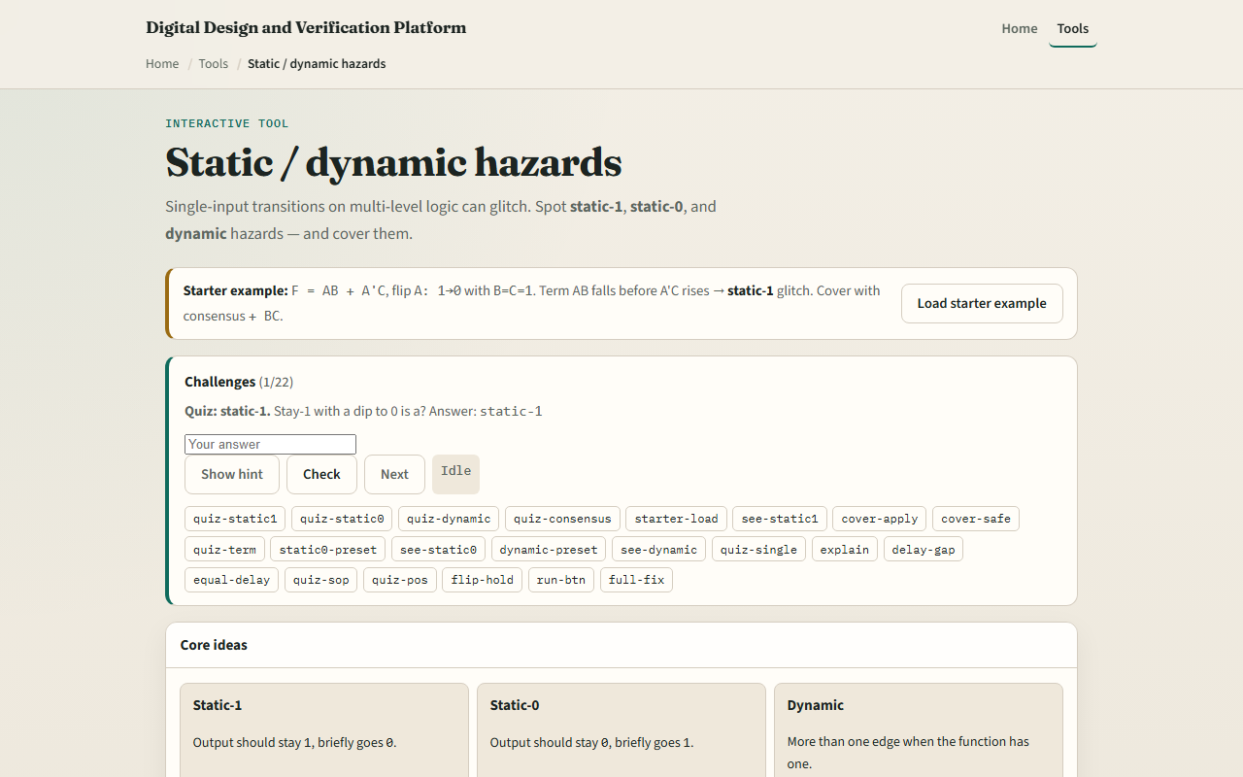
Browser lab
Logic hazards starter
learn_digital — logic hazards
Notes:
In the browser lab, look at three pieces: the challenge panel, the circuit and timing trace, and Run or Apply cover controls. Load the starter for A B plus A-prime C with A going one to zero and B equals C equals one. Run the transition and watch a static-one verdict. Apply consensus cover with B C and rerun for a safe steady one. Try static-zero and dynamic presets too. Use Check when a challenge looks done.

Slide 4
Workbook practice
In the workbook track
Write the consensus term B C by hand
Name static-one versus static-zero from the dip or spike direction
Note one pitfall: assuming equal gate delays means no hazard in real hardware
learn_digital — logic hazards
Notes:
In the workbook track, sketch why A B and A-prime C both cover ABC when A is one, but only B C holds when A is zero. Write the consensus term B C by hand. Name static-one versus static-zero from the dip or spike direction. Note one pitfall: assuming equal gate delays means no hazard in real hardware.

Slide 5
Pitfalls to watch
Do not confuse a hazard with wrong logic
Cover terms must actually bridge the risky transition
And remember: the browser lab is literacy
Real designs still need timing analysis
learn_digital — logic hazards
Notes:
Do not confuse a hazard with wrong logic—the truth table can be correct while timing glitches. Cover terms must actually bridge the risky transition. And remember: the browser lab is literacy. Real designs still need timing analysis, registers, or hazard-free encodings where glitches matter.

Slide 6
Your turn
Complete the checklist for at least one track, preferably both
In the browser, finish a few challenges after the starter
On paper, identify one static hazard and one consensus fix
When you are ready, take the short quiz, then continue to gate composer
learn_digital — logic hazards
Notes:
Complete the checklist for at least one track—preferably both. In the browser, finish a few challenges after the starter. On paper, identify one static hazard and one consensus fix. When you are ready, take the short quiz, then continue to gate composer.

