Slide 1
Tri-state / bus
A shared bus lets several drivers connect to one wire, but only one should drive at a time
learn_digital — tri state bus
Notes:
A shared bus lets several drivers connect to one wire—but only one should drive at a time. With enable off, the driver is high-Z, disconnected from the net. With enable on, it drives zero or one. No active driver means float Z, unless a pull-up or pull-down resistor defines idle level. Two enabled drivers with different data fight and the bus reads X. This module makes resolution rules concrete.

Slide 2
Enable, float, fight
Starter case: driver A enabled with data one, B and C off, the bus is one
Turn all enables off with no pull and the bus is Z
Enable B with zero while A still drives one and you get contention X
Two drivers on the same value may still show that bit
Safe protocol: exactly one enable high, often one-hot output-enable in real designs
learn_digital — tri state bus
Notes:
Starter case: driver A enabled with data one, B and C off—the bus is one. Turn all enables off with no pull and the bus is Z. Enable B with zero while A still drives one and you get contention X. Two drivers on the same value may still show that bit, but overlapping enables is unsafe practice. Safe protocol: exactly one enable high—often one-hot output-enable in real designs.

Slide 3
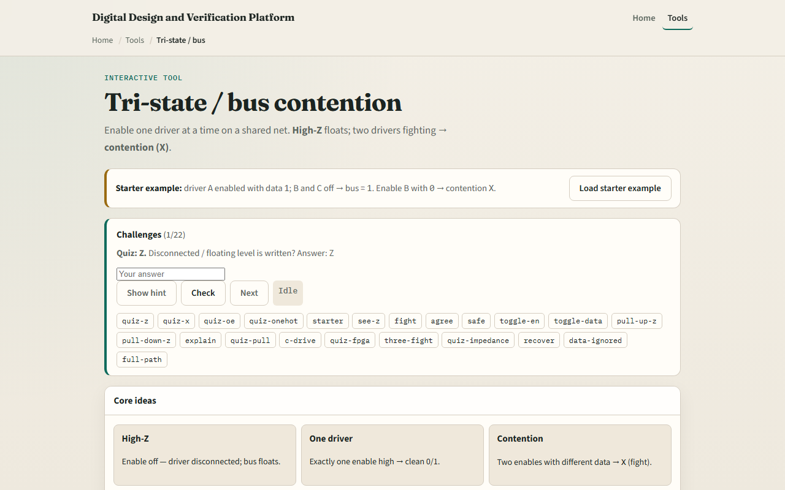
Browser lab
Tri-state bus starter
learn_digital — tri state bus
Notes:
In the browser lab, look at three pieces: the challenge panel, the driver toggles and bus readout, and the schematic. Load the starter—only A drives one, bus equals one. Try all off for Z, force contention, or set pull-up on a float. Hit Explain resolution to see the verdict trace. Use Check when a challenge looks done.

Slide 4
Workbook practice
In the workbook track, fill a small table
Sketch three tri-state buffers on one bus line with enable pins
With all enables low and pull-up on, what is the bus?
Name one pitfall: enabling two drivers at once on an external bus
learn_digital — tri state bus
Notes:
In the workbook track, fill a small table: all off, one driver on, two drivers agree, two drivers fight. Sketch three tri-state buffers on one bus line with enable pins. With all enables low and pull-up on, what is the bus? Name one pitfall: enabling two drivers at once on an external bus.

Slide 5
Pitfalls to watch
Do not treat multi-drive same value as safe, it still violates one-driver discipline
Internal FPGA fabrics often prefer muxes over tri-state
And remember: the browser lab is literacy
Real boards still need OE timing, bus holders, and protocol rules beyond this toy resolver
learn_digital — tri state bus
Notes:
Do not treat multi-drive same value as safe—it still violates one-driver discipline. Internal FPGA fabrics often prefer muxes over tri-state. And remember: the browser lab is literacy. Real boards still need OE timing, bus holders, and protocol rules beyond this toy resolver.

Slide 6
Your turn
Complete the checklist for at least one track, preferably both
In the browser, finish a few challenges after the starter
On paper, draw one bus with two drivers and label Z and X cases
When you are ready, take the short quiz, then continue to barrel shifter
learn_digital — tri state bus
Notes:
Complete the checklist for at least one track—preferably both. In the browser, finish a few challenges after the starter. On paper, draw one bus with two drivers and label Z and X cases. When you are ready, take the short quiz, then continue to barrel shifter.

