Slide 1
Seven-segment
A seven-segment display turns a four-bit nibble into a glyph, zero through nine and A through F
learn_digital — seven segment
Notes:
A seven-segment display turns a four-bit nibble into a glyph—zero through nine and A through F. Seven lines labeled a through g form the digit; a decoder maps the nibble to which segments light. Common-cathode parts treat one as segment on; common-anode parts invert the whole bus. This module makes nibble decode and polarity concrete.

Slide 2
Segments, patterns, polarity
Starter nibble A in common cathode drives one-one-one-zero-one-one-one
Digit eight lights all seven; digit one lights only b and c on the right
Digit zero turns g off in the middle
Flip to common anode and the same glyph needs the bitwise complement on the drive bus
The decoder is a lookup table, ROM or case statement in RTL, not seven unrelated wires
learn_digital — seven segment
Notes:
Starter nibble A in common cathode drives one-one-one-zero-one-one-one—every segment on except d. Digit eight lights all seven; digit one lights only b and c on the right. Digit zero turns g off in the middle. Flip to common anode and the same glyph needs the bitwise complement on the drive bus. The decoder is a lookup table—ROM or case statement in RTL—not seven unrelated wires.

Slide 3
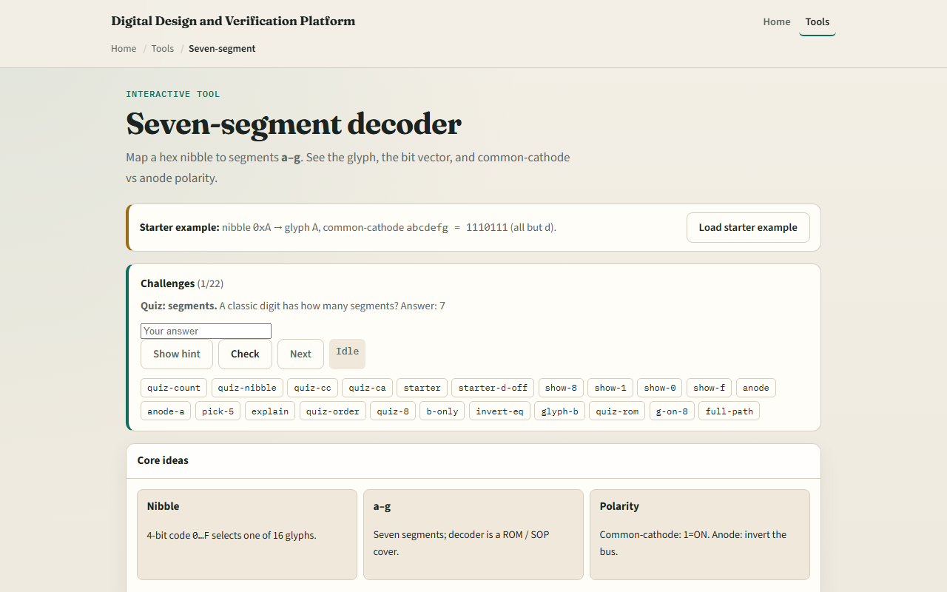
Browser lab
Seven segment starter
learn_digital — seven segment
Notes:
In the browser lab, look at three pieces: the challenge panel, the segment display and nibble picker, and the abcdefg drive readout. Load the starter—nibble A, common cathode, pattern one-one-one-zero-one-one-one. Try digits zero, one, and eight, then flip to common anode. Use Check when a challenge looks done.

Slide 4
Workbook practice
In the workbook track
Write the common-cathode pattern for F
For nibble A on common anode, give the inverted drive string
Name one pitfall
learn_digital — seven segment
Notes:
In the workbook track, sketch segment layout a through g and label which segments form digit two. Write the common-cathode pattern for F. For nibble A on common anode, give the inverted drive string. Name one pitfall: wiring common cathode patterns into a common-anode board without inversion.

Slide 5
Pitfalls to watch
Do not scramble segment order, this lab uses abcdefg as the bit string
Mixed-case hex letters are for readability, not arbitrary encoding
And remember: the browser lab is literacy
Real displays still need current limiting, multiplexing
learn_digital — seven segment
Notes:
Do not scramble segment order—this lab uses abcdefg as the bit string. Mixed-case hex letters are for readability, not arbitrary encoding. And remember: the browser lab is literacy. Real displays still need current limiting, multiplexing, and scan timing beyond a single static digit.

Slide 6
Your turn
Complete the checklist for at least one track, preferably both
In the browser, finish a few challenges after the starter
On paper, draw one digit and write its abcdefg pattern
When you are ready, take the short quiz, then continue to clock edge stepper
learn_digital — seven segment
Notes:
Complete the checklist for at least one track—preferably both. In the browser, finish a few challenges after the starter. On paper, draw one digit and write its abcdefg pattern. When you are ready, take the short quiz, then continue to clock edge stepper.

