Slide 1
Clock-edge stepper
Sequential logic does not change on every input wiggle, it samples on a clock edge
learn_digital — clock stepper
Notes:
Sequential logic does not change on every input wiggle—it samples on a clock edge. A D flip-flop copies D into Q on each rising edge of clk. Poke the input first, then step the clock—same rhythm as the HDL simulator toolbar. Registers, counters, and shift chains are all edge-triggered blocks built from this idea. This module makes posedge stepping concrete.

Slide 2
Poke, edge, capture
Starter lab: D flip-flop with a toggling clock
Set D to one, apply poke, then advance to posedge clk, Q becomes one
Set D to zero and take another posedge, Q returns to zero
Enable registers only capture when EN is high
Counters increment on edge after reset clears
A pipeline needs two edges before the second stage sees your bit
learn_digital — clock stepper
Notes:
Starter lab: D flip-flop with a toggling clock. Set D to one, apply poke, then advance to posedge clk—Q becomes one. Set D to zero and take another posedge—Q returns to zero. Enable registers only capture when EN is high. Counters increment on edge after reset clears. A pipeline needs two edges before the second stage sees your bit. The truth table records each poke and each edge in time order.

Slide 3
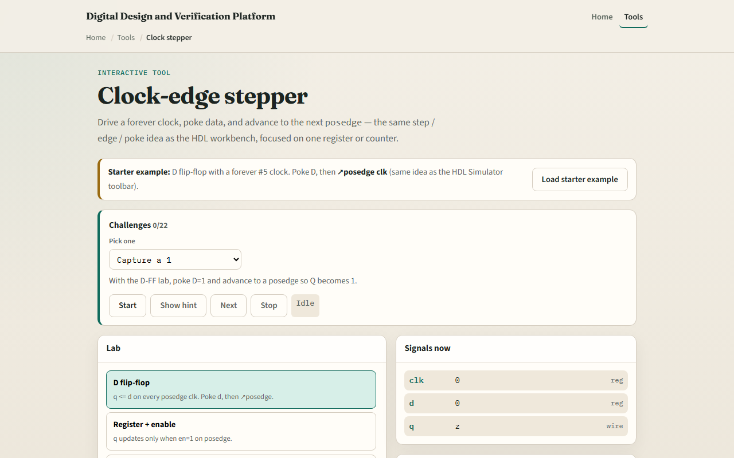
Browser lab
Clock stepper starter
learn_digital — clock stepper
Notes:
In the browser lab, look at three pieces: the challenge panel, the signal readout and truth table, and the poke fields with posedge button. Load the starter—D flip-flop, poke D equals one, then posedge clk. Switch presets for enable, counter, or shift register. Use Check when a challenge looks done.

Slide 4
Workbook practice
In the workbook track, sketch a D flip-flop timing diagram
For an enable register with EN equals zero, say whether Q changes on posedge
Draw two pipeline stages and label the one-cycle delay
Name one pitfall: changing D and expecting Q to move before the clock edge
learn_digital — clock stepper
Notes:
In the workbook track, sketch a D flip-flop timing diagram: D changes, then posedge, then Q updates. For an enable register with EN equals zero, say whether Q changes on posedge. Draw two pipeline stages and label the one-cycle delay. Name one pitfall: changing D and expecting Q to move before the clock edge.

Slide 5
Pitfalls to watch
Do not confuse level-sensitive latches with edge-triggered flops
Reset and enable matter on the same edge as data
And remember: the browser lab is literacy
Real designs still need setup, hold
learn_digital — clock stepper
Notes:
Do not confuse level-sensitive latches with edge-triggered flops—this lab is edge-triggered. Reset and enable matter on the same edge as data. And remember: the browser lab is literacy. Real designs still need setup, hold, and clock-domain crossing rules beyond manual stepping.

Slide 6
Your turn
Complete the checklist for at least one track, preferably both
In the browser, finish a few challenges after the starter
On paper, draw one posedge capture wave
When you are ready, take the short quiz, then continue to setup and hold
learn_digital — clock stepper
Notes:
Complete the checklist for at least one track—preferably both. In the browser, finish a few challenges after the starter. On paper, draw one posedge capture wave. When you are ready, take the short quiz, then continue to setup and hold.

