Slide 1
Setup / hold
A flip-flop does not sample D at an instant, it needs setup time before the clock edge and hold time after
learn_digital — setup hold
Notes:
A flip-flop does not sample D at an instant—it needs setup time before the clock edge and hold time after. Setup means D must be stable for at least tsu before the capturing edge. Hold means D must not change for at least th after that edge. Clock-to-Q is how long until Q updates. Violate a window and capture becomes unreliable. This module makes the annotated timing diagram concrete.

Slide 2
Windows, margins, Q delay
Starter case: clean pass with comfortable margins
D settles at time fourteen
Data stays low through the hold window after the edge
Q moves at edge plus tcq
Drag D later into the red setup band and setup fails
Flip D too soon after the edge and hold fails
learn_digital — setup hold
Notes:
Starter case: clean pass with comfortable margins. D settles at time fourteen, the edge is at twenty, tsu is two—setup deadline is eighteen, so setup passes. Data stays low through the hold window after the edge. Q moves at edge plus tcq. Drag D later into the red setup band and setup fails. Flip D too soon after the edge and hold fails. In a two-flop path, launch delay plus combo delay must fit inside the clock period minus setup at the capture flop.

Slide 3
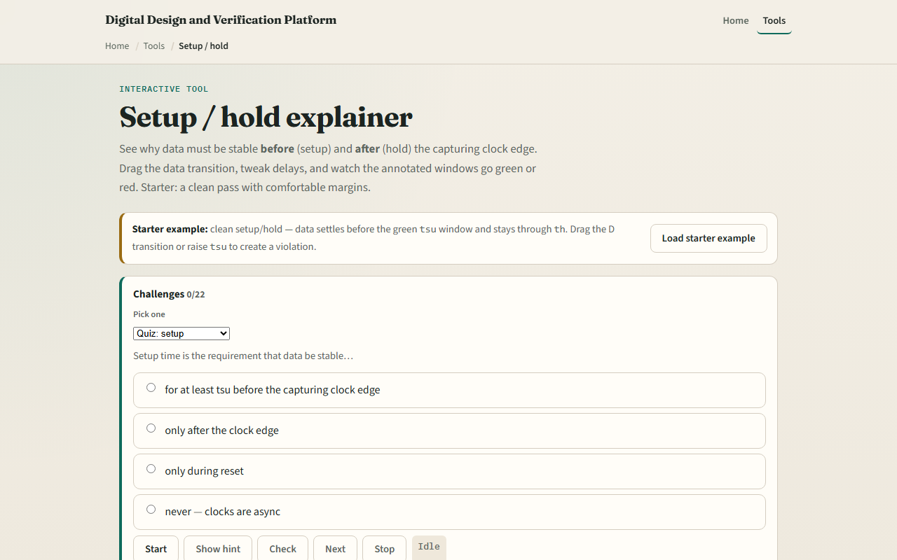
Browser lab
Setup hold starter
learn_digital — setup hold
Notes:
In the browser lab, look at three pieces: the challenge panel, the clk-D-Q timing diagram with green windows, and the tsu-th-tcq sliders. Load the starter—both setup and hold pass. Try the setup violation or hold violation presets. Drag the D transition or raise tsu to break a margin. Use Check when a challenge looks done.

Slide 4
Workbook practice
In the workbook track, draw one posedge with tsu and th bands on the D line
For edge at twenty, tsu two, D change at nineteen, does setup pass?
For hold th one, D change at twenty point five, does hold pass?
Sketch a two-FF path and label tcq, tpd, and tsu
Name one pitfall: changing D on the same cycle you expect Q to capture it
learn_digital — setup hold
Notes:
In the workbook track, draw one posedge with tsu and th bands on the D line. For edge at twenty, tsu two, D change at nineteen—does setup pass? For hold th one, D change at twenty point five—does hold pass? Sketch a two-FF path and label tcq, tpd, and tsu. Name one pitfall: changing D on the same cycle you expect Q to capture it.

Slide 5
Pitfalls to watch
Do not confuse this teaching diagram with full static timing analysis or SPICE
Setup and hold are flip-flop requirements, combo logic delay is separate
And remember: the browser lab is literacy
Real chips still need SDC constraints, corners
learn_digital — setup hold
Notes:
Do not confuse this teaching diagram with full static timing analysis or SPICE. Setup and hold are flip-flop requirements—combo logic delay is separate. And remember: the browser lab is literacy. Real chips still need SDC constraints, corners, and sign-off tools beyond dragging one transition.

Slide 6
Your turn
Complete the checklist for at least one track, preferably both
In the browser, finish a few challenges after the starter
On paper, mark setup and hold on one wave
When you are ready, take the short quiz, then continue to reset timelines
learn_digital — setup hold
Notes:
Complete the checklist for at least one track—preferably both. In the browser, finish a few challenges after the starter. On paper, mark setup and hold on one wave. When you are ready, take the short quiz, then continue to reset timelines.

