Slide 1
CDC / 2-FF sync
When a signal crosses from one clock domain to another
learn_digital — cdc sync
Notes:
When a signal crosses from one clock domain to another, timing is not guaranteed—the source can change while the destination flop is sampling. That is clock-domain crossing, or CDC. The first flop in the destination domain may go metastable, stuck between zero and one. A two-flop synchronizer gives one extra cycle to settle: q1 samples async_in, q2 samples q1, and dst logic uses q2—not q1. This module shows why that chain matters.

Slide 2
Safe, unsafe, multi-bit
Starter: two-FF mode with async_in toggling and clk_dst stepping
After a near-edge sample, q1 may show M for metastable
One-FF mode is unsafe, sync_out comes straight from q1
Multi-bit misuse warns you
Never fan q1 into combinational logic in the dst domain
learn_digital — cdc sync
Notes:
Starter: two-FF mode with async_in toggling and clk_dst stepping. After a near-edge sample, q1 may show M for metastable; step again and q2 settles to a clean zero or one. One-FF mode is unsafe—sync_out comes straight from q1. Multi-bit misuse warns you: a bus cannot ride a classic two-FF chain; use Gray code, handshake, or an async FIFO instead. Never fan q1 into combinational logic in the dst domain.

Slide 3
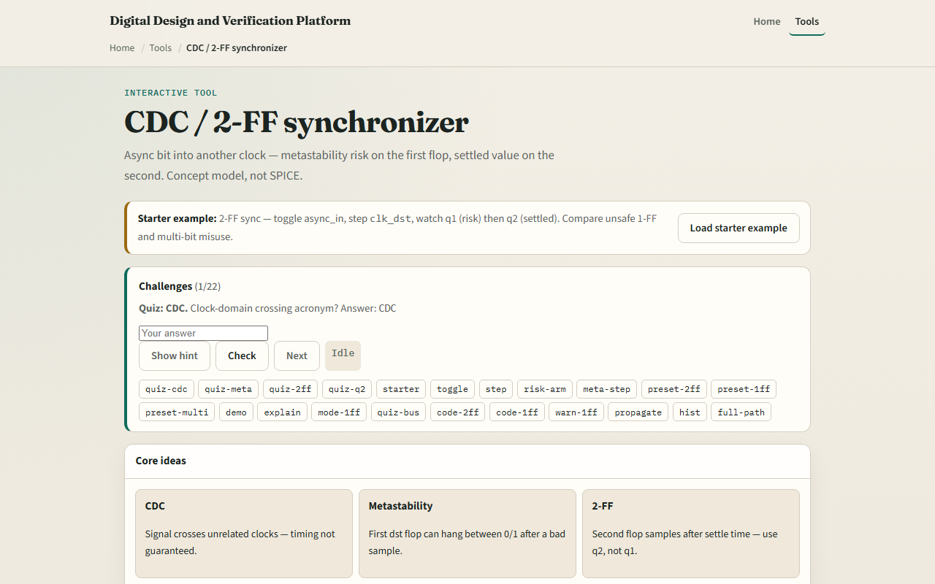
Browser lab
CDC sync starter
learn_digital — cdc sync
Notes:
In the browser lab, look at the synchronizer chain diagram, the async-q1-q2 wave strip, and the RTL for each style. Load the starter—two-FF single-bit sync. Try arm near-edge sample then step, or run the demo toggle-risk-two-steps. Switch to one-FF or multi-bit misuse to see the warnings. Use Check when a challenge looks done.

Slide 4
Workbook practice
In the workbook track, draw async_in, q1, q2, and sync_out across two dst clock edges
Write the always block for a two-FF synchronizer
Explain why q2 is the safe output
Sketch what goes wrong with one flop or with an eight-bit bus through two flops
Name one pitfall: using q1 before it has settled
learn_digital — cdc sync
Notes:
In the workbook track, draw async_in, q1, q2, and sync_out across two dst clock edges. Write the always block for a two-FF synchronizer. Explain why q2 is the safe output. Sketch what goes wrong with one flop or with an eight-bit bus through two flops. Name one pitfall: using q1 before it has settled.

Slide 5
Pitfalls to watch
Do not treat CDC as a timing exception you can ignore
Two flops improve MTBF but do not make multi-bit buses safe
And remember: the browser lab is literacy
Real designs still need CDC constraints, synchronizer cells
learn_digital — cdc sync
Notes:
Do not treat CDC as a timing exception you can ignore—metastability is probabilistic, not impossible. Two flops improve MTBF but do not make multi-bit buses safe. And remember: the browser lab is literacy. Real designs still need CDC constraints, synchronizer cells, and proper protocols for data paths.

Slide 6
Your turn
Complete the checklist for at least one track, preferably both
In the browser, finish a few challenges after the starter
On paper, draw one two-FF settle wave and one multi-bit caution
When you are ready, take the short quiz, then continue to the FSM designer lab
learn_digital — cdc sync
Notes:
Complete the checklist for at least one track—preferably both. In the browser, finish a few challenges after the starter. On paper, draw one two-FF settle wave and one multi-bit caution. When you are ready, take the short quiz, then continue to the FSM designer lab.

