Slide 1
Sequence detector
A sequence detector is an FSM that watches a serial bit stream and raises Z when a target pattern appears
learn_digital — seq detector
Notes:
A sequence detector is an FSM that watches a serial bit stream and raises Z when a target pattern appears. State S-k means the first k bits of the pattern have already matched. On a mismatch, you do not always reset to S0—you jump to the longest proper prefix that still fits. Mealy detectors pulse Z on the transition that completes the match. Moore detectors add a dedicated detect state where Z stays high. Overlap lets a suffix of one match seed the next.

Slide 2
Detect 1011 starter
Starter: Mealy overlapping detector for pattern one-zero-one-one
Step stream one-zero-one-one, Z goes zero, zero, zero, one on the last bit
States track matched prefix: empty, one, one-zero, one-zero-one
Toggle overlap off and see restart behavior
Switch to Moore and Z comes from the detect state instead of the arc
Try pattern one-one-zero-one or a longer stream with two overlapping matches
learn_digital — seq detector
Notes:
Starter: Mealy overlapping detector for pattern one-zero-one-one. Step stream one-zero-one-one—Z goes zero, zero, zero, one on the last bit. States track matched prefix: empty, one, one-zero, one-zero-one. Toggle overlap off and see restart behavior. Switch to Moore and Z comes from the detect state instead of the arc. Try pattern one-one-zero-one or a longer stream with two overlapping matches.

Slide 3
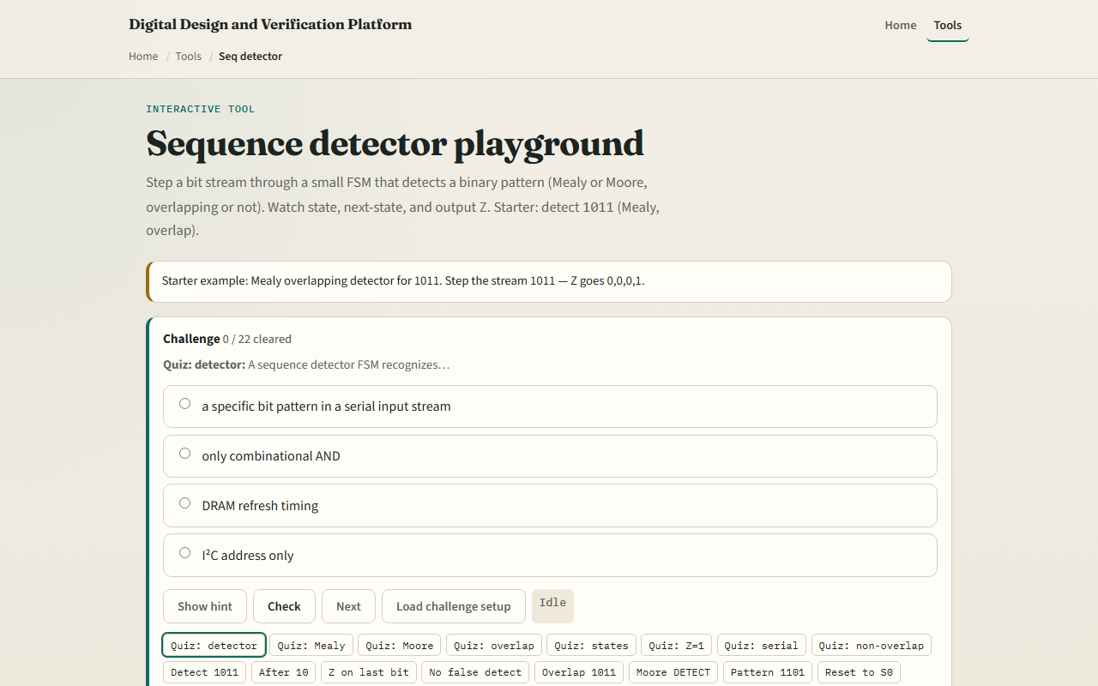
Browser lab
Sequence detector starter
learn_digital — seq detector
Notes:
In the browser lab, look at three pieces: the state row with prefix meanings, the transition table, and the bit-stream stepper with Z history. Load the starter—Mealy overlap on one-zero-one-one. Step one bit at a time, change pattern or style, watch the log. Use Check when a challenge looks done.

Slide 4
Workbook practice
In the workbook track
Fill the transition table for S2 on inputs zero and one
Explain what state you enter after a failed bit
Sketch one overlapping case: one-zero-one-one-one should match twice
Name one pitfall: forgetting overlap when the pattern repeats inside itself
learn_digital — seq detector
Notes:
In the workbook track, draw the Mealy state diagram for detecting one-zero-one-one with overlap. Fill the transition table for S2 on inputs zero and one. Explain what state you enter after a failed bit. Sketch one overlapping case: one-zero-one-one-one should match twice. Name one pitfall: forgetting overlap when the pattern repeats inside itself.

Slide 5
Pitfalls to watch
Do not confuse Mealy pulse timing with Moore level timing, downstream logic may care
Prefix recovery is not optional; brute-force reset wastes matches
Non-overlap mode is a different spec, know which you need
And remember: the browser lab is literacy
Real RTL still needs correct encoding, reset state, and test streams
learn_digital — seq detector
Notes:
Do not confuse Mealy pulse timing with Moore level timing—downstream logic may care. Prefix recovery is not optional; brute-force reset wastes matches. Non-overlap mode is a different spec—know which you need. And remember: the browser lab is literacy. Real RTL still needs correct encoding, reset state, and test streams.

Slide 6
Your turn
Complete the checklist for at least one track, preferably both
In the browser, finish a few challenges after the starter
On paper, draw one Mealy detect arc and one overlap restart
When you are ready, take the short quiz, then continue to ring and Johnson counters
learn_digital — seq detector
Notes:
Complete the checklist for at least one track—preferably both. In the browser, finish a few challenges after the starter. On paper, draw one Mealy detect arc and one overlap restart. When you are ready, take the short quiz, then continue to ring and Johnson counters.

