Slide 1
Ring / Johnson
A shift register with feedback becomes a counter without a binary adder
learn_digital — ring johnson
Notes:
A shift register with feedback becomes a counter without a binary adder. A ring counter feeds the MSB back into the LSB—the one-hot bit walks: zero-zero-zero-one becomes zero-zero-one-zero, and so on. Period N for N bits with one-hot init. A Johnson counter feeds inverted MSB—a twisted ring that visits two-N distinct states from all-zero. Same shift chain, different feedback tap. This module steps both and compares periods.

Slide 2
Ring walk starter
Starter: ring mode with one-hot pattern zero-zero-zero-one
Step once and the one moves to zero-zero-one-zero
Four steps complete a full ring period back to zero-zero-zero-one
Switch to Johnson: load zero-zero-zero-zero, step eight times for the full two-N cycle
Watch the feedback box, plain q-three for ring, not-q-three for Johnson
Beware all-zero on a ring, it can lock with zero feedback forever
learn_digital — ring johnson
Notes:
Starter: ring mode with one-hot pattern zero-zero-zero-one. Step once and the one moves to zero-zero-one-zero—feedback equals q-three, shift into q-zero. Four steps complete a full ring period back to zero-zero-zero-one. Switch to Johnson: load zero-zero-zero-zero, step eight times for the full two-N cycle. Watch the feedback box—plain q-three for ring, not-q-three for Johnson. Beware all-zero on a ring—it can lock with zero feedback forever.

Slide 3
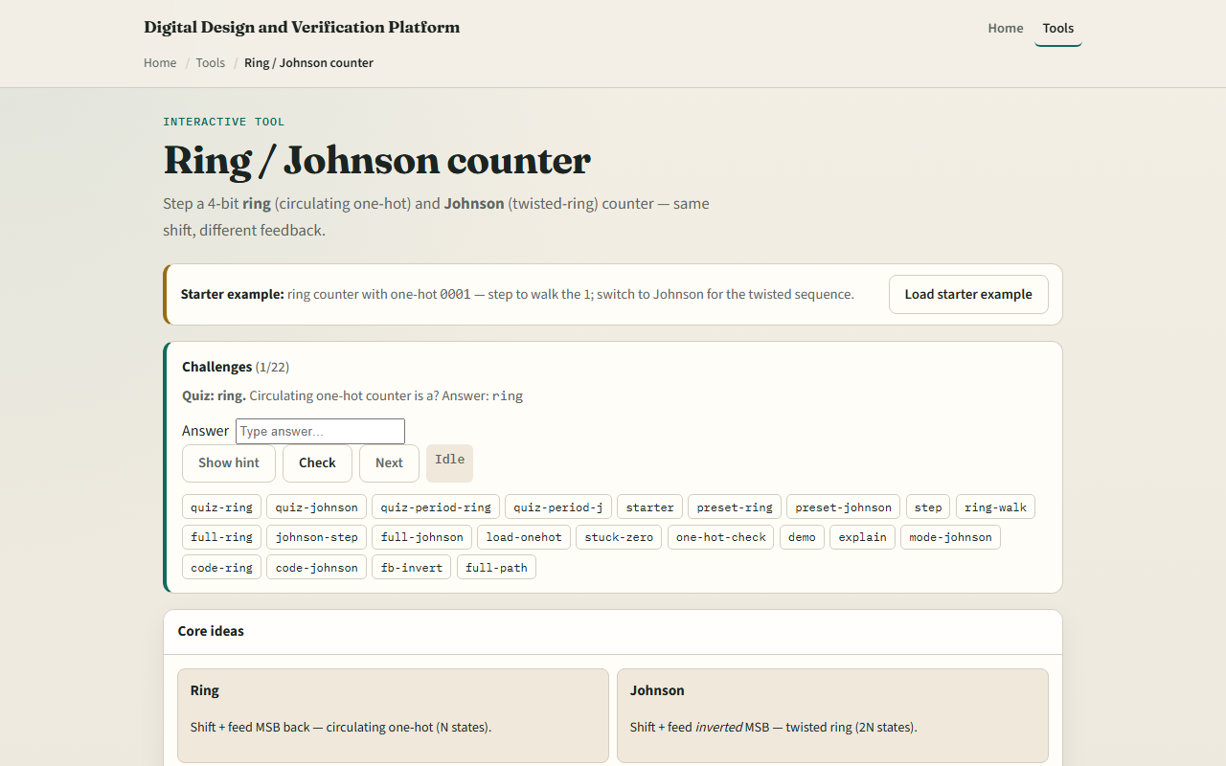
Browser lab
Ring Johnson starter
learn_digital — ring johnson
Notes:
In the browser lab, look at three pieces: the feedback chain diagram, the sequence strip, and the RTL snippet for each mode. Load the starter—ring one-hot zero-zero-zero-one. Step, run full ring period, or try Johnson eight states. Use Check when a challenge looks done.

Slide 4
Workbook practice
In the workbook track, write the always block for ring versus Johnson feedback
List four ring states starting from zero-zero-zero-one
Count Johnson states for four bits, why two-N?
Sketch what happens if a ring starts at all-zero
Name one pitfall: invalid init or illegal states without recovery
learn_digital — ring johnson
Notes:
In the workbook track, write the always block for ring versus Johnson feedback. List four ring states starting from zero-zero-zero-one. Count Johnson states for four bits—why two-N? Sketch what happens if a ring starts at all-zero. Name one pitfall: invalid init or illegal states without recovery.

Slide 5
Pitfalls to watch
Do not confuse display order, here q-three through q-zero is MSB left
Ring needs valid one-hot init; Johnson needs the right reset
Neither replaces a binary counter when you need full two-to-the-N counting
And remember: the browser lab is literacy
Real designs still need timing, enable, and illegal-state handling
learn_digital — ring johnson
Notes:
Do not confuse display order—here q-three through q-zero is MSB left. Ring needs valid one-hot init; Johnson needs the right reset. Neither replaces a binary counter when you need full two-to-the-N counting. And remember: the browser lab is literacy. Real designs still need timing, enable, and illegal-state handling.

Slide 6
Your turn
Complete the checklist for at least one track, preferably both
In the browser, finish a few challenges after the starter
On paper, draw one ring walk and one Johnson feedback inversion
When you are ready, take the short quiz, then continue to LFSR and PRBS
learn_digital — ring johnson
Notes:
Complete the checklist for at least one track—preferably both. In the browser, finish a few challenges after the starter. On paper, draw one ring walk and one Johnson feedback inversion. When you are ready, take the short quiz, then continue to LFSR and PRBS.

