Slide 1
LFSR / PRBS
A linear feedback shift register is a shift chain with XOR taps feeding the next MSB
learn_digital — lfsr lab
Notes:
A linear feedback shift register is a shift chain with XOR taps feeding the next MSB. Each clock, feedback XORs selected bits, shifts in at the top, and the LSB falls out—that bit stream is PRBS, pseudo-random binary sequence. Pick a maximal polynomial and a nonzero seed and you visit every nonzero state before repeating. Period is two-to-the-n minus one. LFSRs show up in scramblers, built-in self-test, and link training. This module steps a Fibonacci LFSR and measures period.

Slide 2
Maximal starter
Starter: four-bit maximal polynomial x-four plus x plus one, seed zero-zero-zero-one
Step and watch feedback XOR the taps, the register shift, and PRBS bits accumulate
Measure period, you should see fifteen before the seed returns
Try the short polynomial x-four plus x-squared plus one for contrast, period under fifteen
Load all-zero and see the lock warning: feedback stays zero forever
Never seed all-zero on a real LFSR
learn_digital — lfsr lab
Notes:
Starter: four-bit maximal polynomial x-four plus x plus one, seed zero-zero-zero-one. Step and watch feedback XOR the taps, the register shift, and PRBS bits accumulate. Measure period—you should see fifteen before the seed returns. Try the short polynomial x-four plus x-squared plus one for contrast—period under fifteen. Load all-zero and see the lock warning: feedback stays zero forever. Never seed all-zero on a real LFSR.

Slide 3
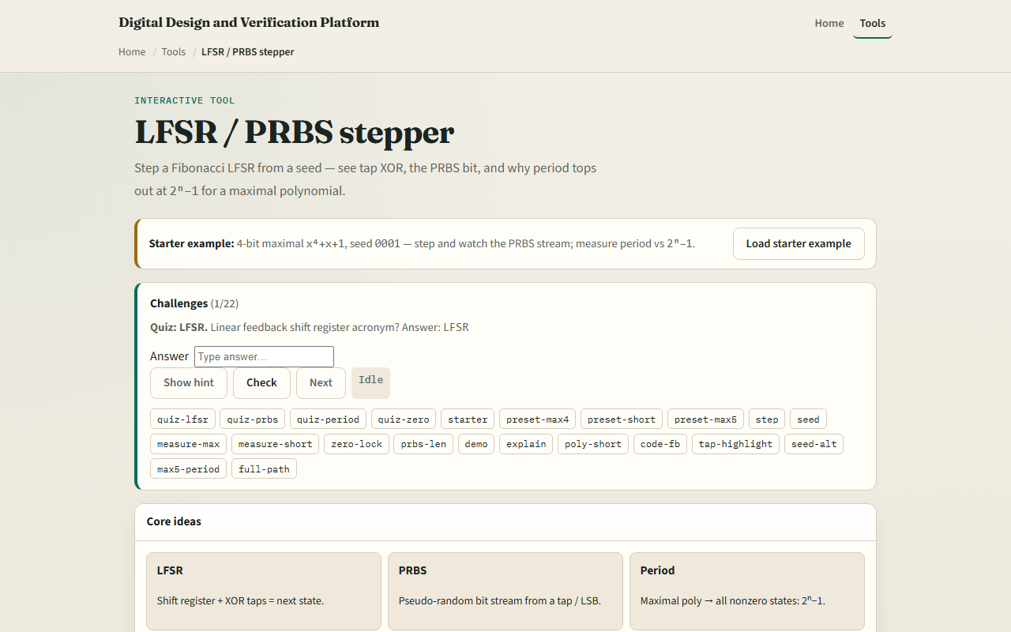
Browser lab
LFSR lab starter
learn_digital — lfsr lab
Notes:
In the browser lab, look at three pieces: the XOR feedback chain with tap highlights, the state sequence strip, and the PRBS stream readout. Load the starter—maximal four-bit, seed zero-zero-zero-one. Step, measure period, or compare short versus maximal polynomials. Use Check when a challenge looks done.

Slide 4
Workbook practice
In the workbook track
Compute period for n equals four with a maximal poly
Sketch why all-zero is forbidden
Explain one use case: PRBS for a serial link or BIST pattern
Name one pitfall: non-maximal polynomial or bad seed choice
learn_digital — lfsr lab
Notes:
In the workbook track, write the Fibonacci update for a four-bit LFSR with taps at MSB and LSB. Compute period for n equals four with a maximal poly. Sketch why all-zero is forbidden. Explain one use case: PRBS for a serial link or BIST pattern. Name one pitfall: non-maximal polynomial or bad seed choice.

Slide 5
Pitfalls to watch
Do not confuse PRBS with true random, it repeats after the period
Maximal taps matter; a wrong polynomial shortens the cycle
All-zero locks the register
And remember: the browser lab is literacy
Real designs still need tap polynomials from tables, seed logic
learn_digital — lfsr lab
Notes:
Do not confuse PRBS with true random—it repeats after the period. Maximal taps matter; a wrong polynomial shortens the cycle. All-zero locks the register. And remember: the browser lab is literacy. Real designs still need tap polynomials from tables, seed logic, and synchronization on receive.

Slide 6
Your turn
Complete the checklist for at least one track, preferably both
In the browser, finish a few challenges after the starter
On paper, draw one LFSR step with XOR feedback
When you are ready, take the short quiz, then continue to the ripple-carry adder animator
learn_digital — lfsr lab
Notes:
Complete the checklist for at least one track—preferably both. In the browser, finish a few challenges after the starter. On paper, draw one LFSR step with XOR feedback. When you are ready, take the short quiz, then continue to the ripple-carry adder animator.

