Slide 1
Carry-lookahead G/P
Ripple-carry waits for each Cout before the next Cin
learn_digital — carry look ahead adder propagate and generate
Notes:
Ripple-carry waits for each Cout before the next Cin. Carry-lookahead computes generate and propagate per bit first. Generate G equals A and B—this bit forces a carry out. Propagate P equals A XOR B—the bit passes Cin through when G is zero. Recursive rule: C out equals G plus P times C in. Sum is P XOR C in. Expand C two, C three, and so on from G, P, and C zero—all carries in parallel, not one long ripple. This module reads the G/P table and steps through expanded equations.

Slide 2
Five plus three starter
Starter: four-bit A equals five, B equals three, C zero zero
Bit zero: both inputs one
Step to reveal C one, C two
Full reveal: sum eight, Cout zero
If G is one, carry out is one regardless of Cin
If G is zero and P is one, carry passes
learn_digital — carry look ahead adder propagate and generate
Notes:
Starter: four-bit A equals five, B equals three, C zero zero. Bit zero: both inputs one, so G zero is one and P zero is zero—G forces C one to one even with C zero zero. Step to reveal C one, C two, and the expanded forms—C two includes G one plus P one dot G zero. Full reveal: sum eight, Cout zero. If G is one, carry out is one regardless of Cin. If G is zero and P is one, carry passes. If both are zero, carry is killed.

Slide 3
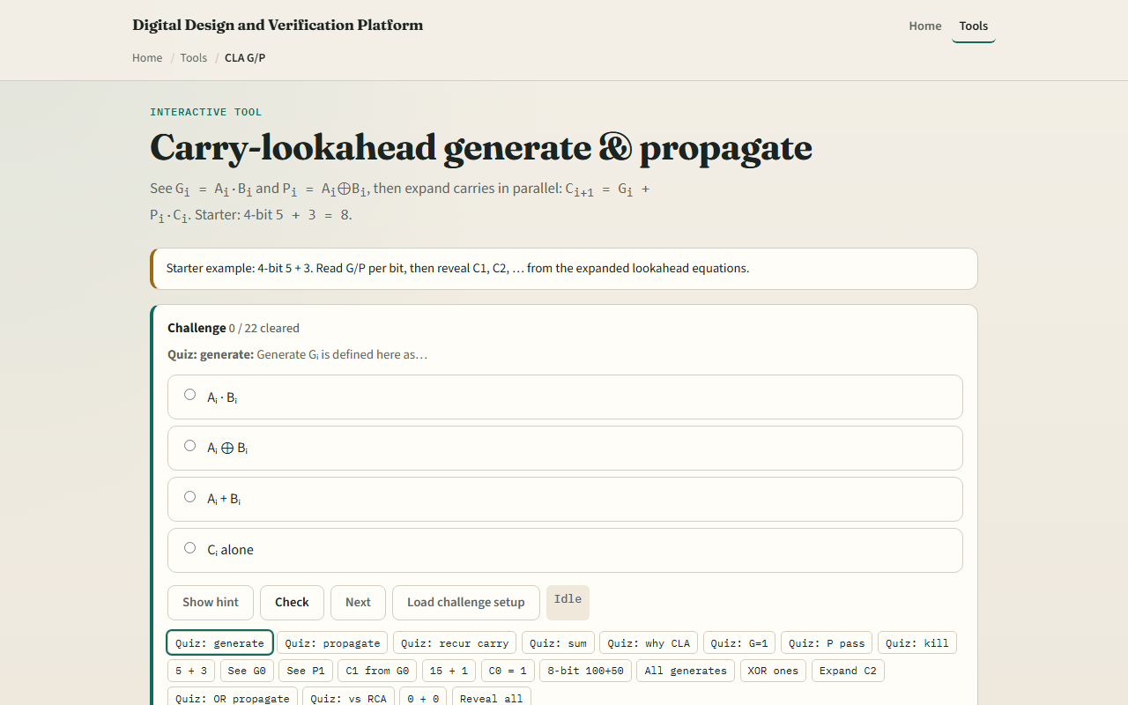
Browser lab
Carry-lookahead starter
learn_digital — carry look ahead adder propagate and generate
Notes:
In the browser lab, look at three pieces: the G and P table per bit, the expanded carry equations, and the sum strip. Load the starter—four-bit five plus three. Reveal carries one at a time or Show all. Compare with ripple: more lookahead logic, shorter carry delay. Use Check when a challenge looks done.

Slide 4
Workbook practice
In the workbook track, write G, P, and C one for bit zero of five plus three
Expand C two symbolically from G one, P one, G zero, and C zero
Explain generate versus propagate in one sentence each
Sketch why CLA trades area for speed versus ripple
Name one pitfall: confusing G with P or forgetting sum uses P XOR C
learn_digital — carry look ahead adder propagate and generate
Notes:
In the workbook track, write G, P, and C one for bit zero of five plus three. Expand C two symbolically from G one, P one, G zero, and C zero. Explain generate versus propagate in one sentence each. Sketch why CLA trades area for speed versus ripple. Name one pitfall: confusing G with P or forgetting sum uses P XOR C.

Slide 5
Pitfalls to watch
Do not treat expanded equations as magic, each term is a real AND-OR path
G equals one always wins; P equals zero kills carry regardless of Cin
Wide adders use prefix trees, not one giant flat expansion
And remember: the browser lab is literacy
Real RTL still needs sensible grouping and timing on carry paths
learn_digital — carry look ahead adder propagate and generate
Notes:
Do not treat expanded equations as magic—each term is a real AND-OR path. G equals one always wins; P equals zero kills carry regardless of Cin. Wide adders use prefix trees, not one giant flat expansion. And remember: the browser lab is literacy. Real RTL still needs sensible grouping and timing on carry paths.

Slide 6
Your turn
Complete the checklist for at least one track, preferably both
In the browser, finish a few challenges after the starter
On paper, write one recursive C equation and one expanded C two
When you are ready, take the short quiz, then continue to the array multiplier
learn_digital — carry look ahead adder propagate and generate
Notes:
Complete the checklist for at least one track—preferably both. In the browser, finish a few challenges after the starter. On paper, write one recursive C equation and one expanded C two. When you are ready, take the short quiz, then continue to the array multiplier.

