Slide 1
Carry-select sketch
Ripple carry waits for each stage before the next begins
learn_digital — carry select adder
Notes:
Ripple carry waits for each stage before the next begins. Carry-select breaks the adder into blocks and speculates on the upper carry. The lower block computes the true lower sum and carry-out C4. The upper block runs two parallel four-bit adds—one with Cin zero, one with Cin one. When C4 arrives, a mux picks the correct upper sum. You trade extra hardware for shorter critical path on wide adders.

Slide 2
A5 plus 3C starter
Starter: eight-bit add, A equals hex A5, B equals hex three C
Lower nibble: five plus C gives sum one and C4 equals one
Upper dual paths: Cin zero gives D, Cin one gives E
Mux selects the Cin-one path because C4 is one
Final sum is hex E1, Cout zero
Step through phases
learn_digital — carry select adder
Notes:
Starter: eight-bit add, A equals hex A5, B equals hex three C. Lower nibble: five plus C gives sum one and C4 equals one. Upper dual paths: Cin zero gives D, Cin one gives E. Mux selects the Cin-one path because C4 is one. Final sum is hex E1, Cout zero. Step through phases—idle, dual paths, lower carry, mux select, done—to see speculation then selection.

Slide 3
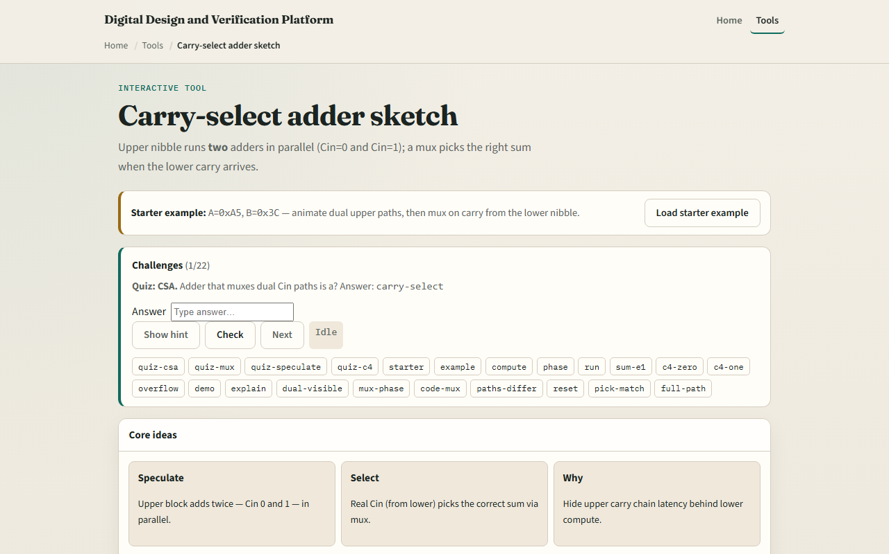
Browser lab
Carry-select adder starter
learn_digital — carry select adder
Notes:
In the browser lab, watch three idea cards: speculate, select, why. Enter nibbles or load the starter. Use Next phase or Run all phases to animate lower carry feeding the mux. Status shows C4 and which path wins. Try Force case C4 equals zero versus one to see the mux flip.

Slide 4
Workbook practice
On paper, sketch an eight-bit carry-select built from two four-bit blocks
For A5 plus three C, compute lower sum and C4, both upper speculative sums
Tabulate Cin zero versus Cin one paths
Name the trade-off
learn_digital — carry select adder
Notes:
On paper, sketch an eight-bit carry-select built from two four-bit blocks. For A5 plus three C, compute lower sum and C4, both upper speculative sums, and the mux choice. Tabulate Cin zero versus Cin one paths. Name the trade-off: about double upper adder area plus mux, in exchange for hiding upper carry delay.

Slide 5
Pitfalls to watch
Do not confuse speculation with the final answer, the mux must wait for real C4
Both upper paths are computed in parallel; only one is selected
C4 is carry out of the lower nibble, not the full eight-bit Cout
And remember
learn_digital — carry select adder
Notes:
Do not confuse speculation with the final answer—the mux must wait for real C4. Both upper paths are computed in parallel; only one is selected. C4 is carry out of the lower nibble, not the full eight-bit Cout. And remember: this sketch teaches the idea; real wide CSAs use more blocks and tuned mux trees.

Slide 6
Your turn
Complete the checklist for at least one track, preferably both
In the browser, run all phases on the starter and confirm sum E1
On paper, draw the dual upper paths and mux
When you are ready, take the short quiz, then continue to Booth encode
learn_digital — carry select adder
Notes:
Complete the checklist for at least one track—preferably both. In the browser, run all phases on the starter and confirm sum E1. On paper, draw the dual upper paths and mux. When you are ready, take the short quiz, then continue to Booth encode.

