Slide 1
Booth encode
Radix-four Booth recodes the multiplier Y into signed digits zero, plus or minus one, or plus or minus two
learn_digital — booth encode
Notes:
Radix-four Booth recodes the multiplier Y into signed digits zero, plus or minus one, or plus or minus two. Each digit comes from an overlapping three-bit triplet of Y, with y minus one equals zero for the first group. Partial product i is digit i times X, shifted left by two i. Eight-bit Y yields four digits—half as many partial products as a plain array multiplier. The trade is a Booth table and signed partial-product hardware.

Slide 2
0C times 1A starter
Starter: X equals hex zero C, twelve signed; Y equals hex one A, twenty-six
Encode Y into four Booth digits: minus two, minus one, plus two, zero
Digit zero triplet one-zero-zero uses y minus one equals zero
Partial products: minus twenty-four, minus forty-eight, plus three eighty-four, zero
Booth sum and signed X times Y both equal three twelve
Click Encode Y to see the bit grid, digit cards, and partial-product list
learn_digital — booth encode
Notes:
Starter: X equals hex zero C, twelve signed; Y equals hex one A, twenty-six. Encode Y into four Booth digits: minus two, minus one, plus two, zero. Digit zero triplet one-zero-zero uses y minus one equals zero. Partial products: minus twenty-four, minus forty-eight, plus three eighty-four, zero. Booth sum and signed X times Y both equal three twelve. Click Encode Y to see the bit grid, digit cards, and partial-product list.

Slide 3
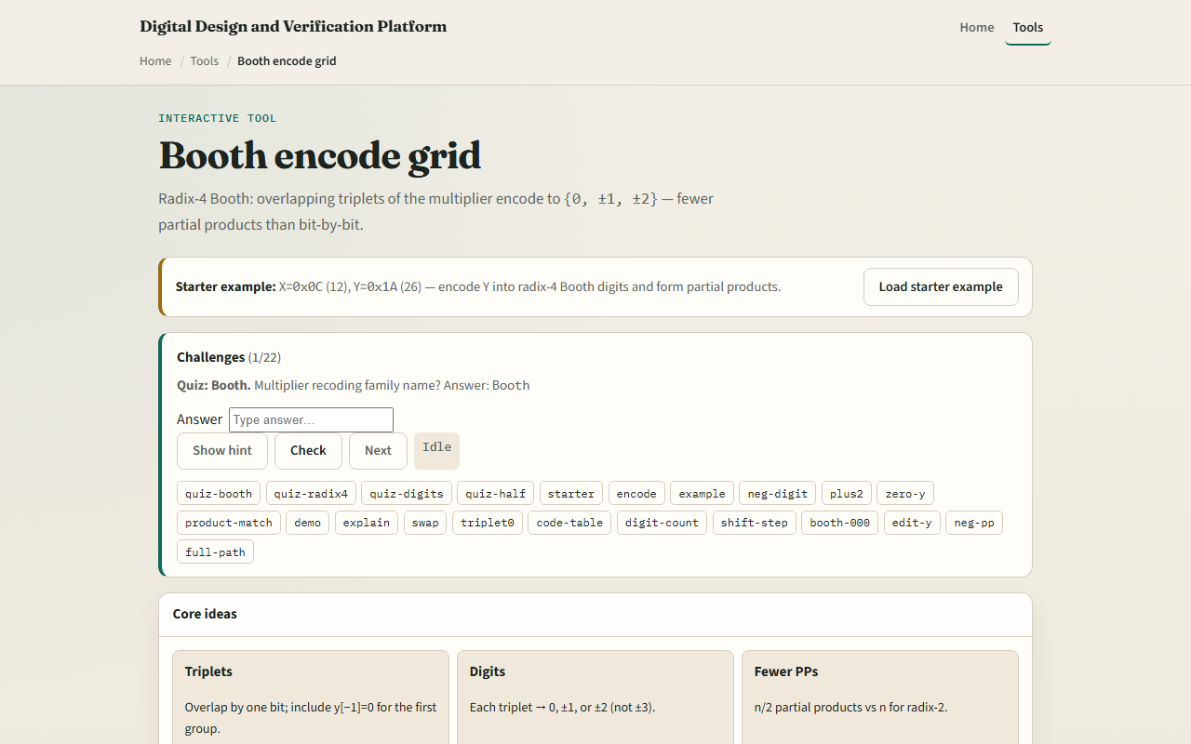
Browser lab
Booth encode starter
learn_digital — booth encode
Notes:
In the browser lab, enter X and Y or load the starter. The bit grid shows overlapping groups and y minus one. Digit cards show each triplet and shift amount. Partial products list digit times X with contributions. Try Example with minus-two digit or Highlight zero-one-one to plus two. Status confirms digits and product match.

Slide 4
Workbook practice
On paper, encode Y equals one A into four radix-four Booth digits using the cheat table
For triplet zero-one-one, record digit plus two
Compute partial products for X equals twelve and sum them
Draw how triplets overlap, each group shares one bit with the next
Name one pitfall: forgetting y minus one on the first digit
learn_digital — booth encode
Notes:
On paper, encode Y equals one A into four radix-four Booth digits using the cheat table. For triplet zero-one-one, record digit plus two. Compute partial products for X equals twelve and sum them. Draw how triplets overlap—each group shares one bit with the next. Name one pitfall: forgetting y minus one on the first digit.

Slide 5
Pitfalls to watch
Do not treat Booth digits as plain binary, they are signed recoding
Triplet bits are y two i plus one, y two i, y two i minus one, not independent pairs
Partial products with minus one or minus two need signed X
And remember
learn_digital — booth encode
Notes:
Do not treat Booth digits as plain binary—they are signed recoding. Triplet bits are y two i plus one, y two i, y two i minus one—not independent pairs. Partial products with minus one or minus two need signed X. And remember: this lab is concept literacy; real multipliers still need sign extension, rounding, and pipeline timing.

Slide 6
Your turn
Complete the checklist for at least one track, preferably both
In the browser, encode the starter and confirm product three twelve
On paper, fill one row of the Booth table from a triplet you choose
When you are ready, take the short quiz, then continue to signed arithmetic
learn_digital — booth encode
Notes:
Complete the checklist for at least one track—preferably both. In the browser, encode the starter and confirm product three twelve. On paper, fill one row of the Booth table from a triplet you choose. When you are ready, take the short quiz, then continue to signed arithmetic.

