Slide 1
Byte-enable memory
A thirty-two-bit word RAM can update one byte at a time using byte-enable bits
learn_digital — byte enable mem
Notes:
A thirty-two-bit word RAM can update one byte at a time using byte-enable bits. Address selects the word; be zero through three each gate one lane on write. Disabled lanes keep their old data—partial store without a full read-modify-write on the bus. Little-endian layout: be zero is byte zero, the LSB. CPU byte, halfword, and word stores map to different be patterns. We equals one with be all zero updates nothing.

Slide 2
be equals 0001 starter
Starter: four words by thirty-two bits
Word zero is hex DDCCBBAA, bytes AA, BB, CC, DD little-endian
Set addr zero
Step clock: only byte zero changes from AA to fifty-five
Word zero becomes DDCCBB55; BB, CC, DD unchanged
Try be equals one-one-one-one for a full word, or zero-zero-one-one for a low halfword
learn_digital — byte enable mem
Notes:
Starter: four words by thirty-two bits. Word zero is hex DDCCBBAA—bytes AA, BB, CC, DD little-endian. Set addr zero, we equals one, be equals zero-zero-zero-one, din hex eight-eight-seven-seven-six-six-five-five. Step clock: only byte zero changes from AA to fifty-five. Word zero becomes DDCCBB55; BB, CC, DD unchanged. Try be equals one-one-one-one for a full word, or zero-zero-one-one for a low halfword.

Slide 3
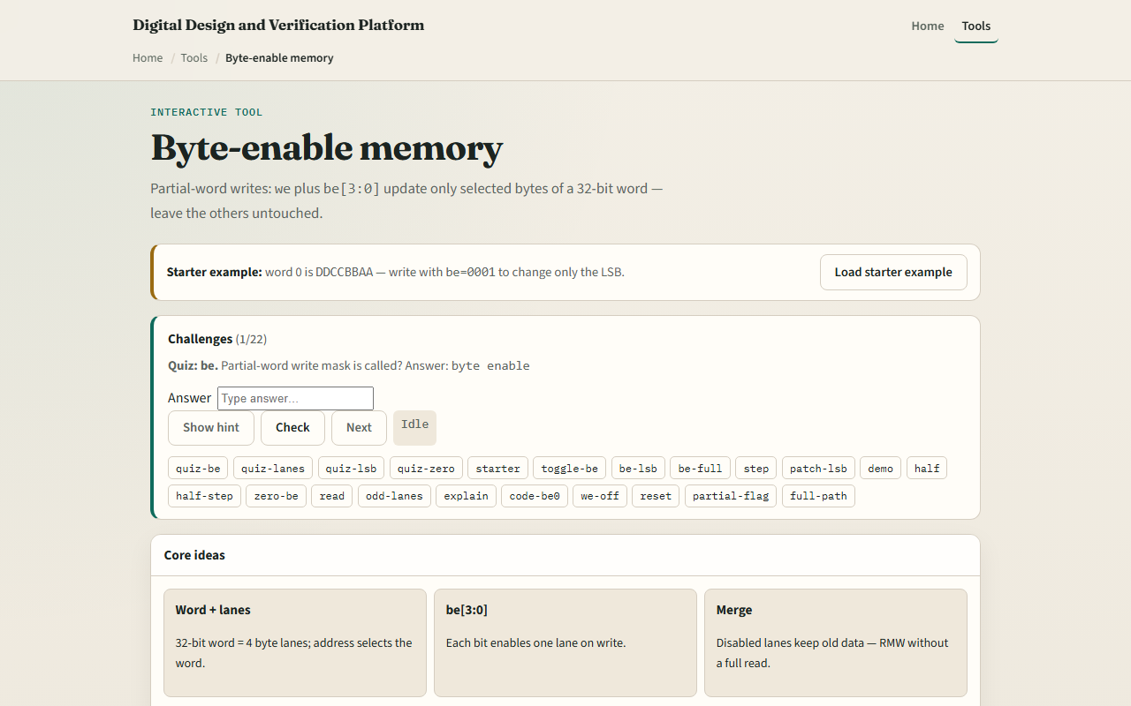
Browser lab
Byte-enable memory starter
learn_digital — byte enable mem
Notes:
In the browser lab, set addr, we, din, and toggle be three down to zero. Green highlights enabled lanes on the selected word. Step clk applies the masked write. Sample dout reads mem of addr without writing. Buttons set common patterns: LSB only, full word, halfword low, or be all zero.

Slide 4
Workbook practice
On paper, draw word zero with four byte lanes
Mark be equals zero-zero-zero-one and din byte zero equals fifty-five
Show the word before and after partial write
Tabulate be patterns
Name one pitfall: confusing be bit order with big-endian byte numbering
learn_digital — byte enable mem
Notes:
On paper, draw word zero with four byte lanes. Mark be equals zero-zero-zero-one and din byte zero equals fifty-five. Show the word before and after partial write. Tabulate be patterns: zero-zero-zero-one byte, zero-zero-one-one halfword, one-one-one-one word, zero-zero-zero-zero no change. Name one pitfall: confusing be bit order with big-endian byte numbering.

Slide 5
Pitfalls to watch
Do not assume we equals one always writes the full word, check be
Disabled lanes are not zeroed; they retain old values
Little-endian means be zero is the least significant byte
And remember
learn_digital — byte enable mem
Notes:
Do not assume we equals one always writes the full word—check be. Disabled lanes are not zeroed; they retain old values. Little-endian means be zero is the least significant byte. And remember: real systems also need alignment rules and write strobes; this lab is lane-mask literacy.

Slide 6
Your turn
Complete the checklist for at least one track, preferably both
In the browser, run the starter step and confirm only byte zero patches
On paper, sketch one partial write with be equals zero-zero-one-one
When you are ready, take the short quiz, then continue to async FIFO Gray pointers
learn_digital — byte enable mem
Notes:
Complete the checklist for at least one track—preferably both. In the browser, run the starter step and confirm only byte zero patches. On paper, sketch one partial write with be equals zero-zero-one-one. When you are ready, take the short quiz, then continue to async FIFO Gray pointers.

