Slide 1
Digital path complete
State machines, then datapath, memory, FIFOs, and handshakes
learn_digital — wrap
Notes:
You have walked the digital foundations path—from radix and two’s complement, through Boolean logic and gates, into clocks, resets, and state machines, then datapath, memory, FIFOs, and handshakes. This short wrap names what you can do now and points you to the next course: learn Verilog.

Slide 2
What you can do now
You can move across number systems and encodings with confidence
You can reason about combinational and sequential logic, FSM encodings
You can explain adders, ALUs, memory maps, Gray FIFO pointers
You are not writing synthesizable HDL yet
learn_digital — wrap
Notes:
You can move across number systems and encodings with confidence. You can reason about combinational and sequential logic, FSM encodings, and simple timing sketches. You can explain adders, ALUs, memory maps, Gray FIFO pointers, and valid-ready handshakes at the concept level—and wire blocks in a system diagram. You are not writing synthesizable HDL yet; you are building the mental model Verilog will describe.

Slide 3
Close the track gaps
If you mainly used browser labs, redo a few workbook sketches for the clock, reset
If you mainly used the workbook, open any skipped browser labs for interactive challenges
Either track works for self-study
learn_digital — wrap
Notes:
If you mainly used browser labs, redo a few workbook sketches for the clock, reset, and FSM modules so tables and timing feel natural on paper. If you mainly used the workbook, open any skipped browser labs for interactive challenges. Either track works for self-study; both together stick best before you open a Verilog editor.

Slide 4
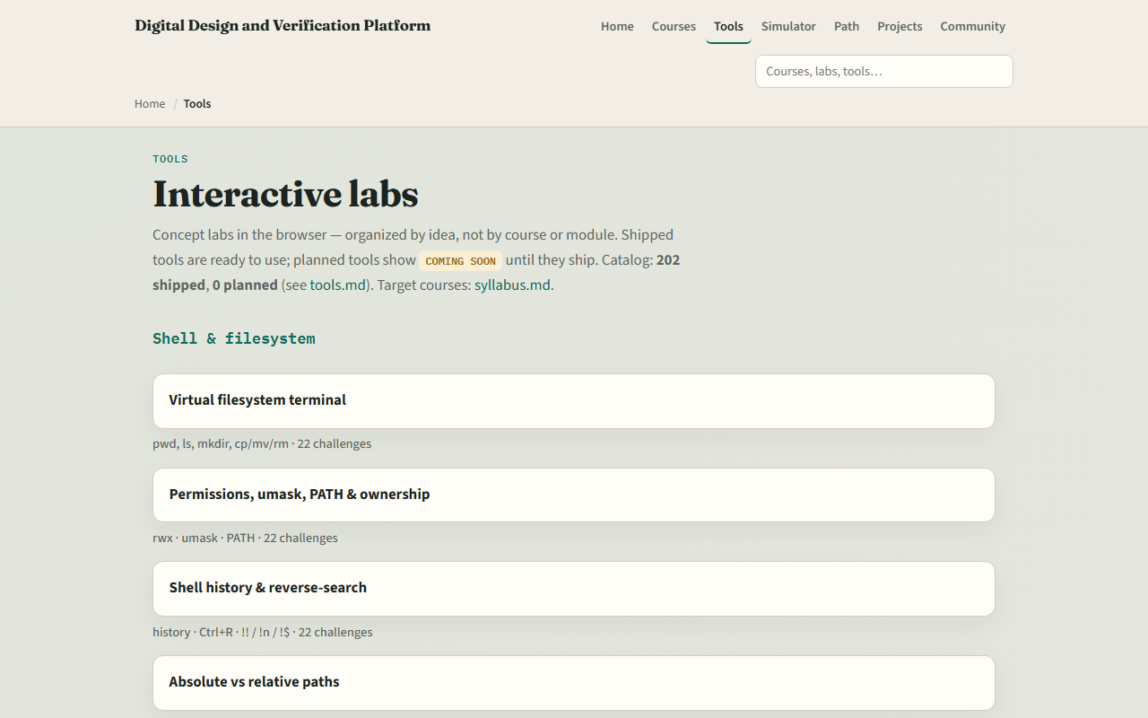
The labs you practiced
Here is the tools index again, the same shelf of concept labs you opened along the way
You do not need to re-clear every challenge
Use it as a map
learn_digital — wrap
Notes:
Here is the tools index again—the same shelf of concept labs you opened along the way. You do not need to re-clear every challenge. Use it as a map: if a skill still feels shaky, jump back to that lab, then return here when you are ready for RTL.

Slide 5
Next: learn Verilog
Verilog is where these concepts become modules, ports, and always blocks
Start learn Verilog from the syllabus when your wrap checklist feels honest
Keep a small practice folder for exercises
The older combined digital-and-Verilog path is optional stretch reading, not required
learn_digital — wrap
Notes:
Verilog is where these concepts become modules, ports, and always blocks. Start learn Verilog from the syllabus when your wrap checklist feels honest. Keep a small practice folder for exercises—you will reuse it when simulating and debugging. The older combined digital-and-Verilog path is optional stretch reading, not required.

Slide 6
Your turn
Review the wrap checklist
Confirm you can explain radix, two’s complement
Name one module you would revisit if a topic still feels thin
When you are ready, take the short quiz, then continue to learn Verilog
learn_digital — wrap
Notes:
Review the wrap checklist. Confirm you can explain radix, two’s complement, and a simple FSM encoding without looking it up. Name one module you would revisit if a topic still feels thin. When you are ready, take the short quiz, then continue to learn Verilog.

