Slide 1
Stash scenarios
Sometimes you are mid-edit and need a clean tree, to switch branches, pull updates, or run a quick experiment
learn_git — git stash lab
Notes:
Sometimes you are mid-edit and need a clean tree—to switch branches, pull updates, or run a quick experiment. Stash saves your uncommitted work on a side stack and restores a clean working tree. This module practices push, list, apply, and pop so you can pause without committing half-baked changes.

Slide 2
Push, list, then pop or apply
Stash push saves tracked dirty files and resets the working tree to match HEAD
Stash list shows the stack, newest on top
Stash pop applies the top entry and removes it from the stack
By default stash does not include untracked files; add minus u when you need those too
learn_git — git stash lab
Notes:
Stash push saves tracked dirty files and resets the working tree to match HEAD. Stash list shows the stack—newest on top. Stash pop applies the top entry and removes it from the stack; stash apply puts changes back but leaves the entry for safety. By default stash does not include untracked files; add minus u when you need those too.

Slide 3
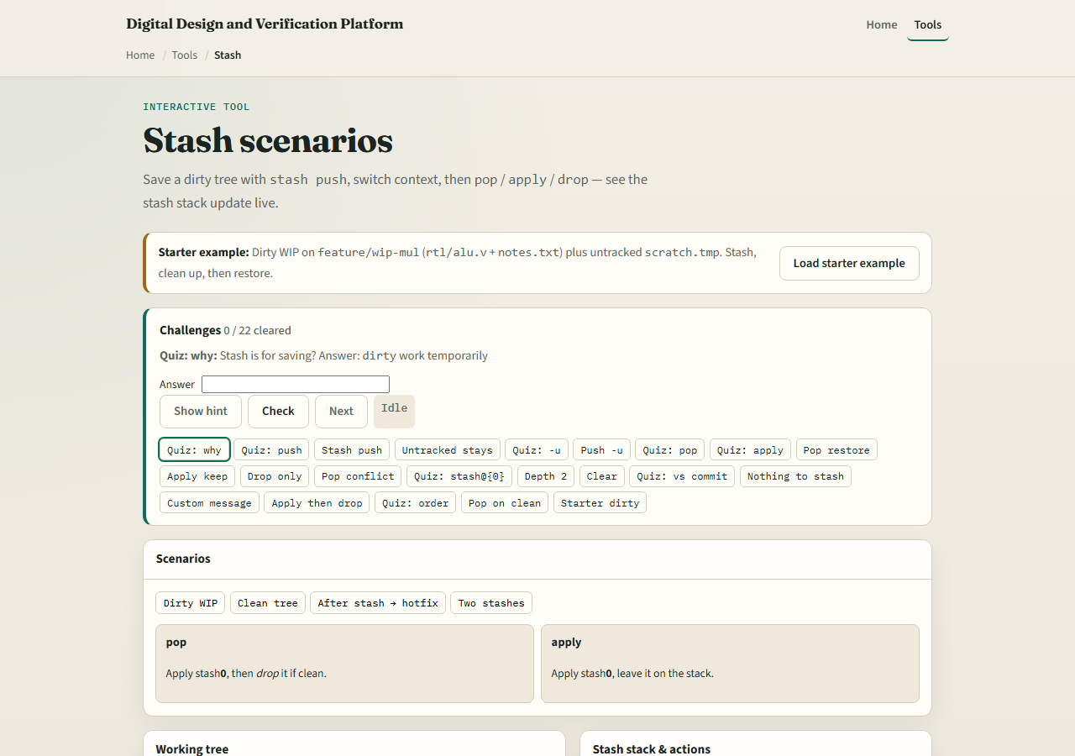
Browser lab
Stash lab starter
learn_git — git stash lab
Notes:
In the browser lab, look at three pieces: the challenge card, the working-tree panel, and the stash stack with push, pop, and apply buttons. Load the starter example, stash a dirty edit, then pop or apply it back. Use Check when you think a challenge is done. You do not need a full tour here—the lab itself guides the rest. Explore a few challenges, then come back for the real Git track.

Slide 4
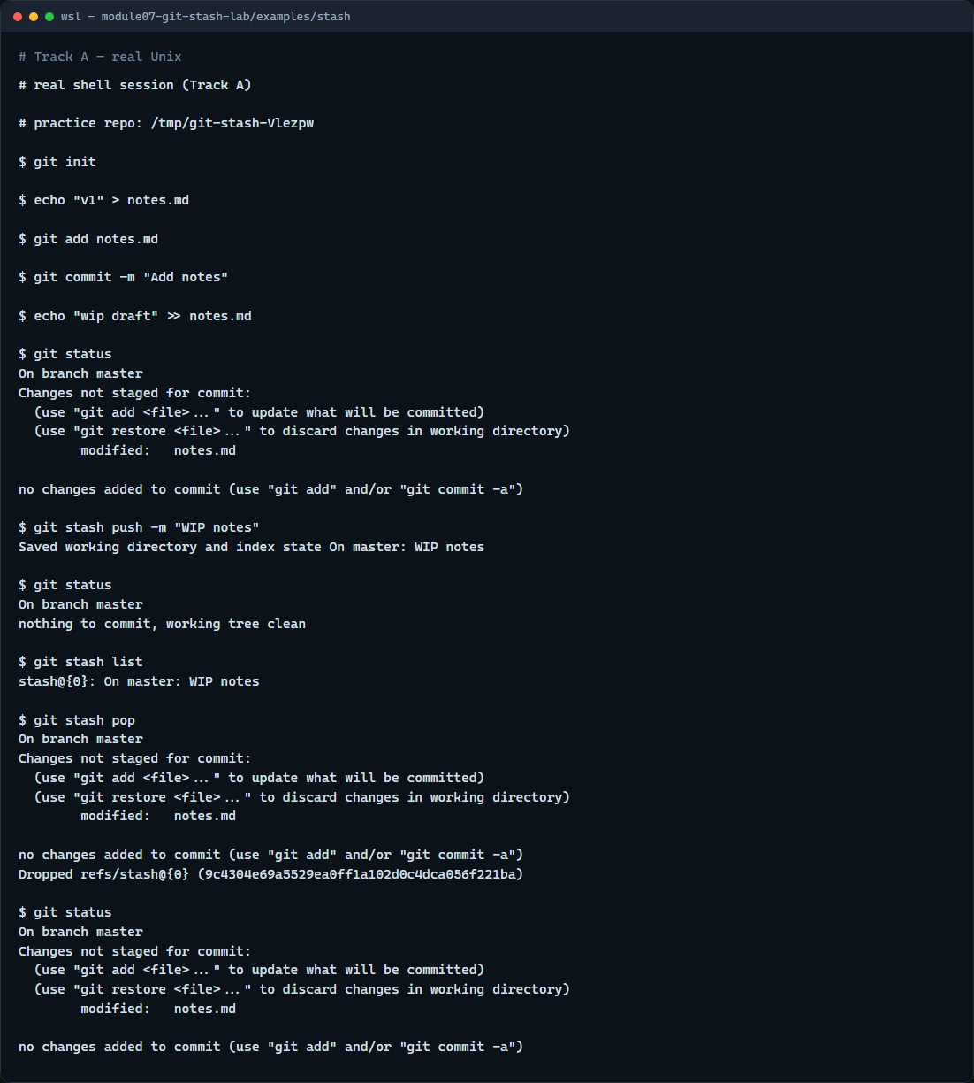
Real Git practice
Real shell — stash push, list, pop
learn_git — git stash lab
Notes:
In the real Git track, create a tiny repo with one committed notes file. Edit the file so status shows a modification, then stash push with a short message so the tree goes clean. List the stash to see your entry, then pop to restore the edits and remove that stash from the stack. That pause-and-resume rhythm is what you want before switching branches or pulling.

Slide 5
Real Git practice — try these
# git init — create a new repository here
git init
# echo … > notes.md — create and commit a tracked file
echo "v1" > notes.md
git add notes.md
git commit -m "Add notes"
# echo … >> notes.md — edit without committing
echo "wip draft" >> notes.md
# git status — see modified, not staged
git status
# git stash push -m "WIP notes" — save dirty tree, clean working tree
git stash push -m "WIP notes"
# git status — working tree should be clean
git status
# ...
learn_git — git stash lab

Slide 6
Pitfalls to watch
Do not stash and forget, run stash list so old entries do not pile up
Remember pop can conflict if the branch moved; apply is gentler while you are learning
Untracked files need stash push with minus u
And remember
learn_git — git stash lab
Notes:
Do not stash and forget—run stash list so old entries do not pile up. Remember pop can conflict if the branch moved; apply is gentler while you are learning. Untracked files need stash push with minus u. And remember: the browser lab is for literacy—real branch switches still need stash in a real repo.

Slide 7
Your turn
Complete the checklist for at least one track, preferably both
In the browser, load the starter and finish a push-then-pop challenge
On real Git, stash, list, and pop in your practice tree
When you are ready, take the short quiz, then continue to the next module on tags
learn_git — git stash lab
Notes:
Complete the checklist for at least one track—preferably both. In the browser, load the starter and finish a push-then-pop challenge. On real Git, stash, list, and pop in your practice tree. When you are ready, take the short quiz, then continue to the next module on tags.

