Slide 1
Branch naming
Branches let you isolate work, a lab feature, a bugfix, a submission, without destabilizing main
learn_git — branch strategy
Notes:
Branches let you isolate work—a lab feature, a bugfix, a submission—without destabilizing main. Good names are short, searchable, and follow a prefix like feature or fix. This module practices naming conventions and creating branches from an updated main.

Slide 2
Prefix, slug, then branch
Use a typed prefix
Branch from main after you have fetched the latest tip, not from random work in progress
One concern per branch keeps reviews and merges readable
learn_git — branch strategy
Notes:
Use a typed prefix—feature slash, fix slash, hotfix slash—then a kebab-case slug that says what the branch is for. Branch from main after you have fetched the latest tip, not from random work in progress. One concern per branch keeps reviews and merges readable.

Slide 3
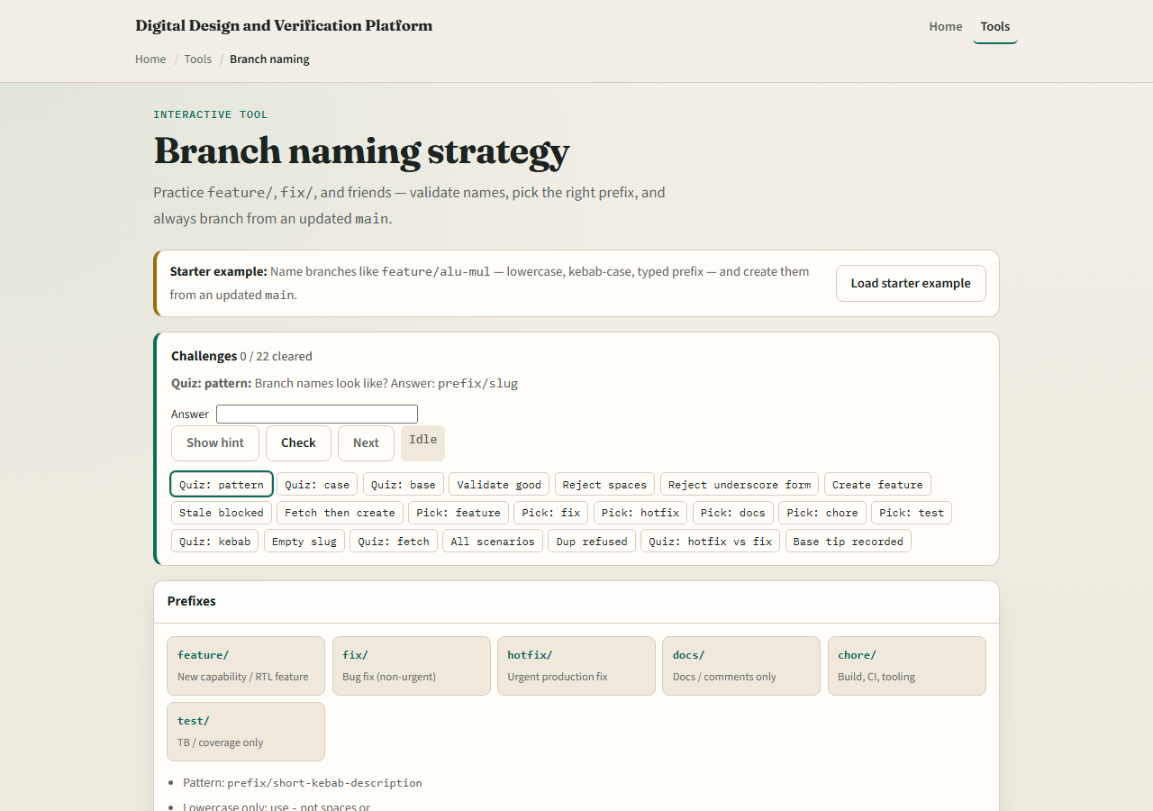
Browser lab
Branch naming lab starter
learn_git — branch strategy
Notes:
In the browser lab, look at three pieces: the challenge card, the prefix cheat sheet, and the name-and-create panel with validation feedback. Load the starter example, draft a name like feature slash alu-mul, and create the branch from main. Use Check when you think a challenge is done. You do not need a full tour here—the lab itself guides the rest. Explore a few challenges, then come back for the real Git track.

Slide 4
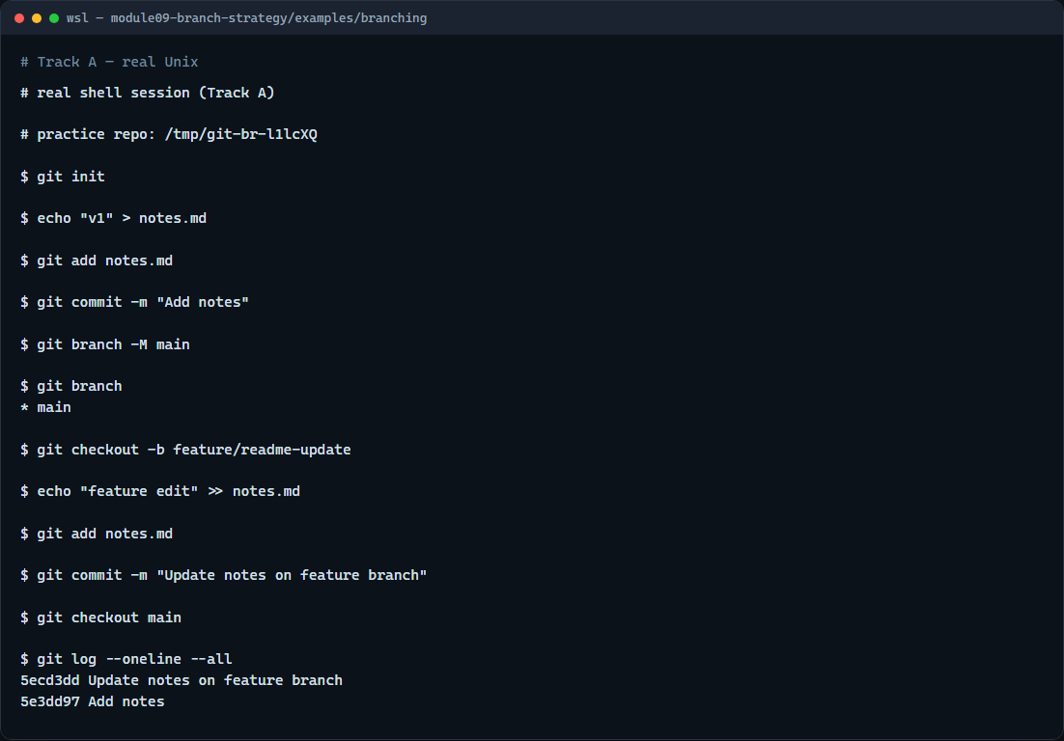
Real Git practice
Real shell — create and switch branches
learn_git — branch strategy
Notes:
In the real Git track, start on main with one committed file. List branches so you see the current star marker. Create and switch to a feature branch with checkout minus b and a clear name. Make a small commit on that branch, list branches again, then switch back to main and show a one-line log with all refs. That isolates the feature work until you merge it later.

Slide 5
Real Git practice — try these
# git init — create a new repository here
git init
# echo … > notes.md — create and commit on main
echo "v1" > notes.md
git add notes.md
git commit -m "Add notes"
# git branch -M main — name the default branch main
git branch -M main
# git branch — list branches; star marks current
git branch
# git checkout -b feature/readme-update — create and switch
git checkout -b feature/readme-update
# echo … >> notes.md — edit on the feature branch
echo "feature edit" >> notes.md
# ...
learn_git — branch strategy

Slide 6
Pitfalls to watch
Do not use spaces or vague names like my branch
Do not branch from a stale main when the team expects you to fetch first
Delete merged feature branches so the list stays short
And remember
learn_git — branch strategy
Notes:
Do not use spaces or vague names like my branch. Do not branch from a stale main when the team expects you to fetch first. Delete merged feature branches so the list stays short. And remember: the browser lab is for literacy—real pull requests still need sensible branch names in a real repo.

Slide 7
Your turn
Complete the checklist for at least one track, preferably both
In the browser, load the starter and fix a few weak branch names until validation passes
On real Git, create a feature branch, commit once, and switch back to main
When you are ready
learn_git — branch strategy
Notes:
Complete the checklist for at least one track—preferably both. In the browser, load the starter and fix a few weak branch names until validation passes. On real Git, create a feature branch, commit once, and switch back to main. When you are ready, take the short quiz, then continue to the next module on merge conflicts.

