Slide 1
Reflog recovery
You reset too far, checked out the wrong branch, or rebased and thought a commit was gone
learn_git — git reflog
Notes:
You reset too far, checked out the wrong branch, or rebased and thought a commit was gone. Reflog is your local diary of where HEAD has been. It often holds the hash you need to recover—even when normal log no longer shows that commit.

Slide 2
Reflog before panic
Run reflog to see recent moves: commits, checkouts, resets
Each line has an index like HEAD at one, meaning one step ago
If a hard reset dropped your tip
Reflog is local only and entries expire after a while, so recover soon
learn_git — git reflog
Notes:
Run reflog to see recent moves: commits, checkouts, resets. Each line has an index like HEAD at one, meaning one step ago. If a hard reset dropped your tip, reset hard to HEAD at one to move back—or create a recovery branch pointing at the hash you find. Reflog is local only and entries expire after a while, so recover soon.

Slide 3
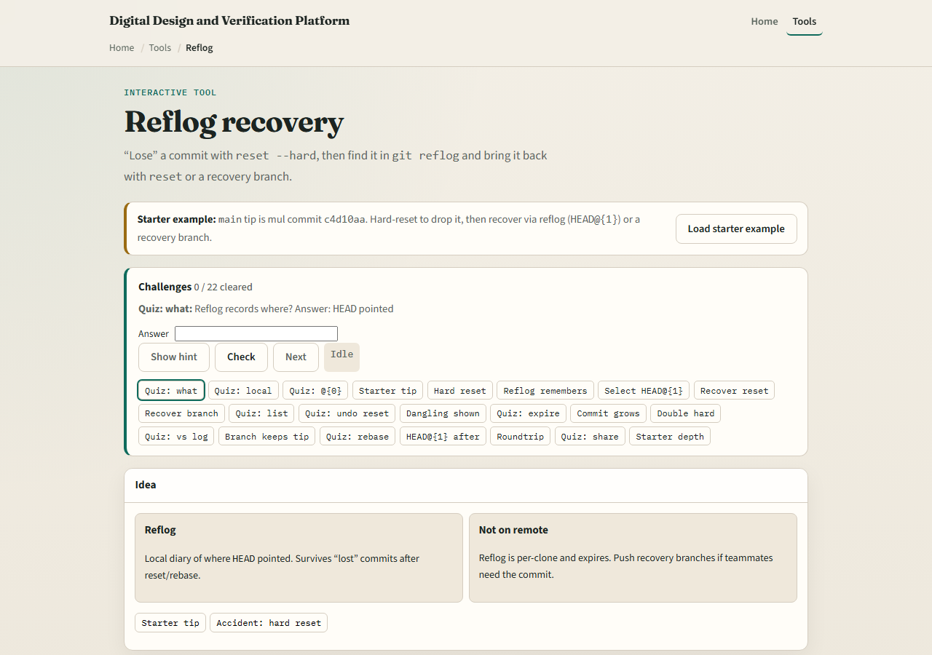
Browser lab
Reflog recovery lab starter
learn_git — git reflog
Notes:
In the browser lab, look at three pieces: the challenge card, the branch tip display, and the reflog list with reset and recovery actions. Load the starter example, hard-reset to drop a commit, then bring it back using reflog. Use Check when you think a challenge is done. You do not need a full tour here—the lab itself guides the rest. Explore a few challenges, then come back for the real Git track.

Slide 4
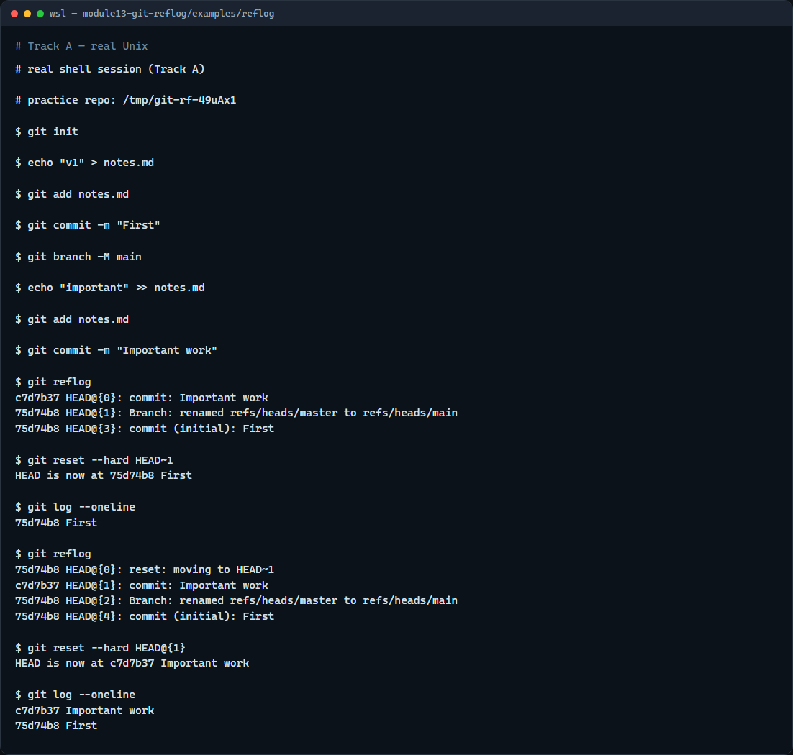
Real Git practice
Real shell — reset, reflog, recover
learn_git — git reflog
Notes:
In the real Git track, make two commits on main, then run reflog so you see the history of HEAD moves. Hard-reset back one commit—the important work disappears from log but stays in reflog. Run reflog again, then reset hard to HEAD at one to restore the tip. Log should show both commits again. That is the safety net when you move too aggressively locally.

Slide 5
Real Git practice — try these
# git init — create a new repository here
git init
# echo … > notes.md — first commit
echo "v1" > notes.md
git add notes.md
git commit -m "First"
git branch -M main
# echo … >> notes.md — commit you might “lose”
echo "important" >> notes.md
git add notes.md
git commit -m "Important work"
# git reflog — see where HEAD has been
git reflog
# ...
learn_git — git reflog

Slide 6
Pitfalls to watch
Reflog does not travel to the remote, recovery is for your local clone
Entries expire; do not treat reflog as permanent backup
Prefer reset hard to HEAD at one only when you are sure that entry is the state you want
And remember
learn_git — git reflog
Notes:
Reflog does not travel to the remote—recovery is for your local clone. Entries expire; do not treat reflog as permanent backup. Prefer reset hard to HEAD at one only when you are sure that entry is the state you want. And remember: the browser lab is for literacy—teammates still need a pushed branch if they need your recovered commit.

Slide 7
Your turn
Complete the checklist for at least one track, preferably both
In the browser, load the starter and recover a dropped commit from reflog
On real Git, reset back one commit, then restore with HEAD at one
When you are ready
learn_git — git reflog
Notes:
Complete the checklist for at least one track—preferably both. In the browser, load the starter and recover a dropped commit from reflog. On real Git, reset back one commit, then restore with HEAD at one. When you are ready, take the short quiz, then continue to the next module on blame and bisect.

