Slide 1
Remote-tracking branches
Your laptop keeps local branches like main
learn_git — remote tracking
Notes:
Your laptop keeps local branches like main. Git also keeps remote-tracking refs such as origin slash main—the last tip you saw on the server after fetch or push. Status compares your local branch to that tracking ref so you know if you are ahead, behind, or diverged. This module is about reading those refs and using fetch and pull without surprises.

Slide 2
Fetch, track, compare
Fetch downloads new commits and updates origin slash star refs only
Pull is fetch plus integrate into your current branch, usually a merge
Set upstream with push minus u or branch minus u so status and push know which remote
Prune stale origin refs after branches are deleted on the host
learn_git — remote tracking
Notes:
Fetch downloads new commits and updates origin slash star refs only—it does not move your local branch or working tree. Pull is fetch plus integrate into your current branch, usually a merge. Set upstream with push minus u or branch minus u so status and push know which remote branch you mean. List remote-tracking branches with branch minus r, see upstream links with branch minus v v, and prune stale origin refs after branches are deleted on the host.

Slide 3
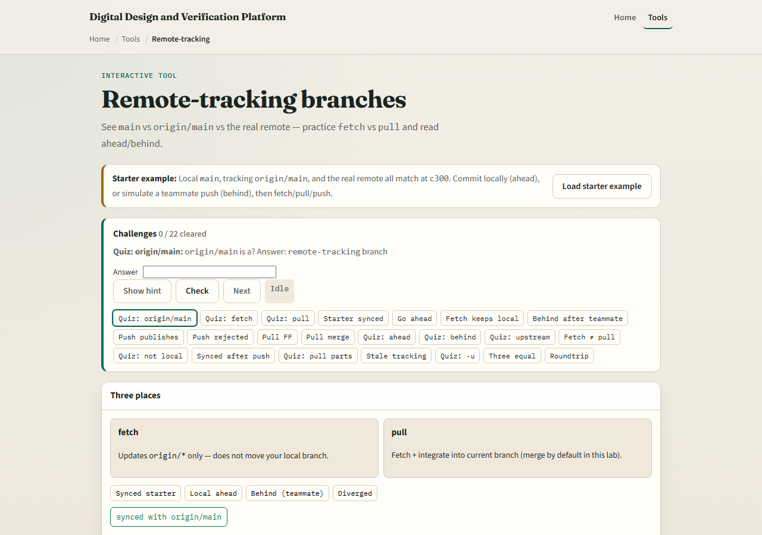
Browser lab
Remote-tracking lab starter
learn_git — remote tracking
Notes:
In the browser lab, load the starter example first so local main, origin slash main, and the server all start in sync. Look at three lanes—the local branch, the remote-tracking ref, and the real remote—and the challenge panel above. Try fetch when the server moves ahead, commit locally to go ahead, then pull or push to resync. Use Check on challenges when you think you have the right state. You do not need a full tour here—the lab itself guides the rest. Explore a few challenges, then come back for the real Git track.

Slide 4
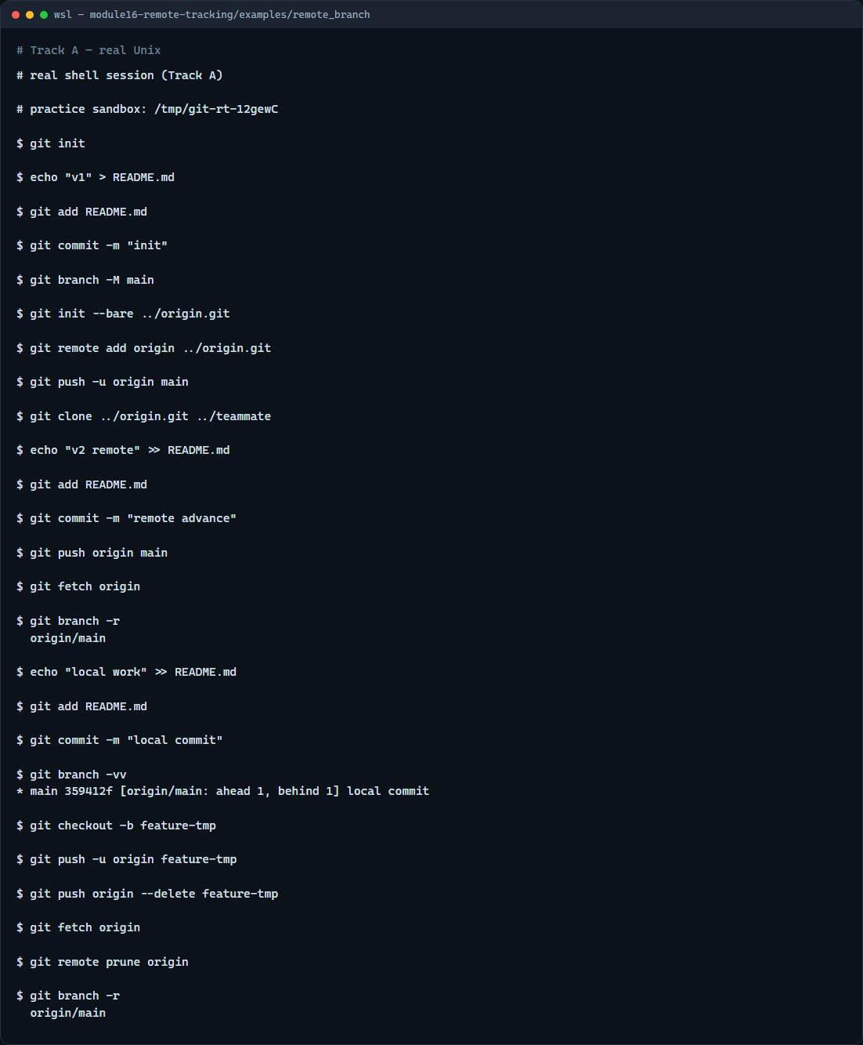
Real Git practice
Real shell — fetch, branch refs, prune
learn_git — remote tracking
Notes:
In the real Git track, use a bare repository as origin. Push main, then simulate a teammate push from a second clone so your practice repo is behind. Fetch to refresh origin slash main without merging. List remote branches, make a local commit, and show branch minus v v with upstream info. Push a short-lived branch, delete it on the remote, fetch, and prune so the stale remote-tracking ref disappears.

Slide 5
Real Git practice — try these
# git init — create a new repository here
git init
# echo … > README.md — first commit on main
echo "v1" > README.md
git add README.md
git commit -m "init"
# git branch -M main — name the default branch main
git branch -M main
# git init --bare ../origin.git — bare remote (simulates GitHub)
git init --bare ../origin.git
# git remote add origin … — link the hosted copy
git remote add origin ../origin.git
# git push -u origin main — publish and set upstream tracking
git push -u origin main
# ...
learn_git — remote tracking

Slide 6
Pitfalls to watch
Fetch is safe
Do not confuse origin slash main with your local main
Prune only removes stale remote-tracking refs, not your local branches
And remember
learn_git — remote tracking
Notes:
Fetch is safe—it does not change your files—but it can make status show you are behind until you pull or rebase. Do not confuse origin slash main with your local main; they diverge whenever only one side moves. Prune only removes stale remote-tracking refs, not your local branches. And remember: the browser lab is for literacy—real team repos still need disciplined fetch, pull, and push habits.

Slide 7
Your turn
Complete the checklist for at least one track, preferably both
In the browser, load the starter and clear a few ahead-or-behind challenges
On real Git, run fetch, read branch minus v v, and prune a deleted remote branch
When you are ready
learn_git — remote tracking
Notes:
Complete the checklist for at least one track—preferably both. In the browser, load the starter and clear a few ahead-or-behind challenges. On real Git, run fetch, read branch minus v v, and prune a deleted remote branch. When you are ready, take the short quiz, then continue to the next module on pull request review.

