Slide 1
Submission reproducibility
Before you push or zip a lab, ask: can a grader reproduce your result from a clean checkout?
learn_git — submission repro
Notes:
Before you push or zip a lab, ask: can a grader reproduce your result from a clean checkout? That means a working tree without stray junk, scripts run from the repo root, and evidence captured in a log file. Secrets stay out—ship env example, not your real env file. This module trains the pre-submission checklist so your GitHub repo matches what you actually tested.

Slide 2
Clean, root, log, push
Run status and confirm build artifacts and logs are gitignored, not accidentally staged
Remove local secrets and scratch files graders should never see
Run demo or test scripts from the repository root so relative paths match the README
Capture stdout and stderr with tee into run dot log so reviewers see what you saw
Then push and verify on the host that only the right files and commits appear
learn_git — submission repro
Notes:
Run status and confirm build artifacts and logs are gitignored, not accidentally staged. Remove local secrets and scratch files graders should never see. Run demo or test scripts from the repository root so relative paths match the README. Capture stdout and stderr with tee into run dot log so reviewers see what you saw. Then push and verify on the host that only the right files and commits appear.

Slide 3
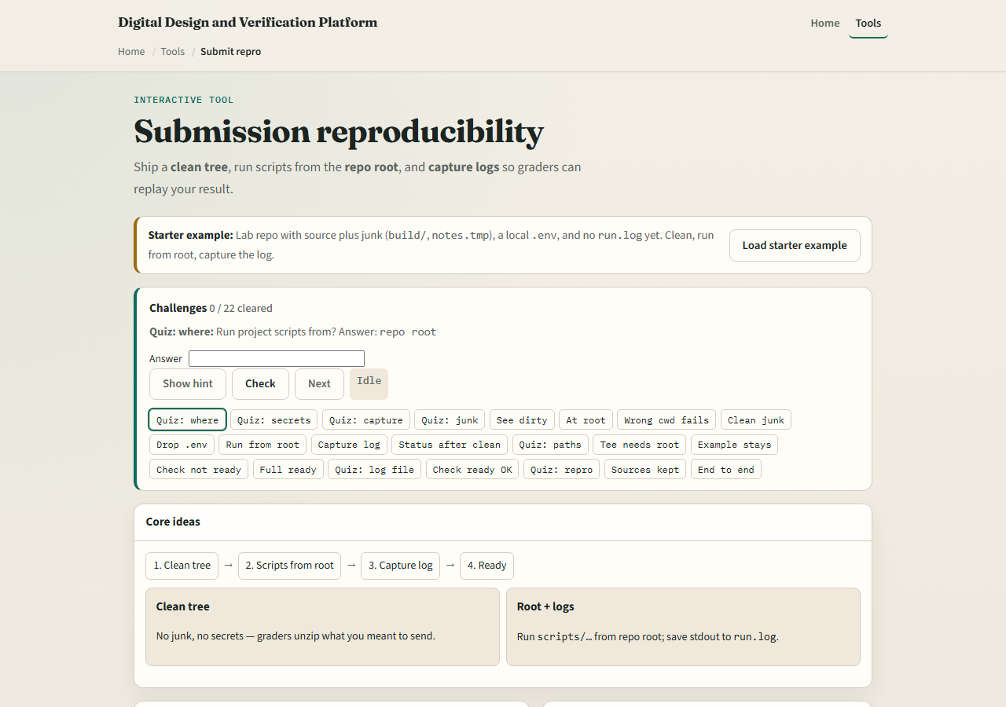
Browser lab
Submission reproducibility lab starter
learn_git — submission repro
Notes:
In the browser lab, load the starter example—a lab repo with source plus junk, a local env file, and no run log yet. Look at the submit checklist, the file tree, and the challenge panel above. Clean junk, run from root with tee, and pass the ready checks. Use Check when your tree matches the challenge. You do not need a full tour here—the lab itself guides the rest. Work a few challenges, then come back for the real Git track.

Slide 4
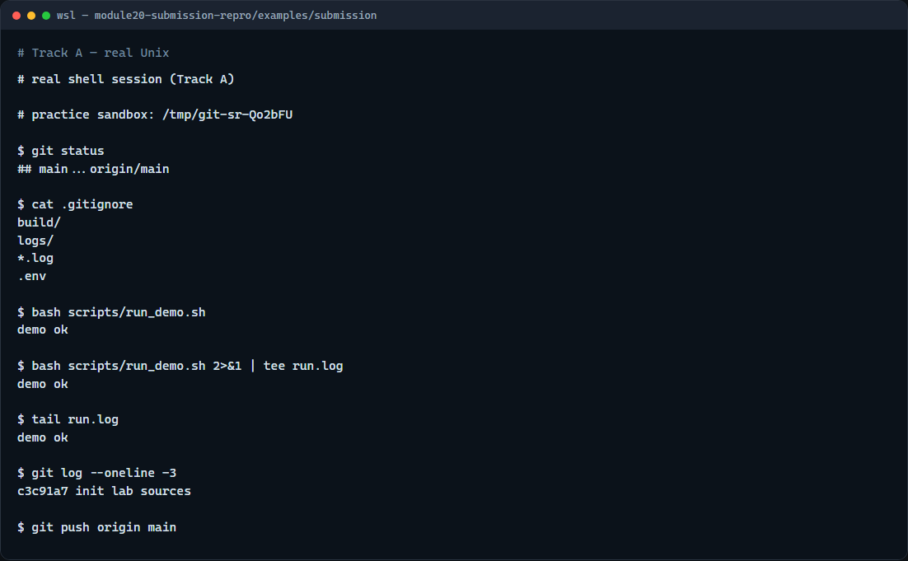
Real Git practice
Real shell — clean tree, run from root, capture log
learn_git — submission repro
Notes:
In the real Git track, start in a small chip-lab repo with gitignore rules for build and logs. Check status, read gitignore, run the demo script from the repo root and tee output to run dot log. Show a short log tail and status again so you know what you would push.

Slide 5
Real Git practice — try these
# git status — see tracked vs ignored files before submit
git status
# cat .gitignore — confirm build/, logs/, and .env are excluded
cat .gitignore
# bash scripts/run_demo.sh — run the demo from repo root
bash scripts/run_demo.sh
# bash scripts/run_demo.sh 2>&1 | tee run.log — capture stdout and
stderr
bash scripts/run_demo.sh 2>&1 | tee run.log
# tail run.log — verify the log captured success output
tail run.log
# git log --oneline -3 — confirm recent commits look right
git log --oneline -3
# git push origin main — publish when checks pass (needs remote)
git push origin main
learn_git — submission repro

Slide 6
Pitfalls to watch
Running scripts from a subdirectory breaks relative paths, check pwd first
Never commit env files with real tokens; copy from env example instead
A dirty tree with surprise untracked files means you might zip or push the wrong snapshot
Capture the log only after a successful root run
And remember
learn_git — submission repro
Notes:
Running scripts from a subdirectory breaks relative paths—check pwd first. Never commit env files with real tokens; copy from env example instead. A dirty tree with surprise untracked files means you might zip or push the wrong snapshot. Capture the log only after a successful root run, not from a failed attempt in the wrong folder. And remember: the browser lab is for literacy—real submissions still need your sandbox push and GitHub verification.

Slide 7
Your turn
Complete the checklist for at least one track, preferably both
In the browser, load the starter and get to ready with a clean tree and run dot log
On real Git, practice status, root run, and log capture before push
Pull request
learn_git — submission repro
Notes:
Complete the checklist for at least one track—preferably both. In the browser, load the starter and get to ready with a clean tree and run dot log. On real Git, practice status, root run, and log capture before push. When you are ready, take the short quiz, then continue to the live sandbox module on clone, make, and pull request.

