Slide 1
Live sandbox capstone
Browser labs taught the ideas, now you rehearse on a real GitHub template
learn_git — sandbox
Notes:
Browser labs taught the ideas—now you rehearse on a real GitHub template. The unix-git-practice sandbox is a small chip-lab layout with Make stubs, scripts, and a shared-ip submodule. You create your own writable copy, clone with submodules, run tests, and optionally open a practice pull request on your fork. This module is Track A only: no browser lab, just the live toolchain.

Slide 2
Sandbox, not the curriculum repo
The learn Git course tree is for reading modules and local examples
The org template is your practice surface
That gives you src, tb, scripts
Read the sandbox note once so you know which URL is which
learn_git — sandbox
Notes:
The learn Git course tree is for reading modules and local examples—do not push student work there. The org template is your practice surface: Use this template on GitHub, then clone your copy with recurse submodules. That gives you src, tb, scripts, and external shared-ip without polluting shared course history. Read the sandbox note once so you know which URL is which.

Slide 3
Capstone workflow
Here is the end-to-end rhythm
On GitHub, generate your repo from the unix-git-practice template
Clone with recurse submodules so shared-ip is populated
Change into the project and run make test to exercise the stub build and demo script
Run the check-ready script before you push
Create a lab branch, commit a small change, push to your fork
learn_git — sandbox
Notes:
Here is the end-to-end rhythm. On GitHub, generate your repo from the unix-git-practice template. Clone with recurse submodules so shared-ip is populated. Change into the project and run make test to exercise the stub build and demo script. Run the check-ready script before you push. Create a lab branch, commit a small change, push to your fork, and open a practice pull request into main. Explore-only is fine too—clone the org template read-only if you are not ready to push.

Slide 4
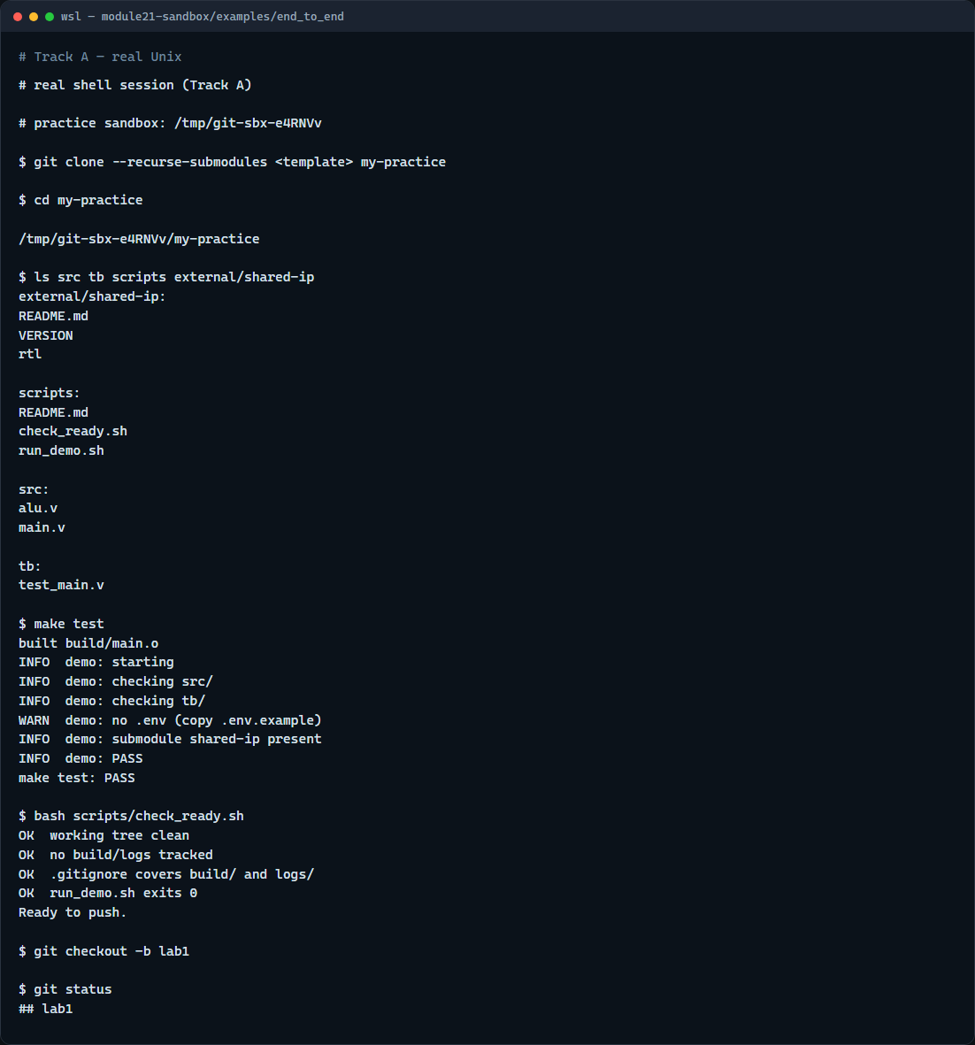
Real Git practice
Real shell — clone template, make test, lab branch
learn_git — sandbox
Notes:
In the real Git track, clone the practice template into a fresh folder—here we use the bundled sandbox stand-in for the GitHub URL. List src, tb, and scripts, run make test, pass check-ready, then create a lab branch and show status.

Slide 5
Real Git practice — try these
# git clone --recurse-submodules <your-template-url> my-practice
git clone --recurse-submodules <your-template-url> my-practice
# cd my-practice — enter the cloned sandbox
cd my-practice
# ls src tb scripts external/shared-ip — map the layout
ls src tb scripts external/shared-ip
# make test — run stub build and demo checks
make test
# bash scripts/check_ready.sh — pre-push readiness script
bash scripts/check_ready.sh
# git checkout -b lab1 — branch for lab work
git checkout -b lab1
# git status — confirm branch and working tree
git status
learn_git — sandbox

Slide 6
Pitfalls to watch
Do not push assignments into the curriculum learn Git repository, use your template fork
Always clone with recurse submodules or run submodule init afterward
Run make and check-ready from the repo root, not a subdirectory
And remember
learn_git — sandbox
Notes:
Do not push assignments into the curriculum learn Git repository—use your template fork. Always clone with recurse submodules or run submodule init afterward, or shared-ip stays empty. Run make and check-ready from the repo root, not a subdirectory. And remember: this is rehearsal—follow course policy on whether a practice PR is required or explore-only is enough.

Slide 7
Your turn
Complete the sandbox checklist on your fork or an explore-only clone
Clone with submodules, run make test
When you are ready
learn_git — sandbox
Notes:
Complete the sandbox checklist on your fork or an explore-only clone. Clone with submodules, run make test, and describe clone to make to pull request in your own words. When you are ready, take the short quiz, then continue to the wrap module on completing the Git path.

