Slide 1
Git path complete
You have walked the Git path for coursework, from the mental model of working tree, index
learn_git — wrap
Notes:
You have walked the Git path for coursework—from the mental model of working tree, index, and commits, through branches, merges, and recovery, to remotes, pull requests, submodules, and a live sandbox rehearsal. This short wrap names what you can do now and points you to the next courses on the ladder.

Slide 2
What you can do now
You can explain how files move from working tree to index to commit graph
You can stage, commit, read history, and undo safely
You can branch, merge or rebase, and recover with reflog when something goes wrong
Rehearse a reproducible submission
That is the Git literacy every later design course expects
learn_git — wrap
Notes:
You can explain how files move from working tree to index to commit graph. You can stage, commit, read history, and undo safely. You can branch, merge or rebase, and recover with reflog when something goes wrong. You can use remotes and pull-request basics, handle submodule pitfalls when shared IP appears, bootstrap from a template, and rehearse a reproducible submission. That is the Git literacy every later design course expects.

Slide 3
Close the track gaps
The sandbox so push and pull feel natural, not only the concept quizzes
Remote-tracking
Either track works for self-study; both together stick best before you move on
learn_git — wrap
Notes:
If you mainly used browser labs, spend a short real-Git session on commits, conflicts, remotes, and the sandbox so push and pull feel natural—not only the concept quizzes. If you mainly used a real terminal, skim any skipped browser labs for the visual challenges on the graph, conflicts, and remote-tracking. Either track works for self-study; both together stick best before you move on.

Slide 4
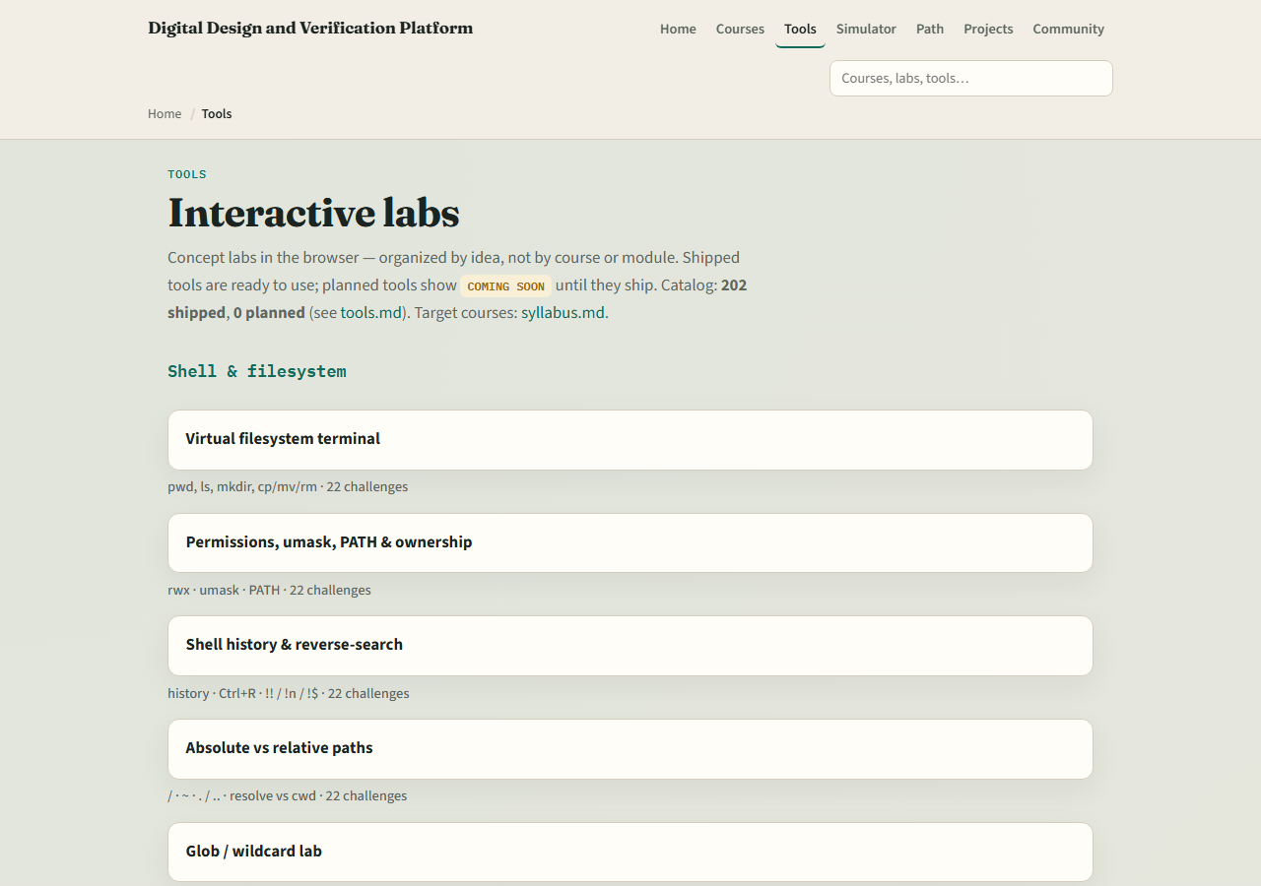
The tools you practiced
Here is the tools index again, the same shelf of concept labs you opened along the way
You do not need to re-clear every challenge
Use it as a map
learn_git — wrap
Notes:
Here is the tools index again—the same shelf of concept labs you opened along the way. You do not need to re-clear every challenge. Use it as a map: if a skill still feels shaky, jump back to that lab, then return here when you are ready for digital design or Verilog.

Slide 5
Next
Complete the quiz for this part
Digital design and Verilog courses assume you can commit cleanly, read a log
learn_git — wrap
Notes:
Digital design and Verilog courses assume you can commit cleanly, read a log, and work from a template repo without panic. Unix fluency from learn Unix still helps for Make, scripts, and log triage. When your wrap checklist feels honest, continue to learn digital or learn Verilog on the syllabus ladder—or keep practicing weak modules and the unix-git-practice sandbox until remotes feel routine.

Slide 6
Your turn
Review the wrap checklist in the module README
Confirm you can run status and log without guessing
When you are ready, take the short quiz, then open the next course that matches your path
learn_git — wrap
Notes:
Review the wrap checklist in the module README. Confirm you can run status and log without guessing, and that you have touched the live sandbox at least once. When you are ready, take the short quiz, then open the next course that matches your path.

