Slide 1
Welcome to the browser simulator
Welcome to learn HDL simulator
learn_hdl_simulator — intro
Notes:
Welcome to learn HDL simulator. This short path teaches the workflow of a browser-based HDL IDE—files, hierarchy, signals, waves, and the console—so you stop getting lost every time you open a session. Browser literacy labs teach the moves; the public HDL Simulator is where you practice for real.

Slide 2
What you’ll build toward
Across the course you’ll tour the five IDE panes, load a tiny DUT and use Run, Stop
Glance at style and synth hints
Sibling courses cover Verilog language depth, Icarus
learn_hdl_simulator — intro
Notes:
Across the course you’ll tour the five IDE panes, load a tiny DUT and use Run, Stop, and Reset, then Step and Continue with a breakpoint mindset. You’ll poke and force safely, read full-sim waves with cursors, link multi-file projects, compare against a golden at a cursor, and glance at style and synth hints. Sibling courses cover Verilog language depth, Icarus, and Verilator—here the job is simulator literacy.

Slide 3
Two tracks, one idea
Track A is the public HDL Simulator in a modern browser, Files, Hierarchy, Signals, Wave
Track B is the platform’s hdl-sim concept labs
You may do either track, or both
A good rhythm is browser lab first for the idea
learn_hdl_simulator — intro
Notes:
Track A is the public HDL Simulator in a modern browser—Files, Hierarchy, Signals, Wave, and Console in a live session. Track B is the platform’s hdl-sim concept labs: guided challenges for tour, hello DUT, step, poke, waves, multi-file, and golden compare. You may do either track, or both. A good rhythm is browser lab first for the idea, then five minutes in the public IDE to harden it.

Slide 4
Set up Track A
Open the public HDL Simulator in a modern browser
Optional: keep a tiny counter or testbench sketch ready from learn Verilog
From this course folder, open module READMEs and EXAMPLES prompts as you go
learn_hdl_simulator — intro
Notes:
Open the public HDL Simulator in a modern browser. Optional: keep a tiny counter or testbench sketch ready from learn Verilog. From this course folder, open module READMEs and EXAMPLES prompts as you go; the course self-check script can grade checklist items when you want them.

Slide 5
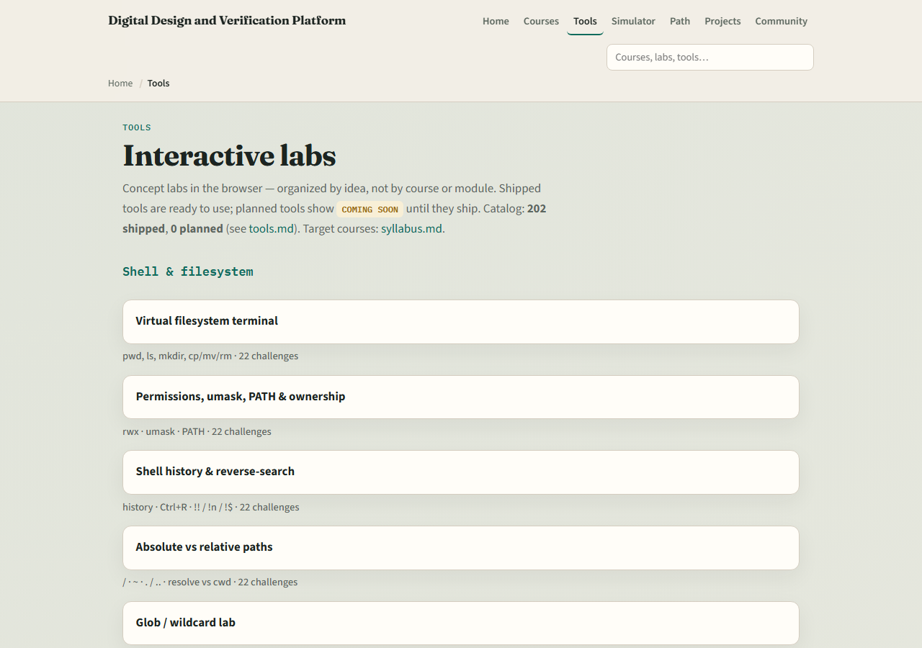
Set up Track B
From the monorepo
All seven hdl-sim literacy labs ship, plus the style and synth bridge labs
If you prefer, use the published tools site instead
Confirm you can reach the index, the next module sends you into the UI tour lab
learn_hdl_simulator — intro
Notes:
From the monorepo, serve the platform folder with a simple local web server, then open the tools index and jump to the HDL simulator section. All seven hdl-sim literacy labs ship, plus the style and synth bridge labs. If you prefer, use the published tools site instead. Either way, confirm you can reach the index—the next module sends you into the UI tour lab.

Slide 6
How to move through modules
For each module
Prefer Track B when you want graded challenges
When you finish this intro checklist, continue to the UI tour
learn_hdl_simulator — intro
Notes:
For each module, read the README for the outcome, pick a track—or both—then work the checklist. Prefer Track B when you want graded challenges; prefer Track A when you want muscle memory in the real IDE. When you finish this intro checklist, continue to the UI tour.

