Slide 1
Hello DUT
Orientation is not enough, you need a tiny design under control
learn_hdl_simulator — hdl sim hello dut
Notes:
Orientation is not enough—you need a tiny design under control. Hello DUT means load a small module, start time with Run, freeze with Stop, and return to a known state with Reset. Those three controls are the heartbeat of every later debug session.

Slide 2
Run, Stop, Reset
Run starts or resumes simulation time so the DUT updates each step
Stop freezes time so you can inspect state without advancing the model
Reset returns the DUT to its initial state and leaves the sim stopped
Load picks which tiny sketch sits in the sandbox
learn_hdl_simulator — hdl sim hello dut
Notes:
Run starts or resumes simulation time so the DUT updates each step. Stop freezes time so you can inspect state without advancing the model. Reset returns the DUT to its initial state and leaves the sim stopped. Load picks which tiny sketch sits in the sandbox—counter, toggle flip-flop, or a simple combo AND for literacy.

Slide 3
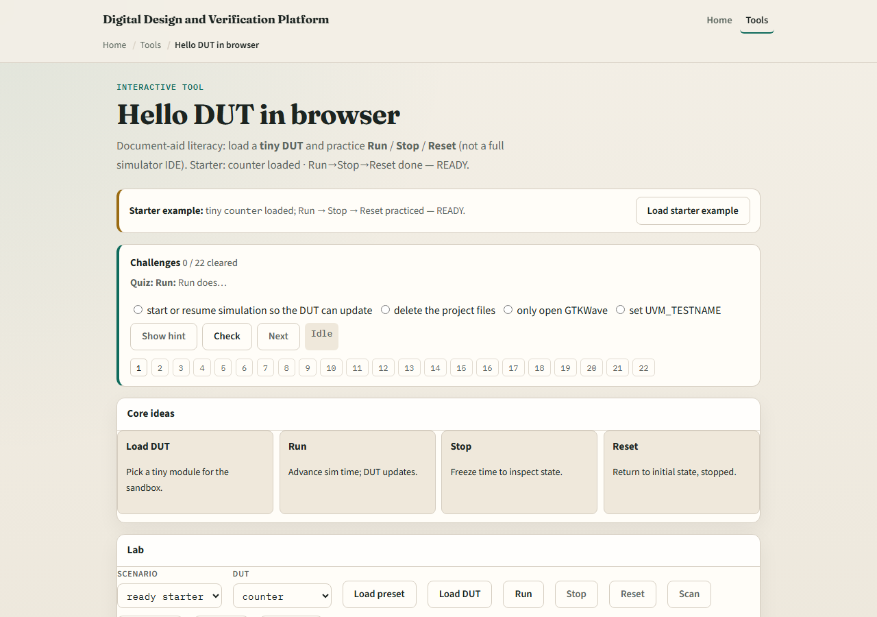
Browser lab
Lab starter
learn_hdl_simulator — hdl sim hello dut
Notes:
In the browser lab, load the starter counter and practice the full Run, Stop, Reset triad until status reads ready. Switch DUT sketches and watch how q behaves while running—count up, toggle, or hold a combo result. Challenges ask you to load a DUT and complete the control triad without leaving a run hanging forever.

Slide 4
Public simulator practice
In the public IDE, open or paste a tiny counter with a short testbench
Compile or elaborate, then hit Run, Stop, and Reset once each
Confirm Console stays clean and that Reset actually clears the output you care about
Keep the design tiny, this module is control literacy, not a full test plan
learn_hdl_simulator — hdl sim hello dut
Notes:
In the public IDE, open or paste a tiny counter with a short testbench. Compile or elaborate, then hit Run, Stop, and Reset once each. Confirm Console stays clean and that Reset actually clears the output you care about. Keep the design tiny—this module is control literacy, not a full test plan.

Slide 5
Pitfalls to watch
Do not confuse Reset of the DUT with closing the browser tab
Do not leave Run forever when you meant to inspect a frozen state, Stop first
And remember
learn_hdl_simulator — hdl sim hello dut
Notes:
Do not confuse Reset of the DUT with closing the browser tab. Do not leave Run forever when you meant to inspect a frozen state—Stop first. And remember: concept clocks in the literacy lab are not the same as a real testbench clock generator; the public IDE still needs a proper TB for meaningful time.

Slide 6
Your turn
Complete the checklist for at least one track, preferably both
In the browser, finish Run, Stop, and Reset on a loaded DUT
In the public IDE, do the same triad on one tiny design
When you are ready, take the short quiz, then continue to Step and Continue
learn_hdl_simulator — hdl sim hello dut
Notes:
Complete the checklist for at least one track—preferably both. In the browser, finish Run, Stop, and Reset on a loaded DUT. In the public IDE, do the same triad on one tiny design. When you are ready, take the short quiz, then continue to Step and Continue.

