Slide 1
Full-sim waves
Waves turn time into a picture
learn_hdl_simulator — hdl sim waves
Notes:
Waves turn time into a picture. You add signals from a scope, run or step, then read values with cursors. Cursor one and cursor two let you measure intervals; radix changes how numbers appear—binary, hex, or unsigned. Full-sim waves means you are reading a real timeline, not a static sketch.

Slide 2
Add, cursor, radix
Pick a scope in Hierarchy, select signals, and add them to the wave pane
Place cursor one at an interesting edge
Switch radix when hex is clearer than a long binary string
Zoom so the region you care about fills the view without losing context
learn_hdl_simulator — hdl sim waves
Notes:
Pick a scope in Hierarchy, select signals, and add them to the wave pane. Place cursor one at an interesting edge; place cursor two to measure a delay or pulse width. Switch radix when hex is clearer than a long binary string. Zoom so the region you care about fills the view without losing context.

Slide 3
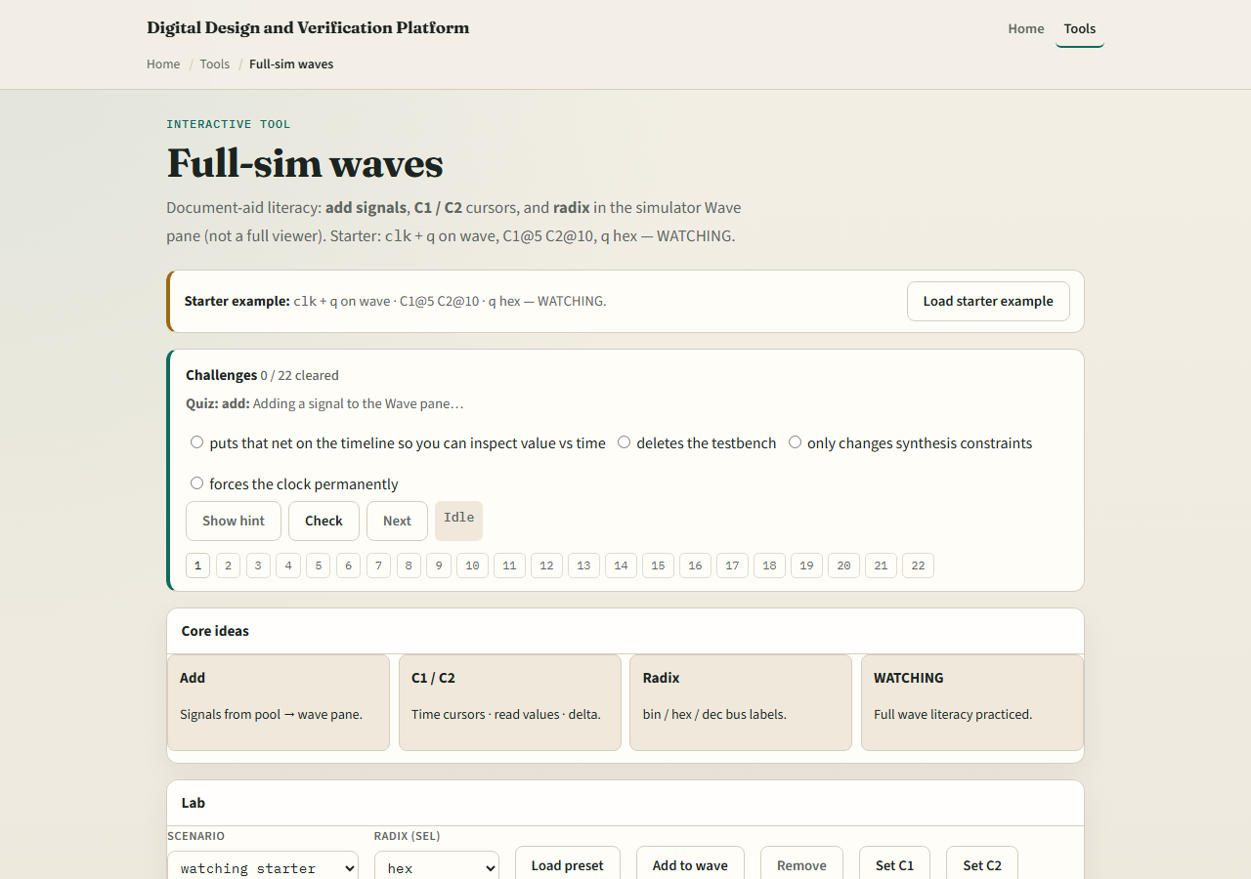
Browser lab
Lab starter
learn_hdl_simulator — hdl sim waves
Notes:
In the browser waves lab, load the starter with signals already on the wave and cursors placed. Practice adding a signal, moving cursors, and changing radix until the challenges pass. Treat the verdict as a coach: it tells you whether the wave set and cursors match the ask.

Slide 4
Public simulator practice
In the public IDE, add clock, reset, and a data output to the wave
Run a short window, set two cursors around one interesting transition
If a signal is missing, go back to Hierarchy and Signals, waves only show what you added
learn_hdl_simulator — hdl sim waves
Notes:
In the public IDE, add clock, reset, and a data output to the wave. Run a short window, set two cursors around one interesting transition, and read the value at cursor one in hex. If a signal is missing, go back to Hierarchy and Signals—waves only show what you added.

Slide 5
Pitfalls to watch
Do not debug from Console alone when the bug is timing, open the wave
Do not forget which cursor is active when you read a value
Do not overload the pane with every net in the design
And remember concept labs animate literacy, the public IDE is where real TB time lives
learn_hdl_simulator — hdl sim waves
Notes:
Do not debug from Console alone when the bug is timing—open the wave. Do not forget which cursor is active when you read a value. Do not overload the pane with every net in the design; start with clock, reset, and the outputs you own. And remember concept labs animate literacy—the public IDE is where real TB time lives.

Slide 6
Your turn
Complete the checklist for at least one track, preferably both
Add signals, place two cursors, and read one value with a sensible radix
When you are ready, take the short quiz, then continue to multi-file projects
learn_hdl_simulator — hdl sim waves
Notes:
Complete the checklist for at least one track—preferably both. Add signals, place two cursors, and read one value with a sensible radix. When you are ready, take the short quiz, then continue to multi-file projects.

