Slide 1
Multi-file project
Real designs are rarely one file
learn_hdl_simulator — hdl sim multi file
Notes:
Real designs are rarely one file. Multi-file literacy means knowing which sources are in the project, which file is the top or testbench, and how include or compile order affects elaboration. Get the file set wrong and you will debug the wrong module for an hour.

Slide 2
Top, TB, and linkage
Name the DUT file and the testbench file explicitly
Know which module is top for the run
If the IDE links multiple files into one session
learn_hdl_simulator — hdl sim multi file
Notes:
Name the DUT file and the testbench file explicitly. Know which module is top for the run. If the IDE links multiple files into one session, confirm every needed source is present—missing a package or a sub-module shows up as hierarchy holes or compile errors in the Console.

Slide 3
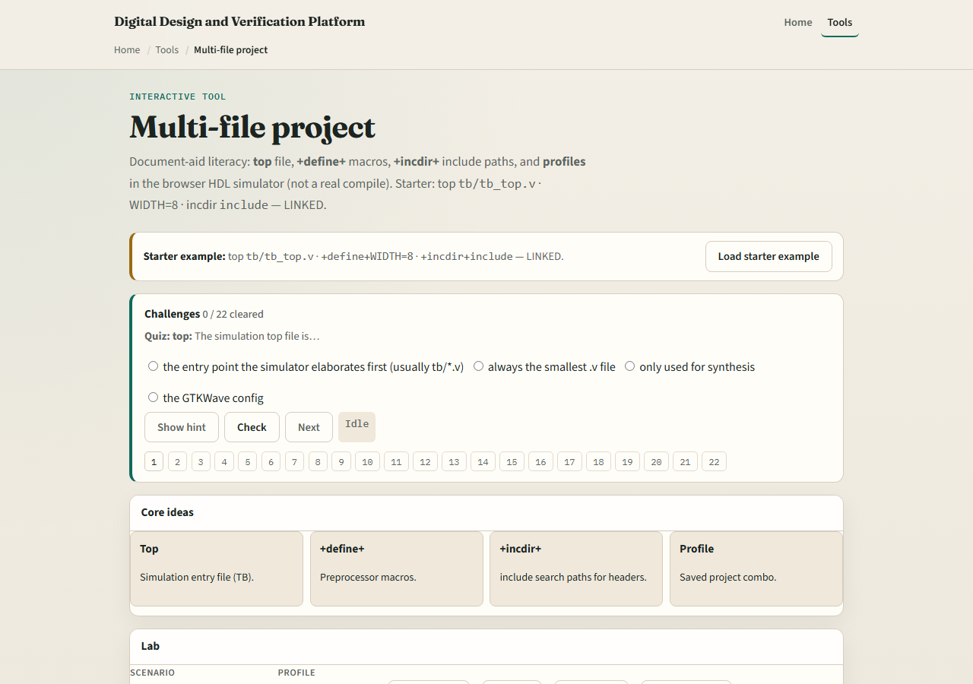
Browser lab
Lab starter
learn_hdl_simulator — hdl sim multi file
Notes:
In the browser multi-file lab, load the starter project and inspect how files are listed and which one is marked top. Try presets that drop a file or mis-mark top, and watch status leave ready. Challenges ask you to restore a coherent multi-file set before you “run.”

Slide 4
Public simulator practice
In the public IDE, open a tiny two-file sketch: DUT plus testbench
Confirm both appear under Files, set top correctly, and elaborate or run once
Intentionally remove the testbench from the set
learn_hdl_simulator — hdl sim multi file
Notes:
In the public IDE, open a tiny two-file sketch: DUT plus testbench. Confirm both appear under Files, set top correctly, and elaborate or run once. Intentionally remove the testbench from the set, note the Console error, then restore it—that muscle memory prevents silent wrong builds.

Slide 5
Pitfalls to watch
Do not assume the open editor tab is the top module
Do not forget packages or included files that the DUT needs
Do not mix two unrelated testbenches in one run and expect clean waves
Always reconcile Files with Hierarchy after a change
learn_hdl_simulator — hdl sim multi file
Notes:
Do not assume the open editor tab is the top module. Do not forget packages or included files that the DUT needs. Do not mix two unrelated testbenches in one run and expect clean waves. Always reconcile Files with Hierarchy after a change.

Slide 6
Your turn
Complete the checklist for at least one track, preferably both
Build or restore a coherent DUT-plus-testbench file set and name the top
When you are ready, take the short quiz, then continue to golden compare
learn_hdl_simulator — hdl sim multi file
Notes:
Complete the checklist for at least one track—preferably both. Build or restore a coherent DUT-plus-testbench file set and name the top. When you are ready, take the short quiz, then continue to golden compare.

