Slide 1
Simulator path complete
You now have a working map of the browser HDL Simulator path
learn_hdl_simulator — wrap
Notes:
You now have a working map of the browser HDL Simulator path. You can name the IDE panes, control a tiny DUT with Run, Stop, and Reset, step and continue with a halt mindset, poke and force safely, read waves with cursors, link multi-file projects, and golden-compare at a cursor—then practice freely in the public IDE.

Slide 2
Skills you can reuse
Files, Hierarchy, Signals, Wave, and Console are reusable in almost any HDL IDE
Soft poke versus sticky force, and releasing when done, transfers to professional tools
Golden compare at a known time is the seed of stronger checking
Style and synth awareness keeps sim-only habits from becoming silicon surprises
learn_hdl_simulator — wrap
Notes:
Files, Hierarchy, Signals, Wave, and Console are reusable in almost any HDL IDE. Soft poke versus sticky force, and releasing when done, transfers to professional tools. Golden compare at a known time is the seed of stronger checking. Style and synth awareness keeps sim-only habits from becoming silicon surprises.

Slide 3
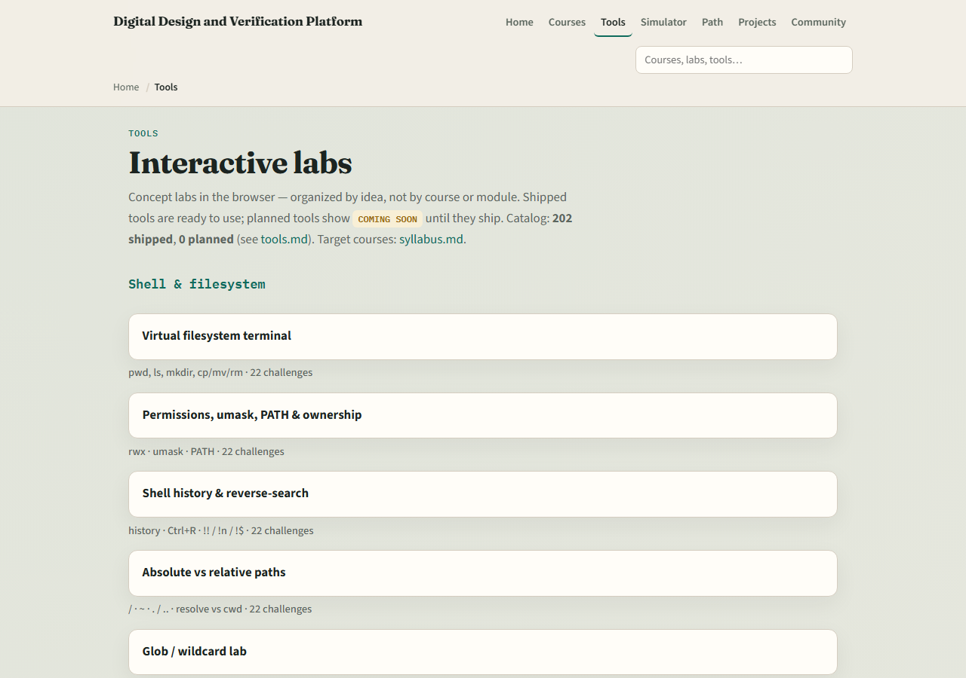
Dual-track recap
If you mainly used browser labs
If you mainly used the public simulator, revisit any hdl-sim lab for graded challenges
Either way, confirm you can open the public simulator without getting lost
learn_hdl_simulator — wrap
Notes:
If you mainly used browser labs, open the public IDE and recreate one tour plus waves session. If you mainly used the public simulator, revisit any hdl-sim lab for graded challenges. Either way, confirm you can open the public simulator without getting lost.

Slide 4
Where to go next
For offline compile and sim fidelity, continue to learn Icarus Verilog or learn Verilator
For protocol bring-up, UART, SPI, and I²C courses reuse the same wave and TB habits
For deeper SystemVerilog and UVM, climb the syllabus ladder when you are ready
learn_hdl_simulator — wrap
Notes:
For offline compile and sim fidelity, continue to learn Icarus Verilog or learn Verilator. For protocol bring-up, UART, SPI, and I²C courses reuse the same wave and TB habits. For deeper SystemVerilog and UVM, climb the syllabus ladder when you are ready.

Slide 5
Mindset to keep
Prefer tiny DUTs when learning tools
Read the Console before blaming the RTL
Never leave forces on
Know which file is top
And remember
learn_hdl_simulator — wrap
Notes:
Prefer tiny DUTs when learning tools. Read the Console before blaming the RTL. Never leave forces on. Know which file is top. And remember: literacy labs teach the moves; real confidence comes from time in the IDE and, later, in offline simulators.

Slide 6
Closing
Check off the wrap checklist
You finished the learn HDL simulator path
Open the public IDE once more if you want a victory lap
learn_hdl_simulator — wrap
Notes:
Check off the wrap checklist. You finished the learn HDL simulator path. Open the public IDE once more if you want a victory lap, then pick the next course that matches your goal—language depth, offline sim, or protocols.

