Slide 1
File / vector I/O
Regression stimulus often lives outside the testbench source
learn_sv_tb — file vector io
Notes:
Regression stimulus often lives outside the testbench source — hex files of input vectors and expected outputs that you load once and replay in a loop. SystemVerilog gives you dollar-readmemh and dollar-readmemb to fill memory arrays from disk at simulation start. The testbench then applies each stimulus word, samples the DUT, and compares against the expected array. This module is literacy for that file-driven pattern, not a full regression farm yet.

Slide 2
Stimulus, expect, and apply loop
The usual shape is three arrays: stimulus, expected, and optionally actual results
Dollar-readmemh loads hexadecimal words line by line
A for loop walks from zero to N minus one
The same loop handles four vectors or four thousand
learn_sv_tb — file vector io
Notes:
The usual shape is three arrays: stimulus, expected, and optionally actual results. Dollar-readmemh loads hexadecimal words line by line; at-address prefixes skip to a specific index. A for loop walks from zero to N minus one: drive inputs from stimulus of i, advance time, compare DUT output to expected of i, and flag mismatches. Separating vectors from procedural code lets you swap test sets without recompiling the testbench — the same loop handles four vectors or four thousand.

Slide 3
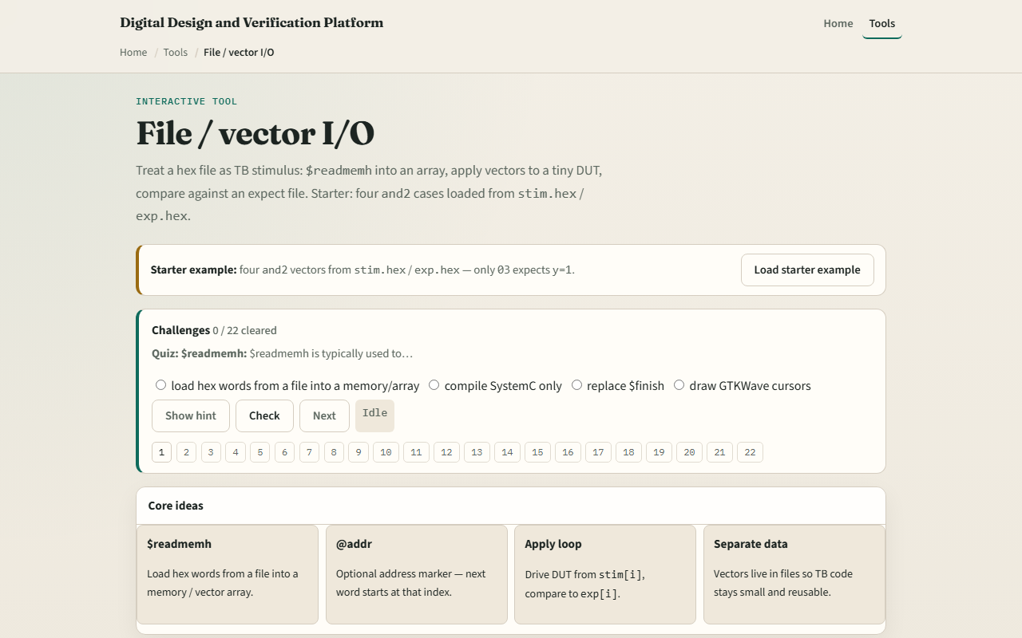
Browser lab
Browser lab starter
learn_sv_tb — file vector io
Notes:
In the browser lab track, open the file-and-vector I/O lab from the tools page. Load the starter and-two example with four stimulus and expect pairs. Step through the apply loop and watch pass or fail per vector. Try the at-address preset to see how line skipping works. Switch to a different gate model and confirm the same loop structure still applies. Work the challenges on hex packing and expected values, then use Check.

Slide 4
Real SystemVerilog practice
In the real SystemVerilog track, open this module's examples prompts
Restate the apply-loop idea in one sentence , load hex files, drive, compare
Sketch the pattern below on paper and label what each array holds
Optional stretch
```systemverilog // Load vectors from hex files at time zero reg [7:0] stim [0:DEPTH-1]
learn_sv_tb — file vector io
Notes:
In the real SystemVerilog track, open this module's examples prompts. Restate the apply-loop idea in one sentence — load hex files, drive, compare. Sketch the pattern below on paper and label what each array holds. Optional stretch: write two hex lines for an and-two with inputs one-one and expected output one.
```systemverilog
// Load vectors from hex files at time zero
reg [7:0] stim [0:DEPTH-1];
reg [7:0] exp [0:DEPTH-1];
initial begin
$readmemh("stim.hex", stim);
$readmemh("exp.hex", exp);
for (int i = 0; i < N; i++) begin
apply(stim[i]); // drive DUT inputs from word i
#1;
if (dut_out !== exp[i]) $error("FAIL @%0d", i);
end
end
// stim.hex bit0=a bit1=b; exp.hex holds expected y
```

Slide 5
Pitfalls to watch
Do not mix up dollar-readmemh and dollar-readmemb
Do not forget at-address when your files have gaps or comments
Do not compare before inputs have settled
And remember
learn_sv_tb — file vector io
Notes:
Do not mix up dollar-readmemh and dollar-readmemb — one expects hex digits, the other binary. Do not forget at-address when your files have gaps or comments — the parser skips lines but address directives matter. Do not compare before inputs have settled — insert a delay or clock edge between apply and check. And remember: the browser lab uses a simplified parser; real simulators still need correct file paths relative to the simulation working directory.

Slide 6
Your turn
Complete the checklist for at least one track , preferably both
In the browser, load the starter and-two set, run Apply all
On paper, write two hex lines for stim and two for exp that test an or-two
When you are ready
learn_sv_tb — file vector io
Notes:
Complete the checklist for at least one track — preferably both. In the browser, load the starter and-two set, run Apply all, and explain one failing vector if you inject a wrong expect. On paper, write two hex lines for stim and two for exp that test an or-two. When you are ready, take the short quiz, then continue to virtual interface wiring in the next module.

